Slide 1

Chronic kidney disease
(CKD)
Teresa Bączkowska
Dept. of Transplantology, Immunology, Nephrology
and Internal Diseases at the Medical University of Warsaw

Slide 2
CKD 9,1 % (8,5 – 9,8%) of population (850 mln in the word, 6-16% , 4,3 mln in Poland)
Annual incidence of new ESRD patients continues to increase at rate of
9% per year, with a predominance in patients older than 60 - 75 years of age
Dialysis treatment, kidney transplantation in patients with ESRD is considered as
an extension of the natural history of chronic renal failure
Aggressive treatment of risk factors for cardiovascular disease –
especially diabetes, hypertension – is essential (cardiovascular morbidity accounts
for 50% of deaths in patients with ESRD)
Dialysis treatment is an equivalent to GFR of only about 10 ml/min/1.73m2
Some problems of patients with chronic renal failure are not completely
resolved by chronic dialysis
A substantial proportion of patients with chronic renal failure might be
converted to chronic renal insufficiency, or at least progression toward ESRD
might be slowed

Slide 3
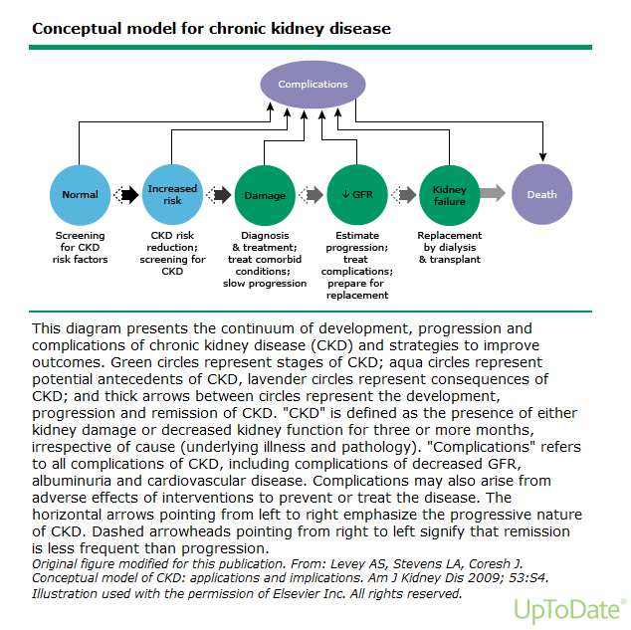

Slide 4
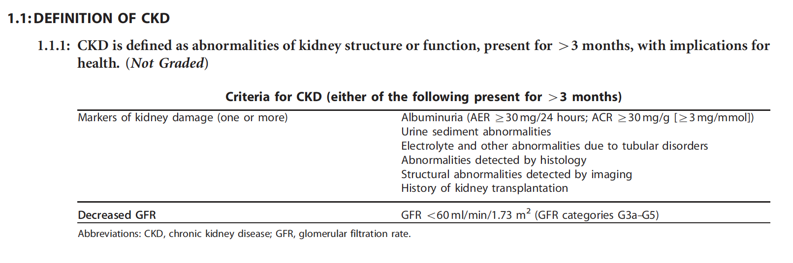

Slide 5
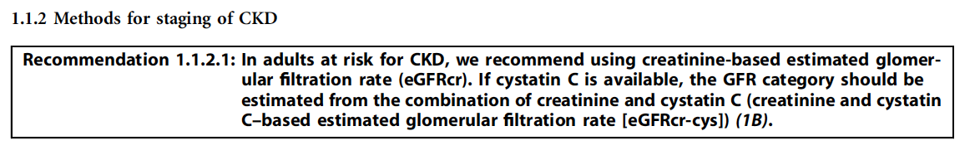

Slide 6
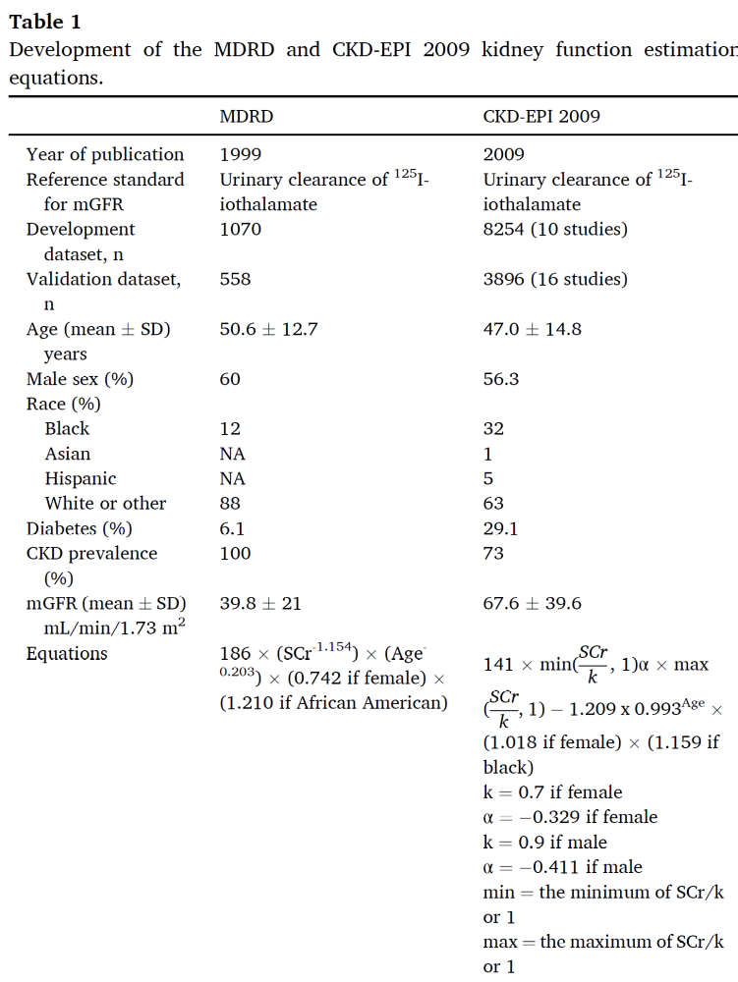

Slide 7
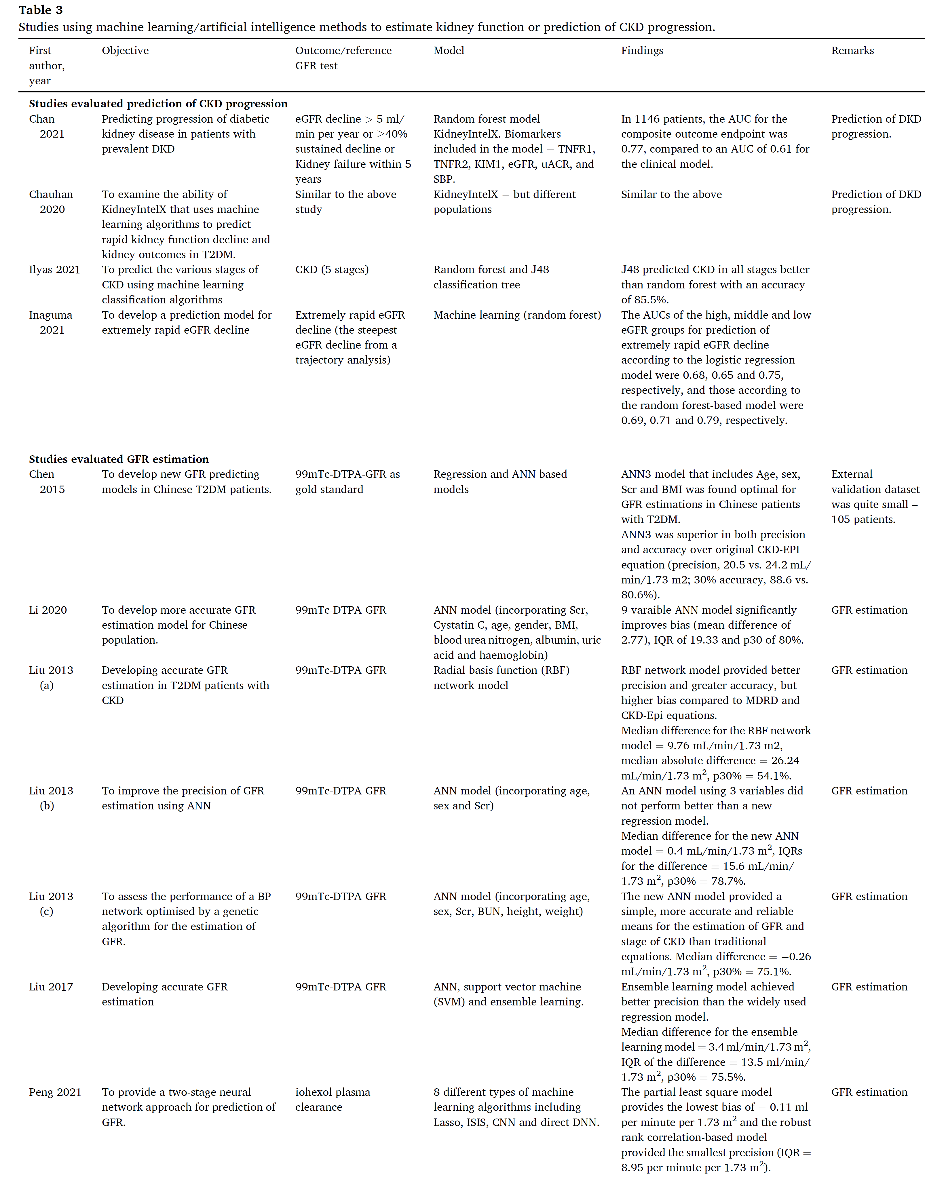
AI in improving GFR estimation

Slide 8
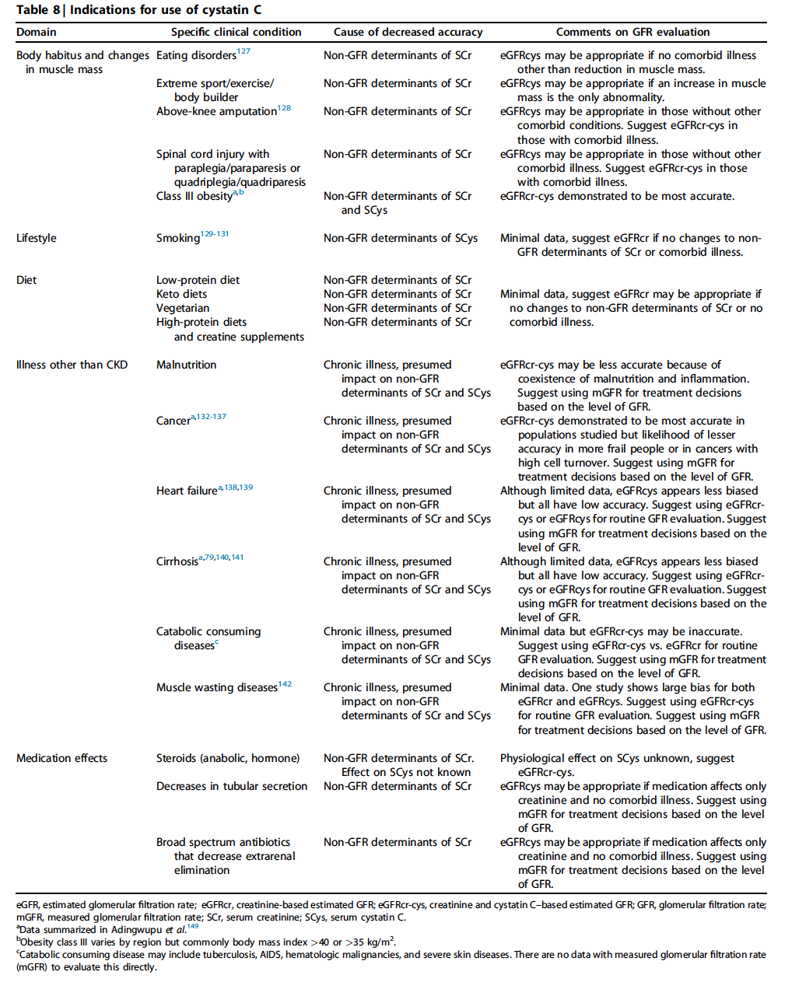

Slide 9
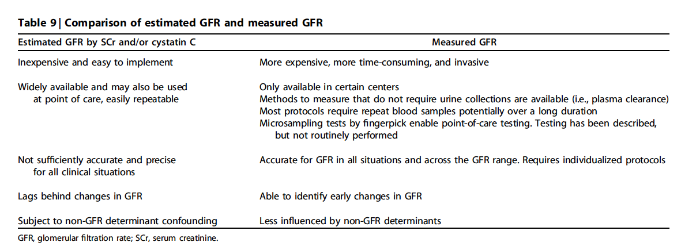

Slide 10
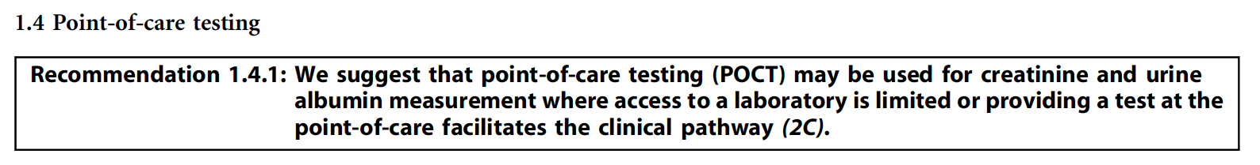

Slide 11
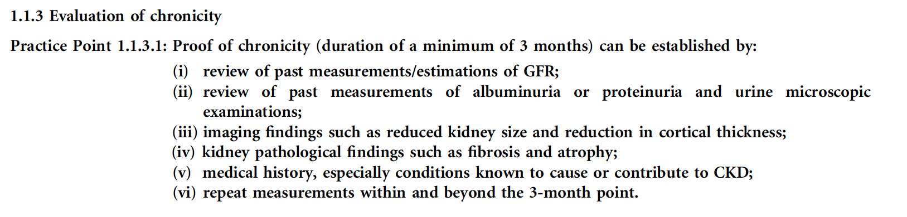

Slide 12
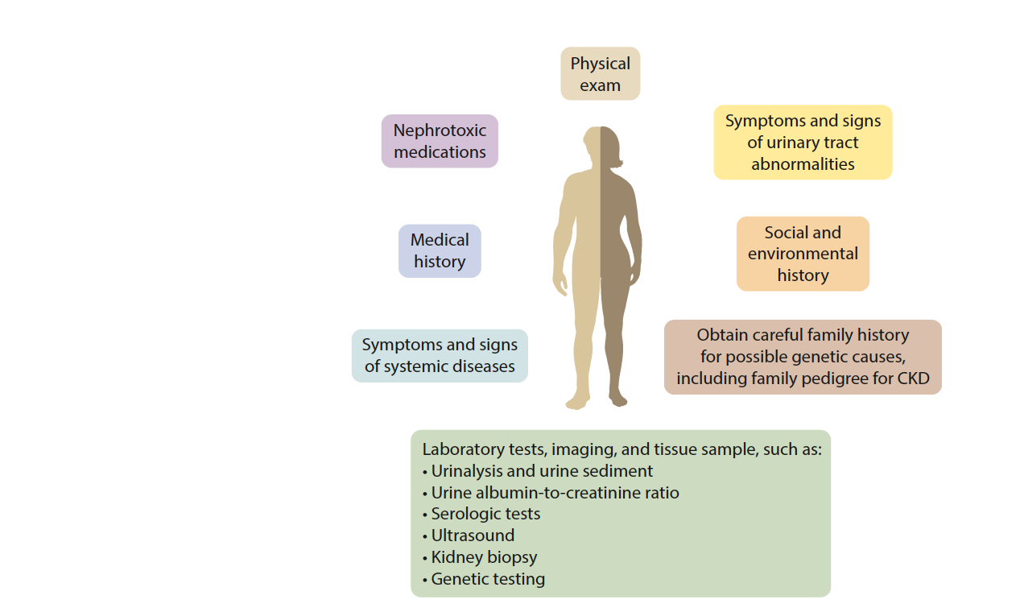

Slide 13
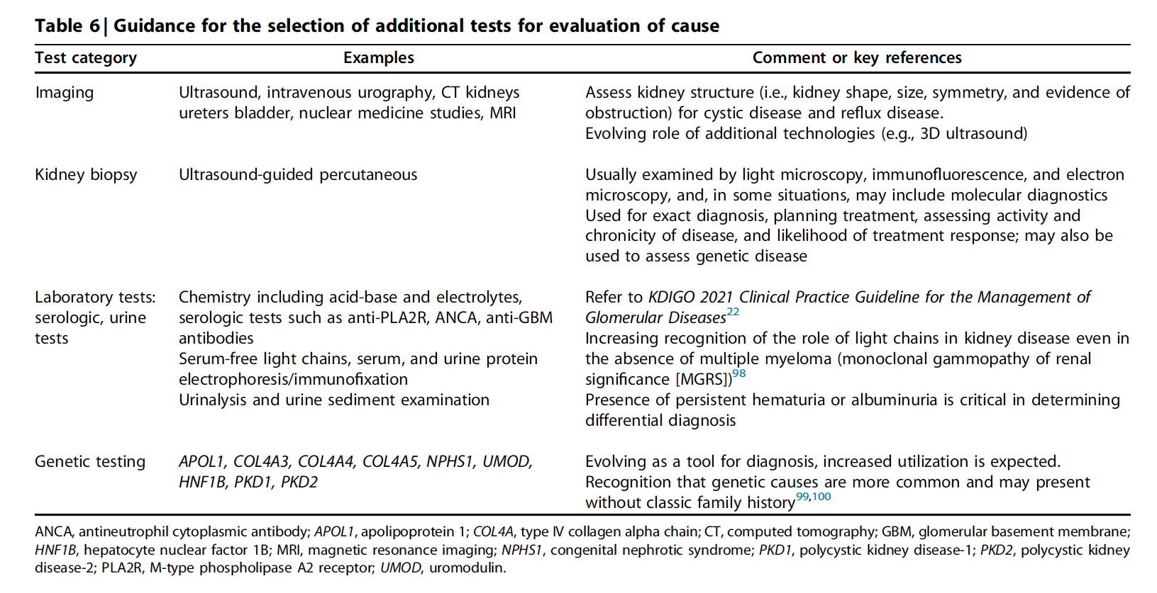

Slide 14
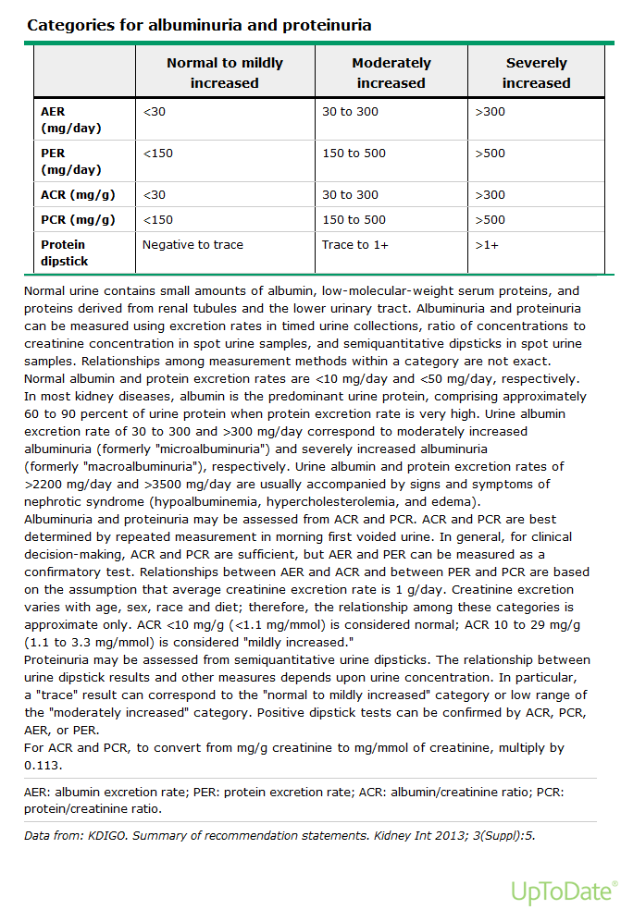

Slide 15
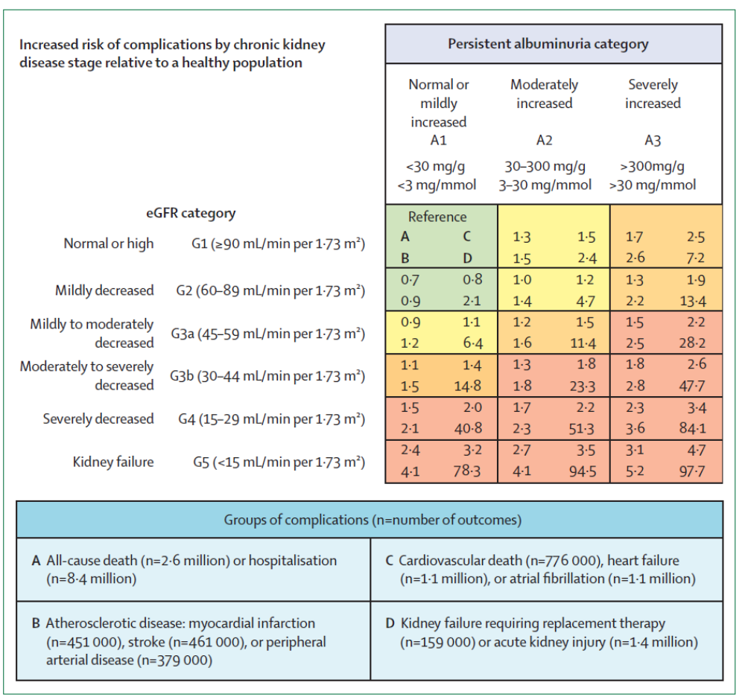

Slide 16
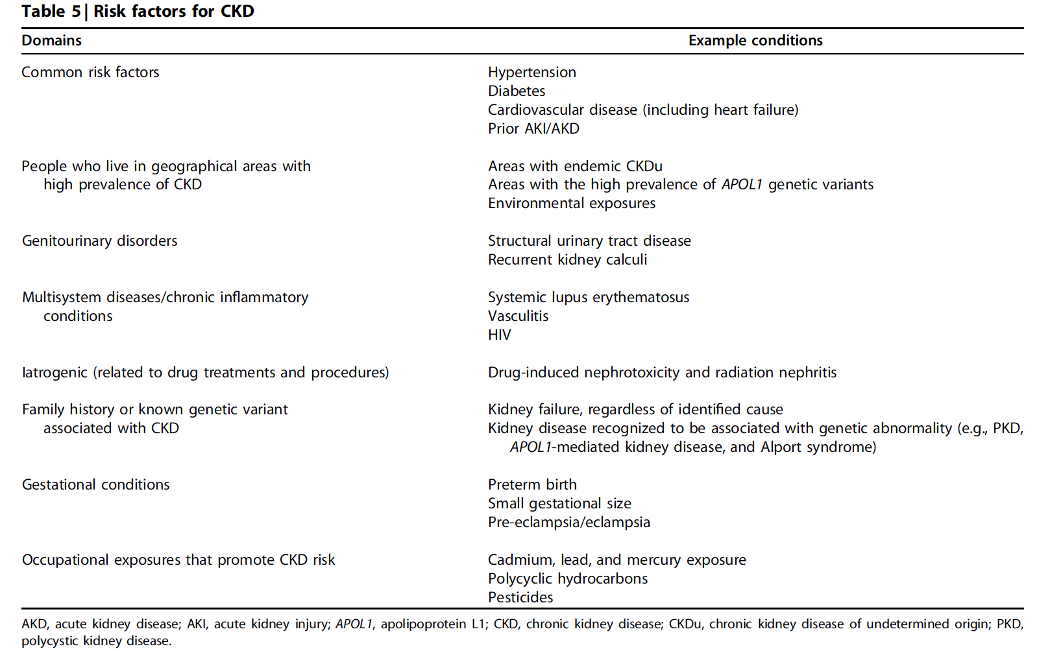

Slide 17
Water excretion
Blood osmolality: 285-295 mOsm/kgH20
CKD - impairment in the urinary concentrating ability (normal range: 50-1200 mOsm/kg H20)
In progressive renal failure the maximum urine osmolality approaches that of plasma
The increased obligatory water excretion in chronic renal disease may lead to polyuria and nocturia

Slide 18
Sodium excretion
Fractional sodium excretion increases and extra renal balance is maintained until late in the course of renal disease
ECF volume is relatively well preserved
In a normal person sodium chloride intake may vary from 3.5 – 7.0 g/day,
(fractional sodium intake changes from 0.25 to 0.5%/day to maintain balance)
In a person with GFR 4 ml/min fractional sodium excretion has to change from 4% to 16% (to maintain sodium balance – restriction in sodium intake!!!)
1-2% of patients with early renal failure have a urine sodium leak, which causes sodium depletion even when sodium salt intake is normal (medullary cystic disease, analgesic nephropathy, chronic interstitial disease, polycystic kidney disease). They are typically normotensive and require a high sodium intake to maintain sodium balance

Slide 19
Potassium excretion
Normally 90% - 95% of ingested potassium is excreted in the urine
In chronic renal failure 20% - 50% of patassium is excreted in the stool
CKD - a marked increase in potassium excretion per nephron
A normal concentration of potassium is maintained even on a normal potassium intake (60-80 mEq/day) until GFR falls below 10 ml/min
Potassium excretion depends on tubular secretion to maintain balance- aldosteron increases secretion in distal tubules (care with prescription of converting enzyme inhibitors – they may reduce aldosterone level)
Plasma level of potassium may rise in chronic renal failure as a result of redistribution of potassium between intra and extra cellular compartments, usually as a consequence of acidosis, use of beta blocking agents
Very little functional reserve remains to respond to sudden changes in potassium intake, metabolic acidosis or catabolic states may result in life-threating hyperkalemia

Slide 20
Acid-Base Balance
In normal human renal reabsorption of bicarbonate equals 4000 mEq
Urinary excretion of hydrogen ions is 50-100 mEq in the form of ammonium and titrable acid (H+ bound to phosphate and other buffer ions)
Because of compensatory adaptations in acid excretion by residual nephrons most patients do not have significant acidosis until GFR falls below about 25% of normal
Other buffers such as carbonate of bone are utilized in buffering the hydrogen ion retention
In some patients is also urinary bicarbonate leak when the plasma levels are restored by the infusion of bicarbonate (high PTH level)
Two types acidosis occurs in chronic renal failure:1) hyperchloremic acidosis (normal anion gap); 2) metabolic acidosis (increased anion gap: accumulation of phosphate, sulfate)

Slide 21
Magnesium
Most patients with chronic renal failure have normal or moderately elevated serum magnesium level
The serum magnesium level rises further in response to acidosis, administration of wit D
In patients with high level of magnesium may occur: muscle weakness, skin irritation, in patients with very high magnesium level may occur dramatic symptoms: muscle paralysis, respiratory failure

Slide 22
Phosphate and Calcium
Hyperfosfatemia is seen commonly in patients with GFR of 25 ml/min or less on an unrestricted diete
Hypocalcaemia is due to several factors: increase in serum phosphate level leads to reciprocal decrease serum levels of 1,25(0H)2 wit D3; nephron loss
Decrease calcium absorption from the gastrointestinal tract
Ability of PTH to mobilize calcium from bone is impaired
Metabolic acidosis tends to increase the fraction of ionized calcium and prevents some of the clinical consequences of hypocalcaemia
Rapid correction of acidosis may lead to a fall in ionized calcium level and to acute manifestations of hypocalcaemia (tetany, convulsions)

Slide 23
Uremic syndrome
Urea itself is relatively non-toxic, but measurement of blood urea offers the best
single laboratory index of the likehood of certain symptoms that occur in renal
failure; it represents an overall measure of the accumulation of products of protein
metabolism
Accumulation of „toxins”
a/ low molecular weight substances (urea, urate, sulfate,
phosphate).
b/ substances such as phenols, guanidines, low-molecular weight
peptides
c/ extra cellular and intracellular electrolyte and acid-base
disturbances
d/ accumulation of various hormones: impaired renal degradation
(GH, insulin, glucagon); PTH, natriuretic factor
e/ impaired production of renal hormones (erythropoietin, 1,25(0H)2
wit D3

Slide 24
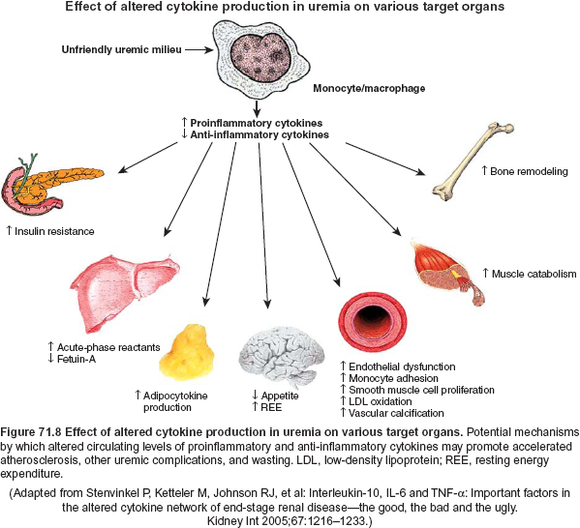

Slide 25
Differentiation of chronic from acute kidney disease
History | Long-standing history suggests chronic kidney disease
Renal osteodystophy | Radiographic evidence of osteitis fibrosa cystica, osteomalcia
Renal size (length) Small kidney (e.g. <9 cm) Normal or enlarged kidney (10-12 cm) | Chronic kidney disease of any cause Acute kidney disease of any cause Chronic kidney disease: HIV nephropathy Diabetic nephropathy Amyloidosis
Enlarged kidneys (>12 cm) | Autosomal dominant kidney disease Tuberous sclerosis Obstructive nephropathy
Renal biopsy | Histological diagnosis

Slide 26
Presentation of CKD
Asymptomatic Presentation
Hypertension
Proteinuria
Microscopic hematuria
Abnormal renal imaging findings

Slide 27
Presentation of Renal Failure – symptomatic
General
Fatigue
Weakness
Cardiovascular
Hypertension
Pulmonary congestion
Cough
Dyspnea
Hemoptysis
Neurologic
Encephalopathy
Seizure
Peropheral neuropathy
Genitourinary
Hematuria
Dysuria
Gastrointestinal
Anorexia
Nausea
Vomiting
Abdominal pain
Bleeding
Musculoskeletal
Muscle weakness
Periarticular and articular pain
Bone pain
Cutaneous
Pruritis
Necrosis
Bruising

Slide 28
KIDGO 2024 –
guidelines

Slide 29
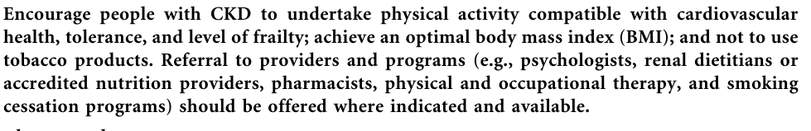
Life style

Slide 30
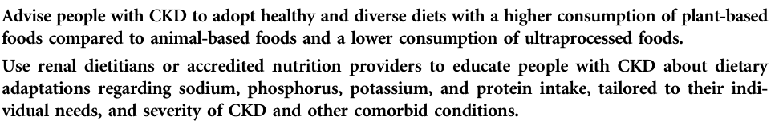
Diet

Slide 31

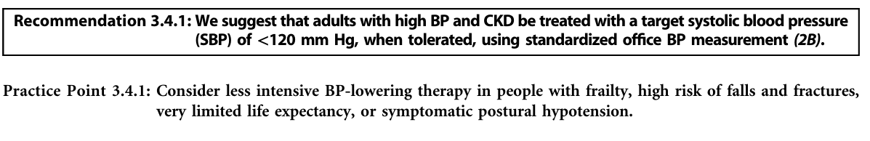
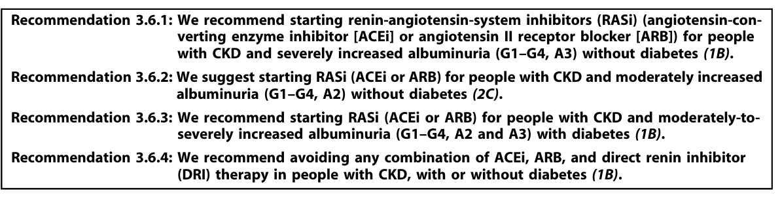

Slide 32
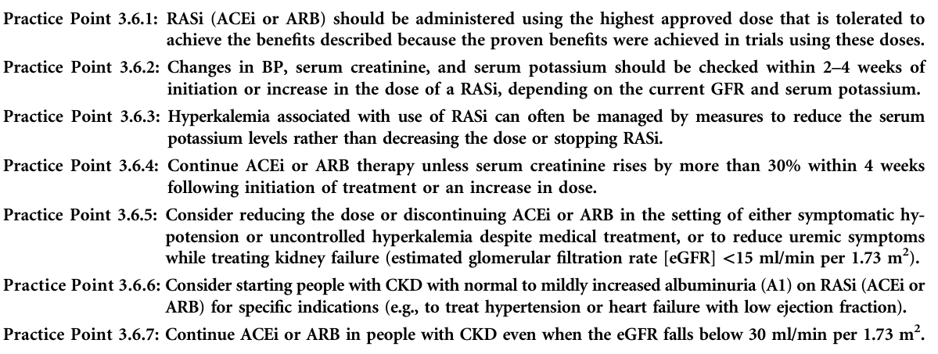
iACE or ARB

Slide 33
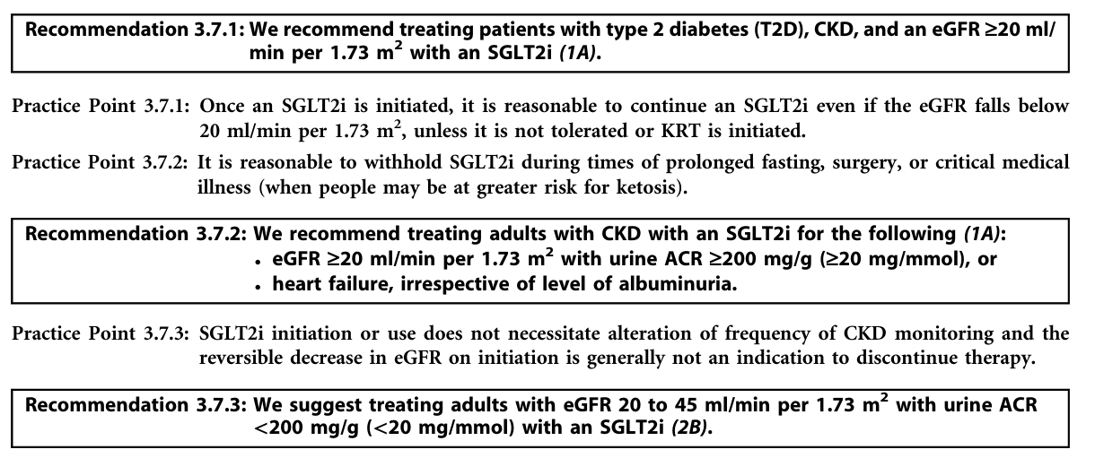

Slide 34
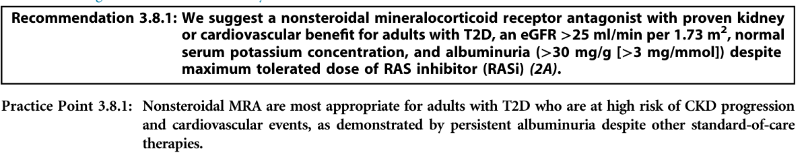

Slide 35
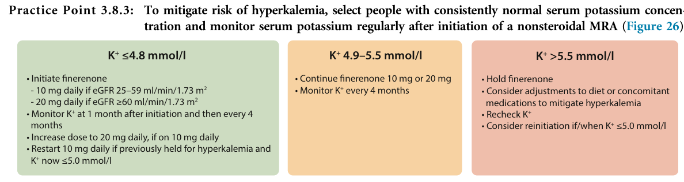

Slide 36
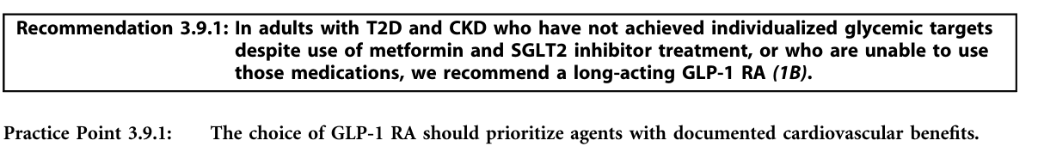

Slide 37

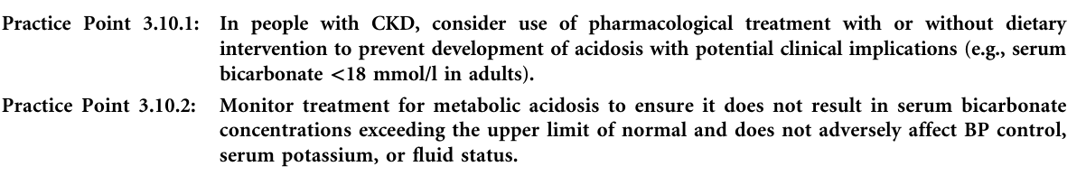

Slide 38

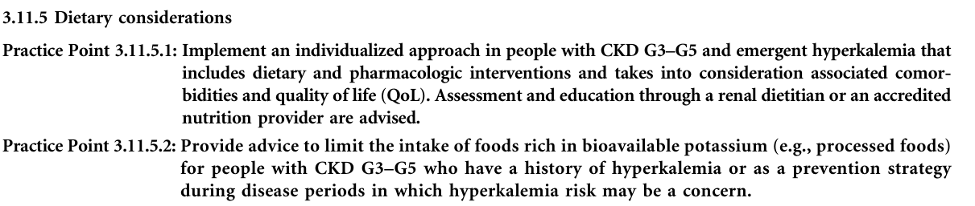

Slide 39

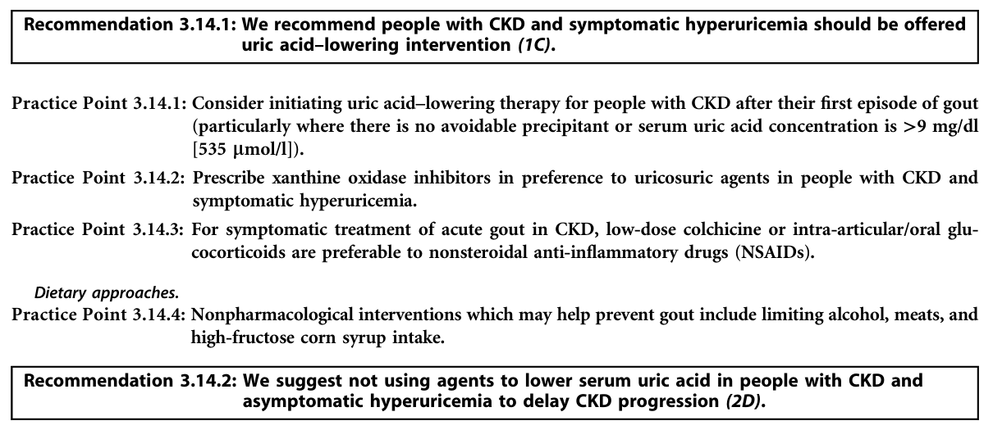

Slide 40

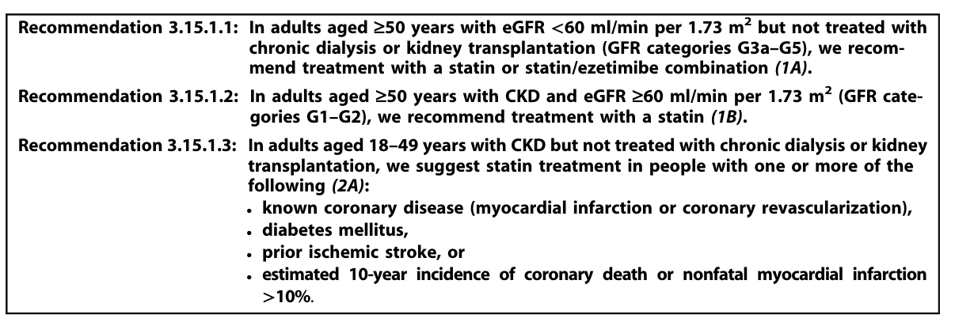

Slide 41
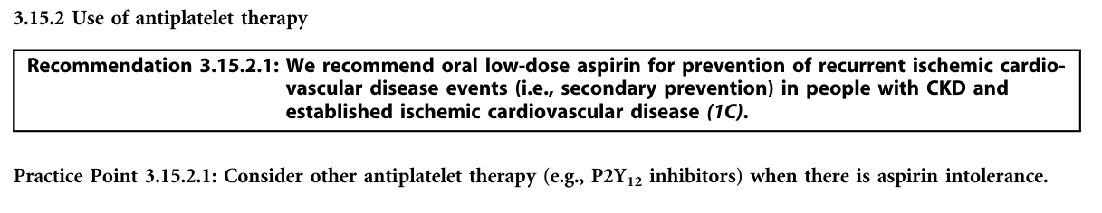

Slide 42
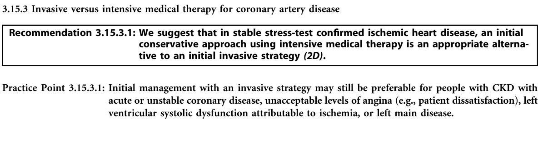

Slide 43
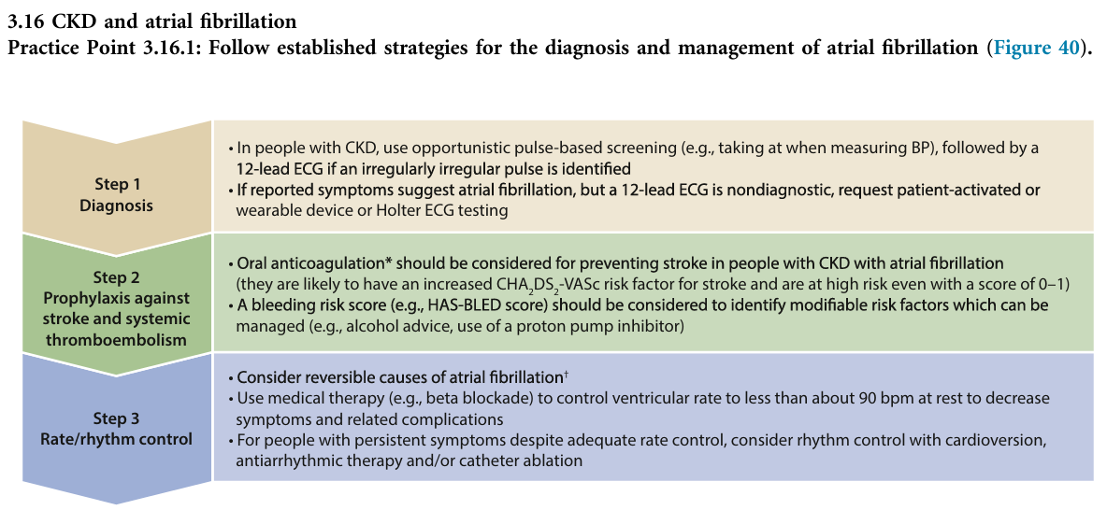
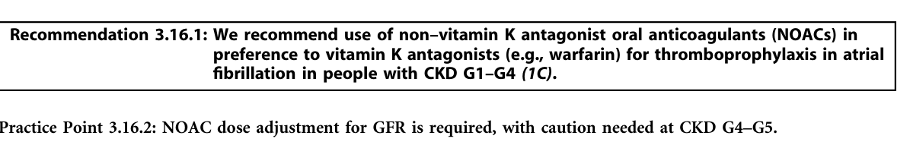

Slide 44
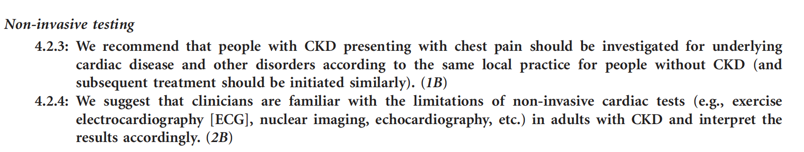

Slide 45
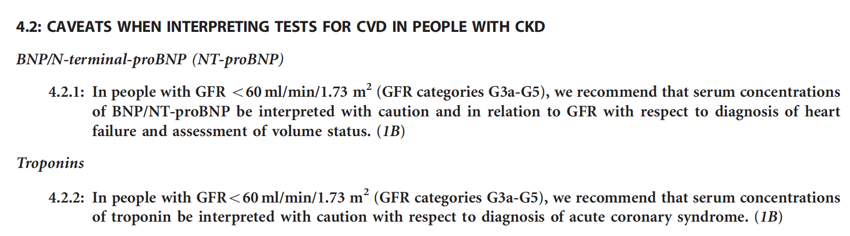

Slide 46
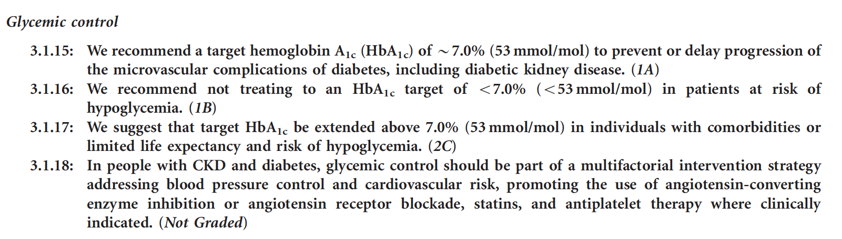

Slide 47
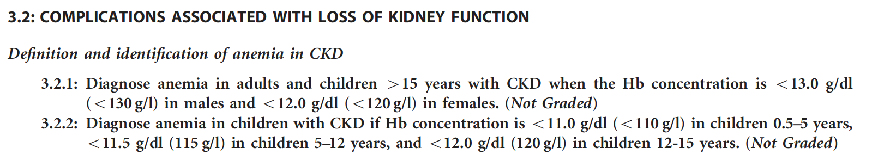

Slide 48
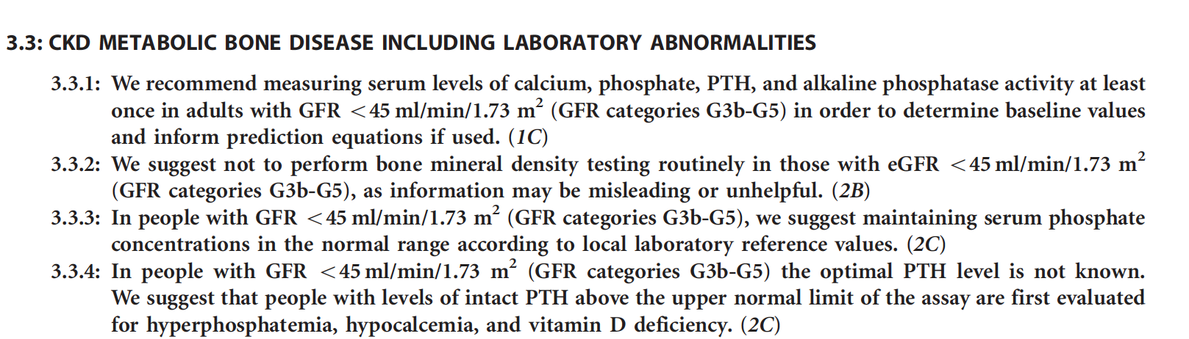

Slide 49
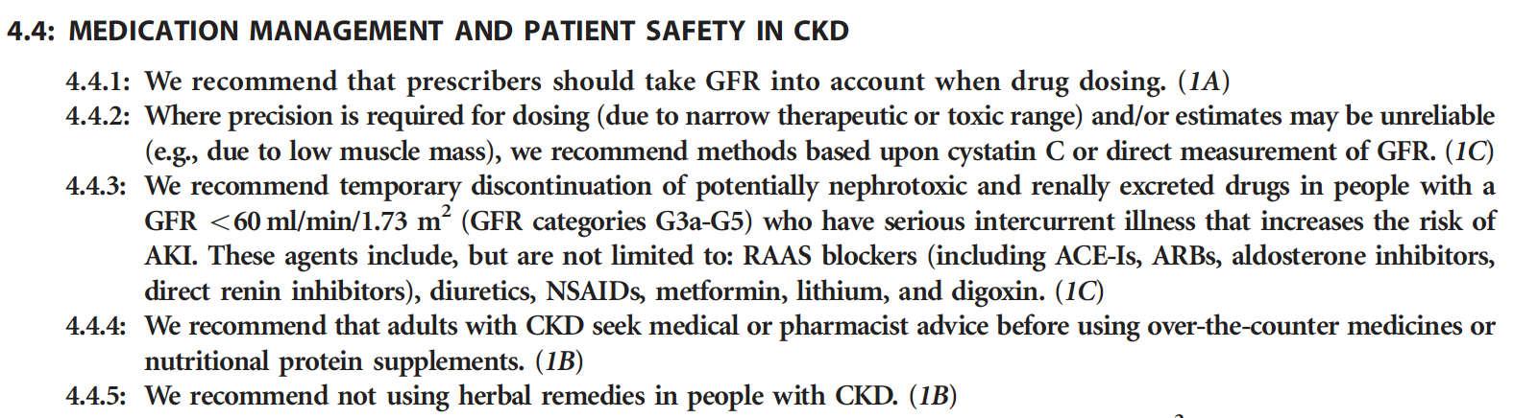

Slide 50
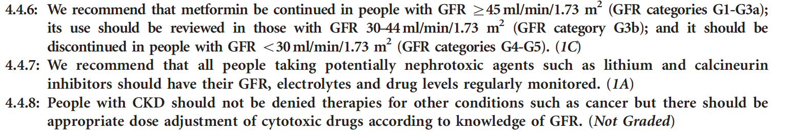

Slide 51
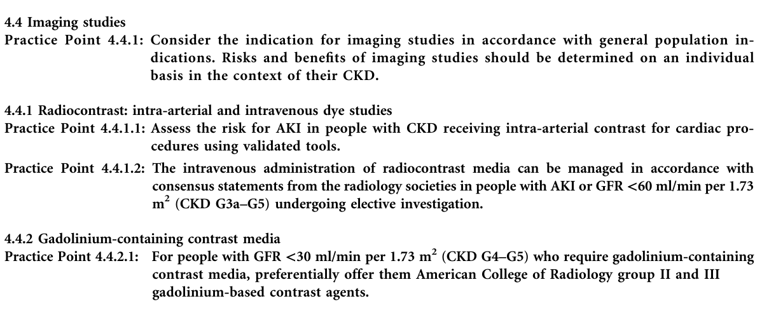

Slide 53
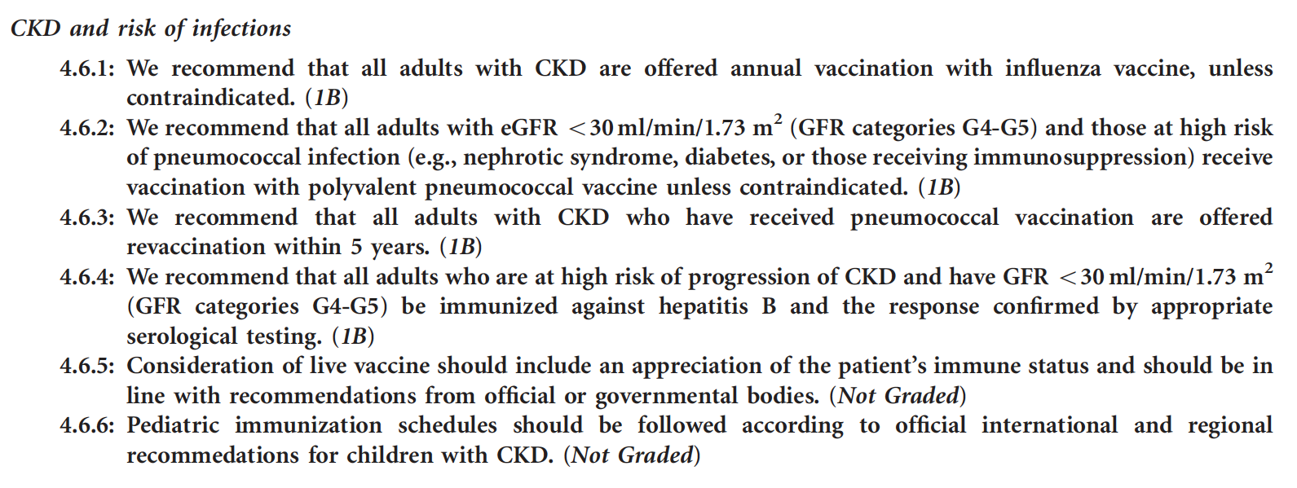

Slide 54
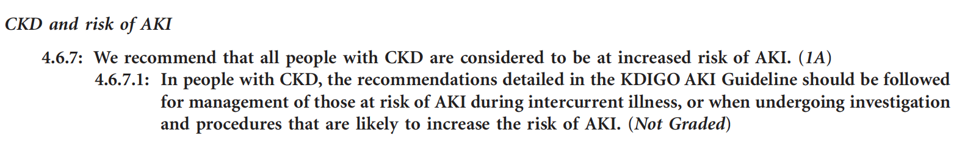

Slide 55
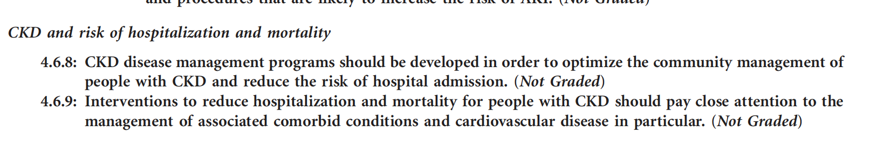

Slide 56
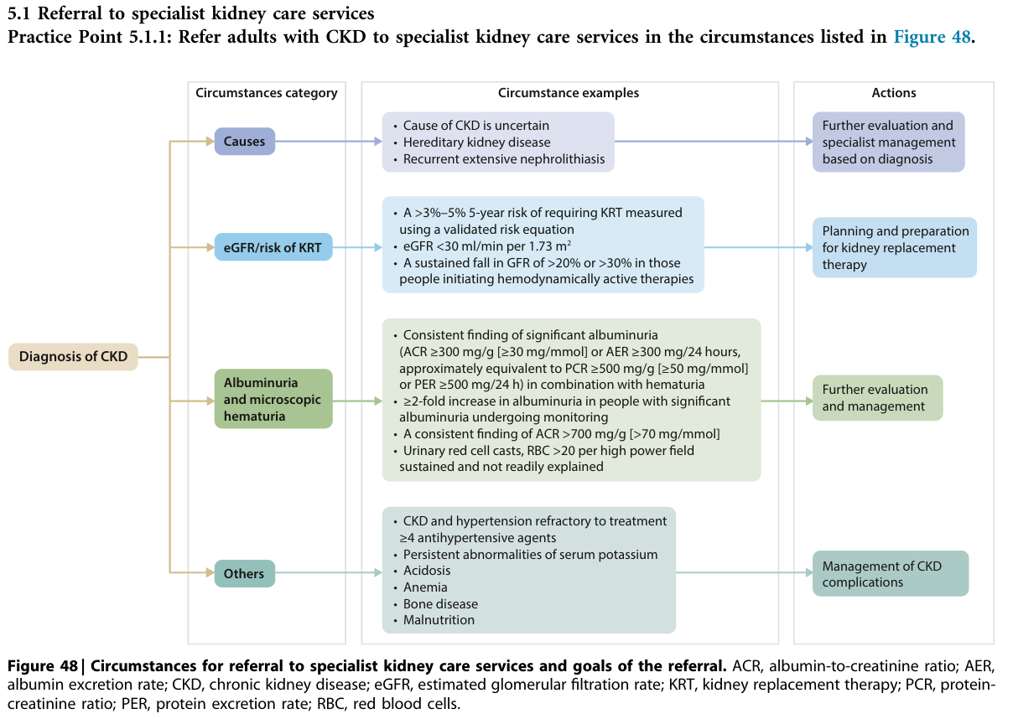

Slide 57
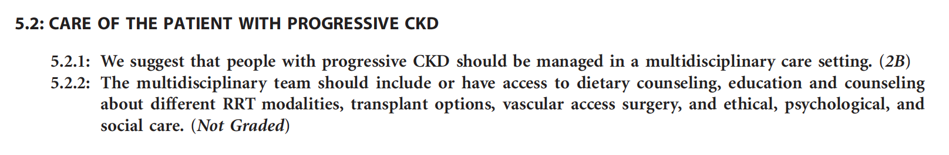

Slide 58
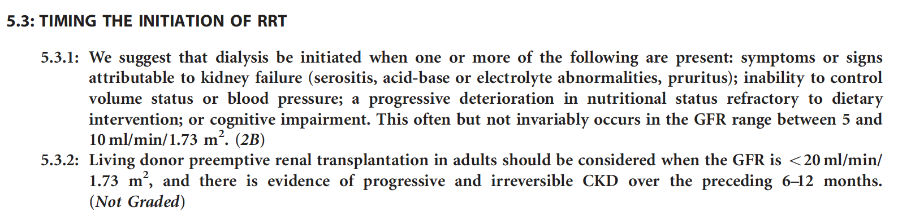

Slide 59
