Slide 1

Acute kidney injury
Agnieszka Furmańczyk-Zawiska
Department of Transplantology, Immunology, Nephrology and Internal Medicine
Medical University of Warsaw
Head Prof. Krzysztof Mucha
2026/27

Slide 2
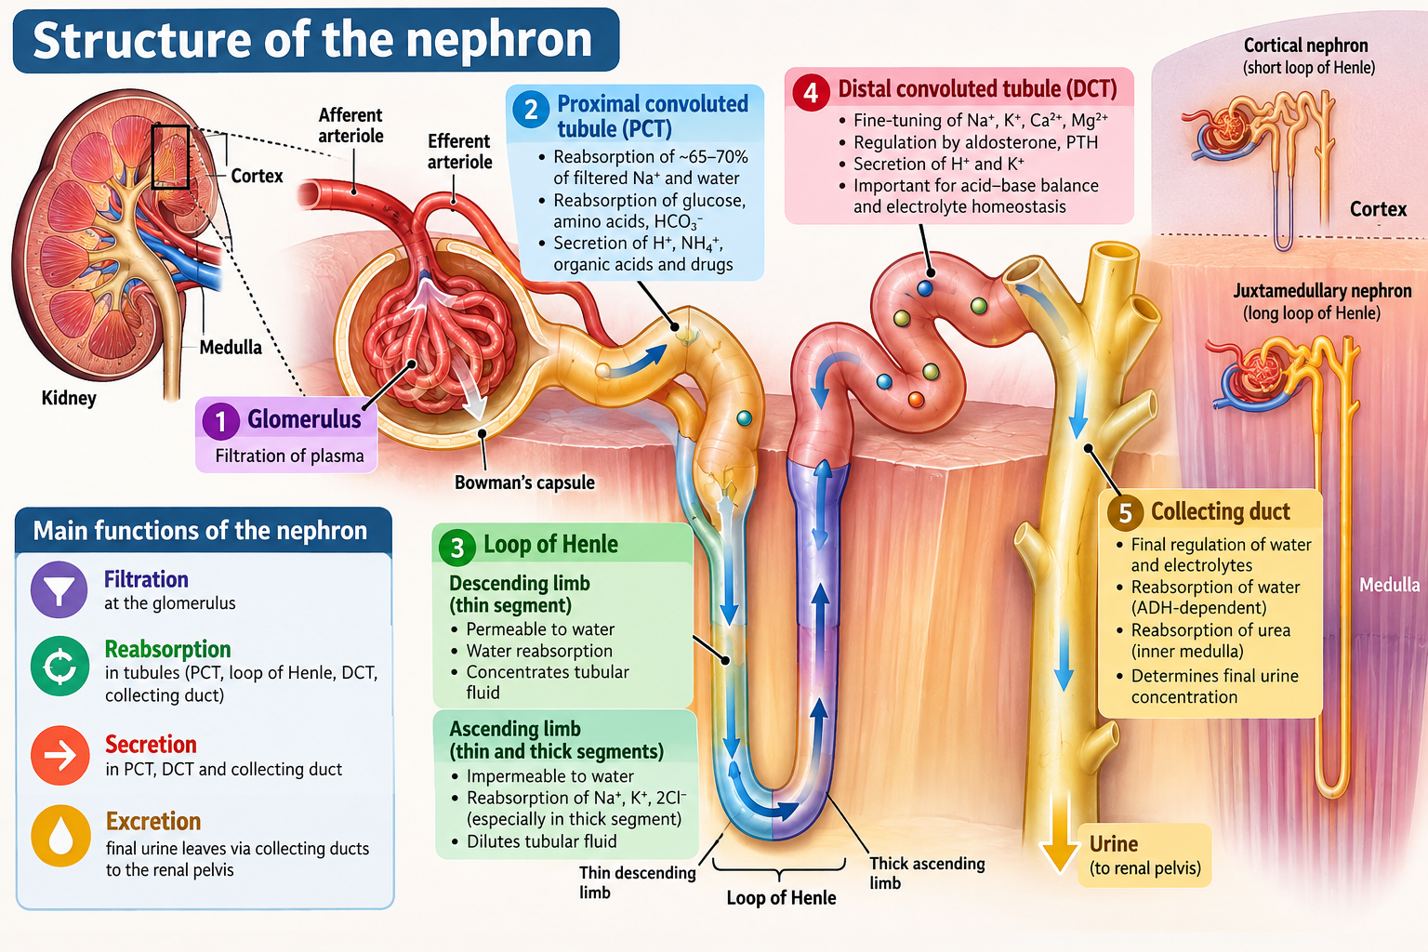

Slide 3
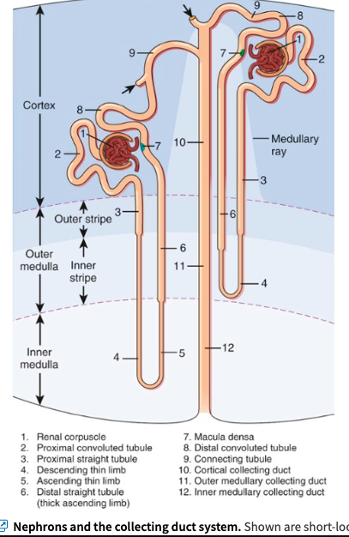
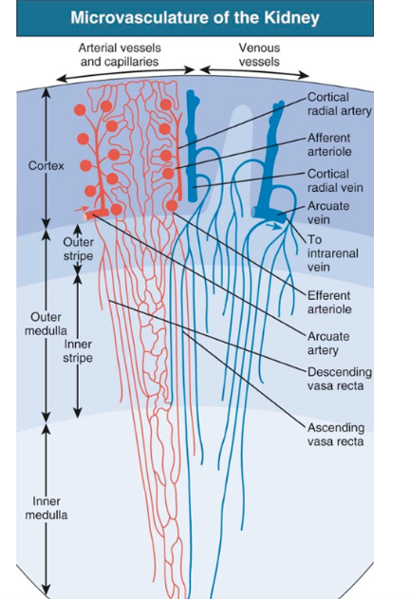
Nephrons and the collecting duct system

Slide 4
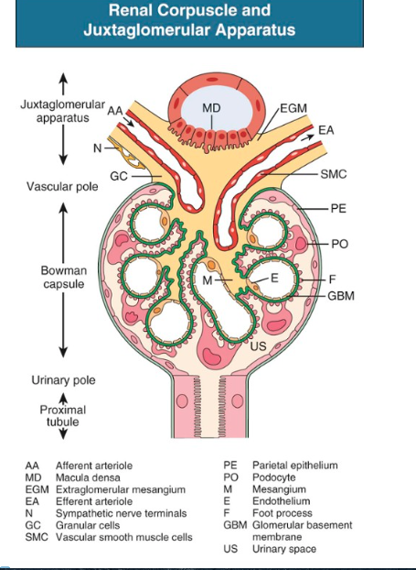

Slide 5
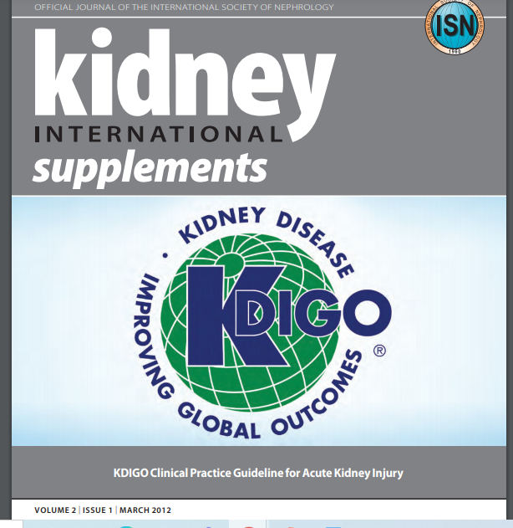
AKI
Clinical syndrome
Abrupt decline in GFR
Insufficient to eliminate waste products
AKI replaced previously used term acute renal failure (ARF)

Slide 6
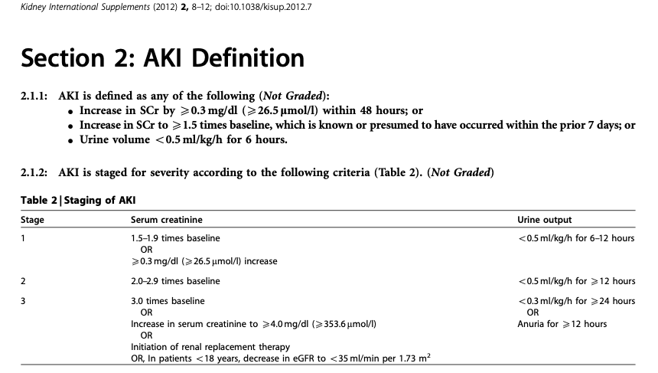

Slide 7
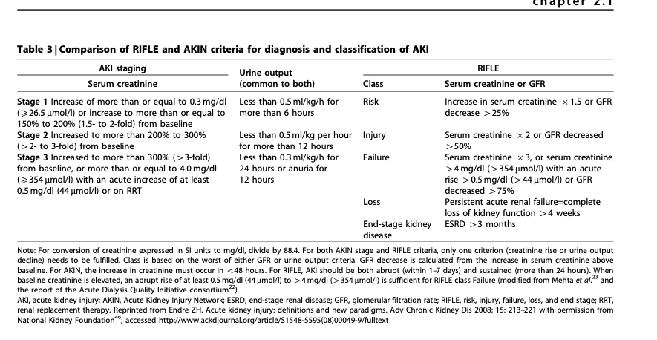

Slide 8
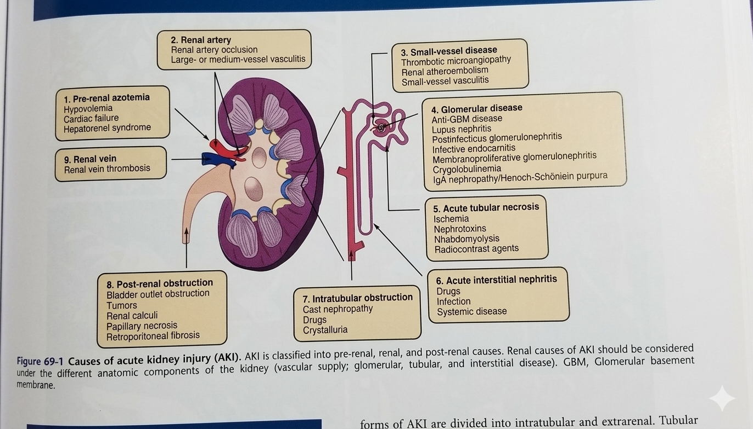
Pre-renal:
Hypovolemia
(GI loss, skin loss, renal loss, trauma, burn, pancreatitis, peritonitis, third-spacing sequestration)
2. Cardiac failure– low EF
3. Systemic arterial vasodilation-Sepsis, HRS
4. Disturbances of renal autoregulation (general anesthesia, COX-I, ACE-I, hypercalcemia, CNI, adrenaline, amphotericin B)
5. Renal artery thrombosis/stenosis
pre-renal
renal
post-renal causes

Slide 9
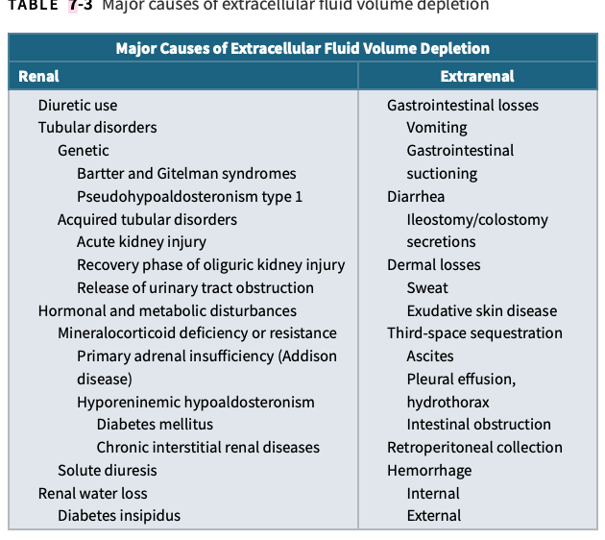

Slide 10
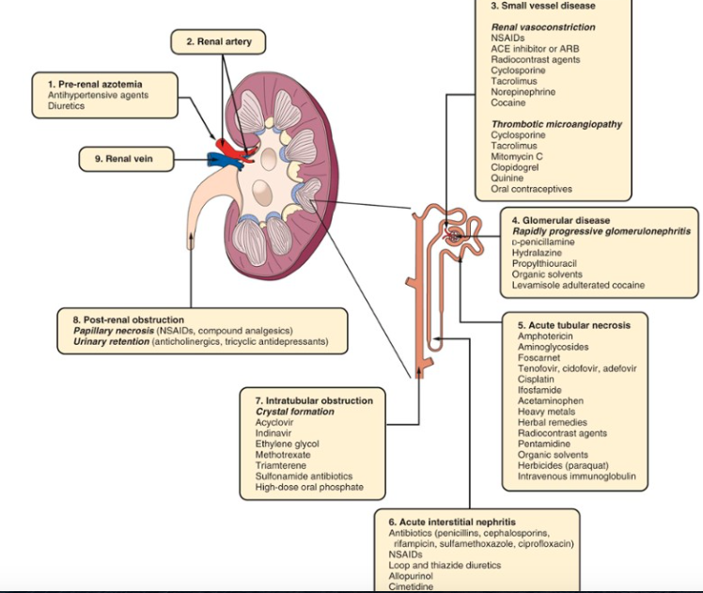
Autoregulation of renal perfusion
If systolic BP<80 mmHg
RAAS
Reflex stimulation of sympathetic nervous system
In renal hypoperfusion glomerular filtration pressure is maintained by
afferent arteriolar vasodilatation (eicosanoids)
efferent arteriolar vasoconstriction (AgII)

Slide 11
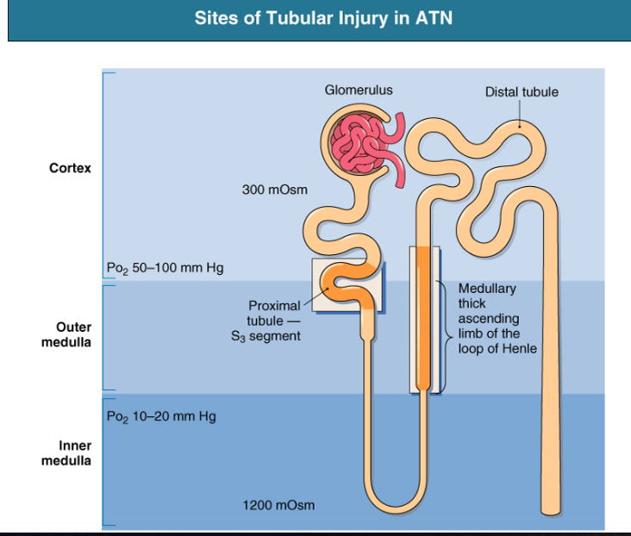
Borderline oxygen supply/ high metabolic demand
High tubular energy requirements
Impaired renal autoregulation – ischemic injury
Ischemia+nephrotoxins=ATN

Slide 12
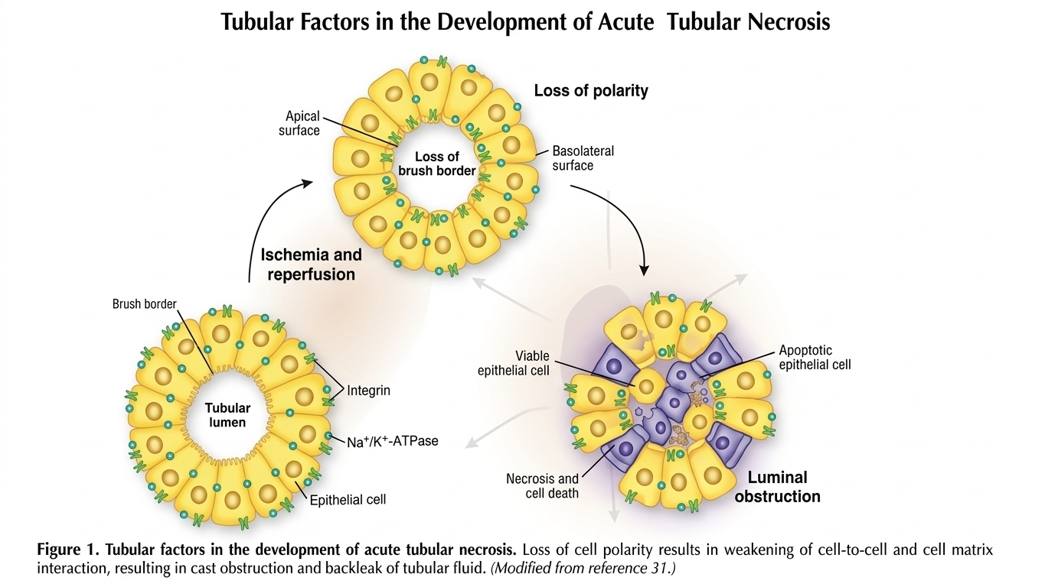

Slide 13
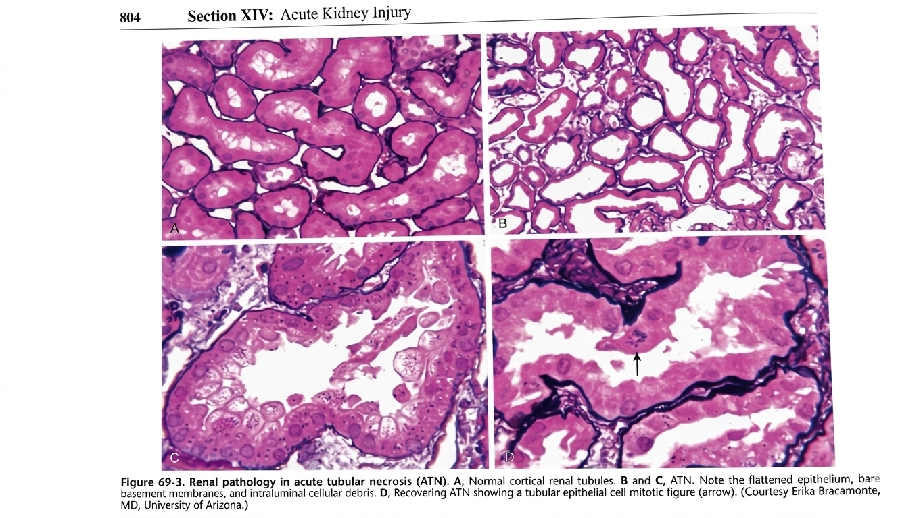

Slide 14
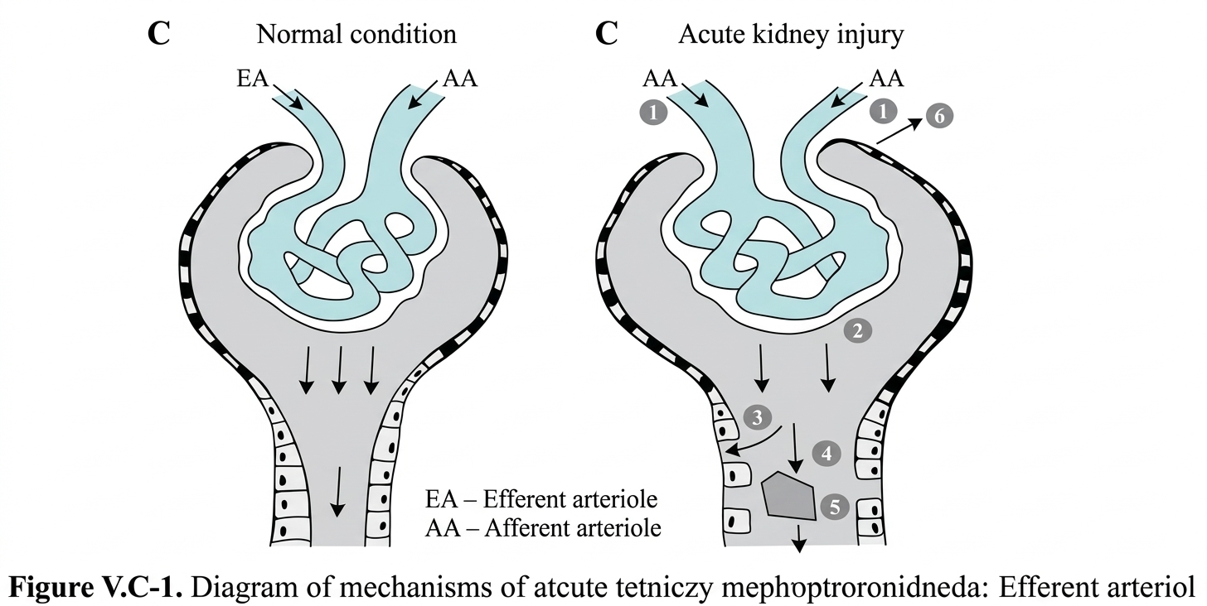
1. dilation of the efferent arteriole, decreased glomerular pressure
2. mesangial contraction, reduction of filtration surface
3. total filtrate reabsorption, interstitial edema
4. acute tutbular injury/necrosis
5. tubular obstruction, cellular debris, bare TBM

Slide 15
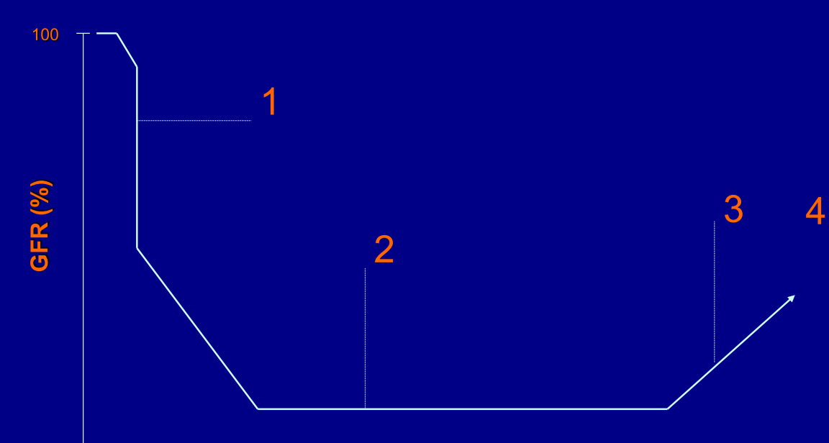
AKI- phases
1. preliminary phase – minutes or hours
2. anuria/oliguria - 10-14 days in 50%, the rest experience non-oliguric AKI. Parenchymal AKI- daily SCr increase 0,5-1 mg/dl
if >2 mg/dl – catabolism, crush syndrome, rhabdomyolisis. Pre-renal AKI – SCr fluctuations depend on renal flow
3. polyuria – few weeks
4. recovery – few months

Slide 16
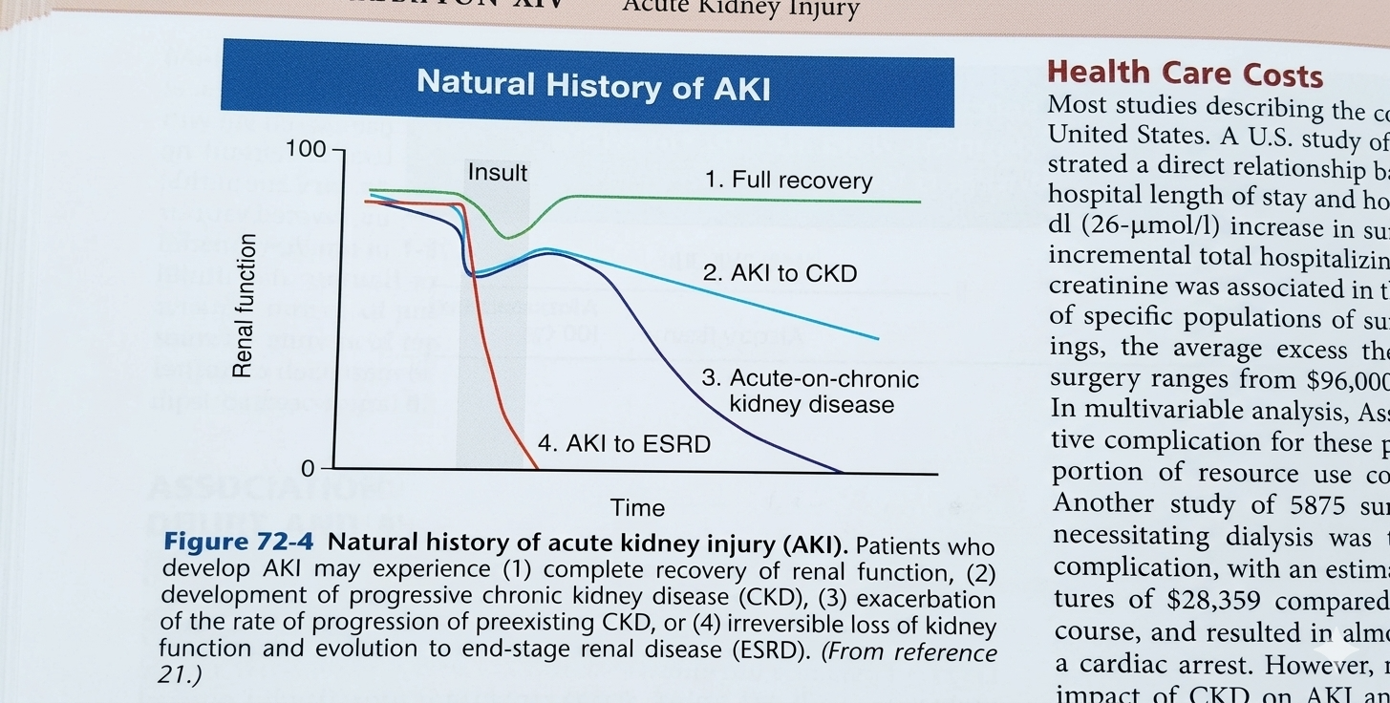

Slide 17
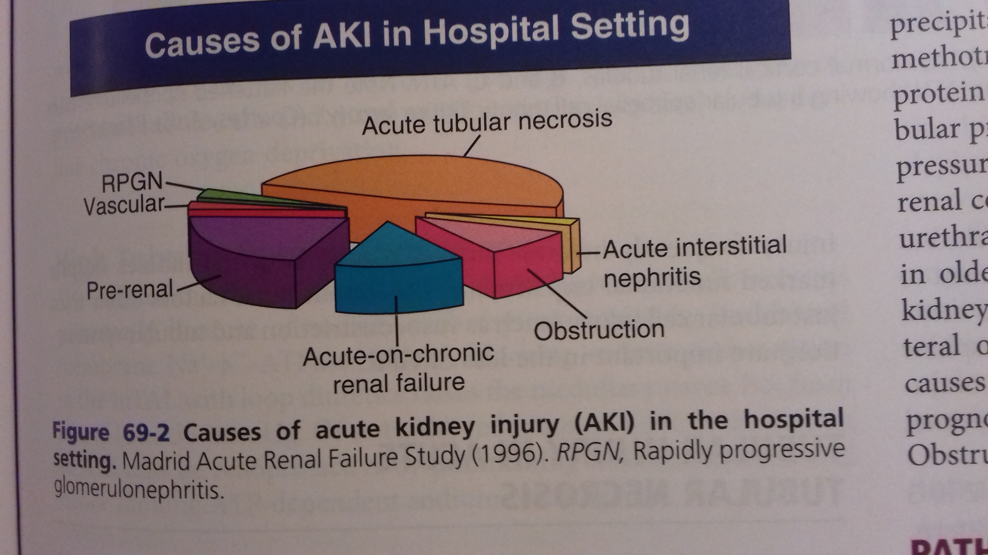
Epidemiology of AKI
  The incidence of AKI 3000/mln/year
  8% of medical pts
  40% critically ill pts
  50% connected to operations or trauma
  10% pregnancy or childbirth
  mortality 20-50% (30%)
    mostly due to comorbidities
    80% multiorgan failure
    10% RRT
    70% full recovery

Slide 18
AKI - symptoms
Urine output – anuria<100ml/d
oliguria<400ml/d in 50%
20% with polyuria! >2500ml/d
If GRF 10 ml/min =14l/24h of primary filtrate
If injured tubules reabsorb only half of it, urine output is preserved

Slide 19
AKI physical examination
BP, HR, volume depletion
Rash, purpura – vasculitis, immune complex disease, HUS, DIC, cryoglobulinemia
Livedo reticularis – SLE
Abdomen – acites, collateral circulation (caput medusae), spleen enlargement, liver cirrhosis - HRS
Bladder enlargement in urine obstruction

Slide 20
Lab tests
SCr, urea, electrolytes Na, K
Urea acid >15mg/dl → gout or AKI
CPK, LDH ↑ → rhabdomyolisis
- ↑LDH→DIC, HUS
- ↑aPTT, ↓fibrinogen, ↓PLT →DIC
- thrombocytopenia if aPTT i PT normal → TMA
- ↑PT→ liver disease
- monoclonal protein, FLC → monoclonal gammapathy
- ANA, ANCA, anty-GBM, APLA → autoimmune disease
- C3, C4 → complement-mediated disease, immune complex

Slide 21
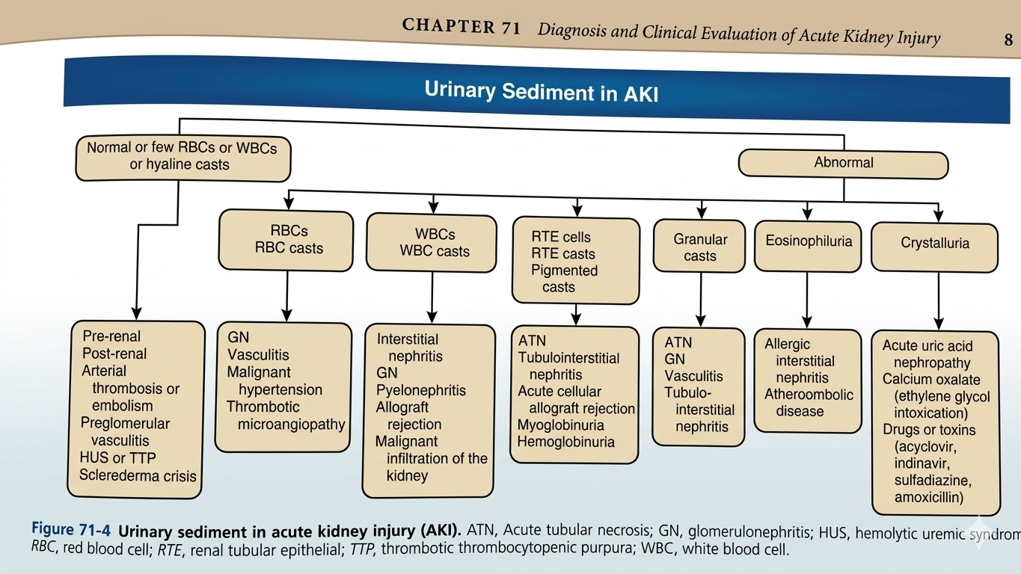

Slide 22
Lab test
Urinalysis and urine microscopy – RBC and proteinuria
Urine sediment – „muddy brown” granular casts, renal tubular epithelial cells indicated ATN-related AKI
Urinary eosinophiles – are neither highly-sensitive nor specific, drug-induced AKI
Uric acid cristals accompanying high serum phosphorus level – tumor lysis syndrome

Slide 23
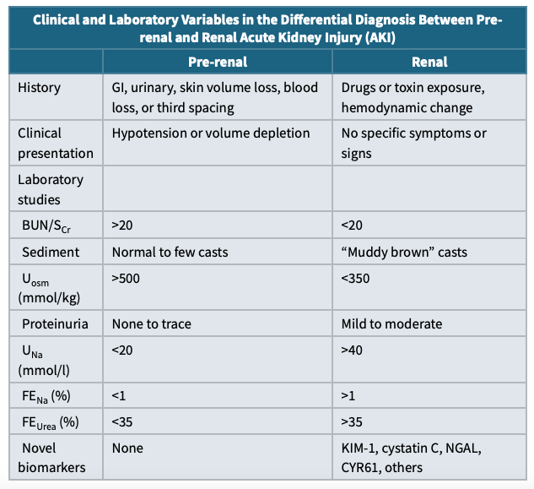

Slide 24
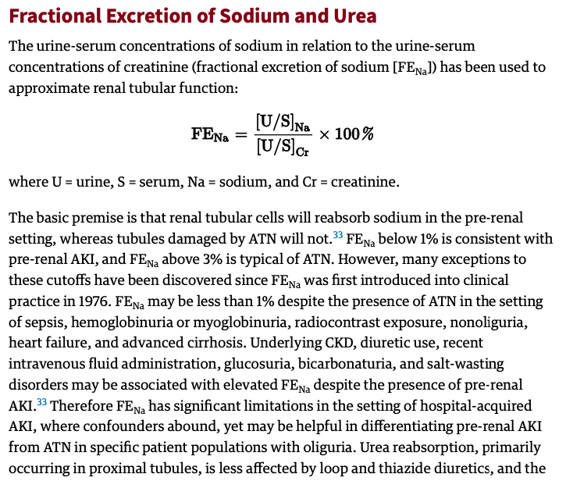

Slide 25
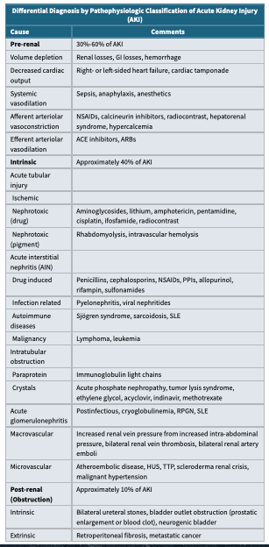
Pre-renal – 30-60% of AKI
Renal – 40% of AKI
Post-renal – 10% of AKI

Slide 26
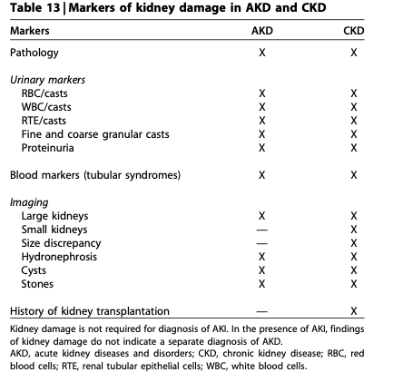
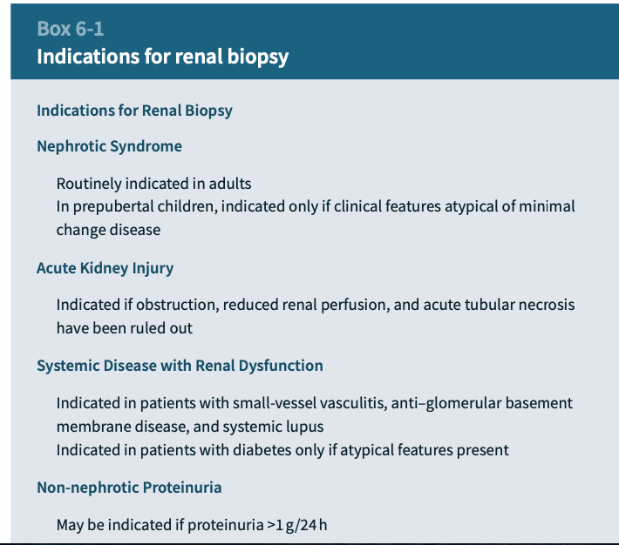
imaging – ultrasound renal biopsy

Slide 27
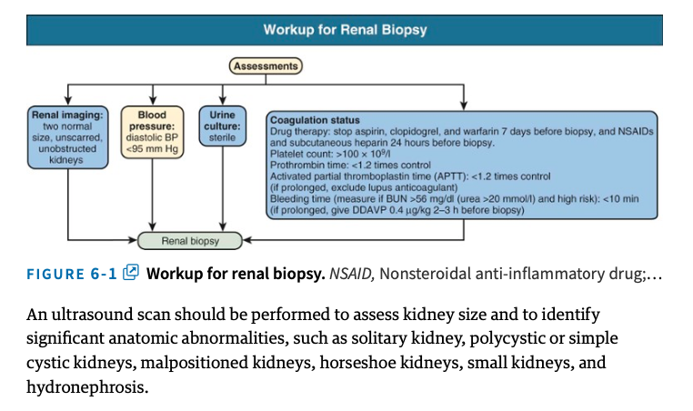

Slide 28
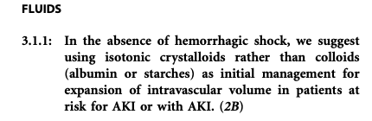
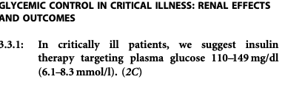

AKI – symptomatic treatment
Remove reversible causes of AKI – urine obstruction, infection
Fluid overload – water intake restrictions, diuretics, optimize volume status
Fluid depletion – cristalloids than colloids, blood transfusion
Metabolic acidosis
Nurition
0.8-1g/kg of protein if not catabolic
total energy intake 20-30kcal/kg/day

Slide 29
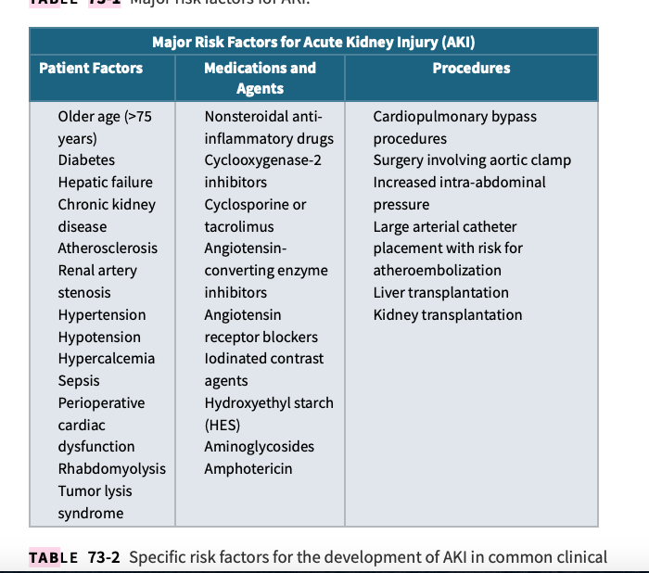
AKI - treatment
The best treatment is to prevent AKI
(primary and secondary prevention)

Slide 30
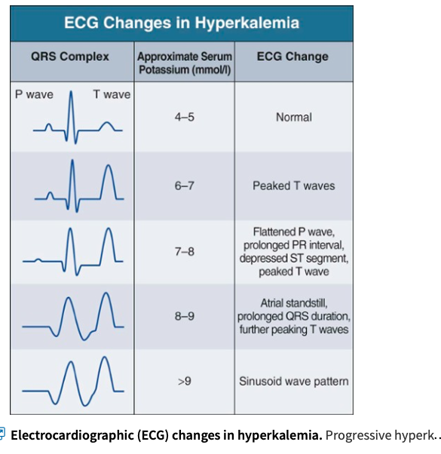
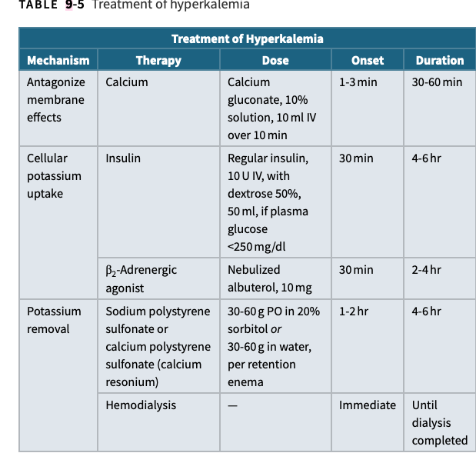
Hyperkaliemia

Slide 31
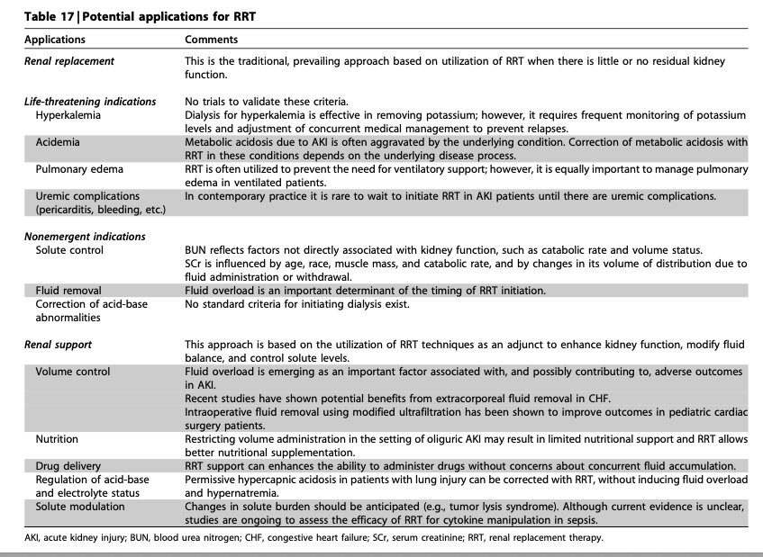
Clinical indication:
pulmonary odema refractory to diuretics
Uremic encephalopathy
Uremic diathesis
Symptomatic fluid in pericardium
Hipercatabolism
Intoxication with substance removing during HD
Biochemical indication
K>6.5 mmol/l
Acidosis pH<7.2 HCO3<12 mmol/l
Urea >200 mg/dl
Na >155 mmol/l
Na <120 mmol/l

Slide 32
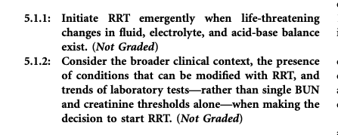
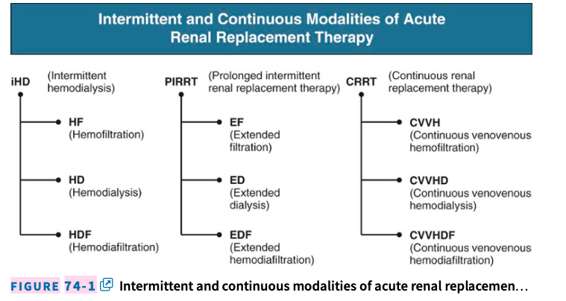

Slide 33
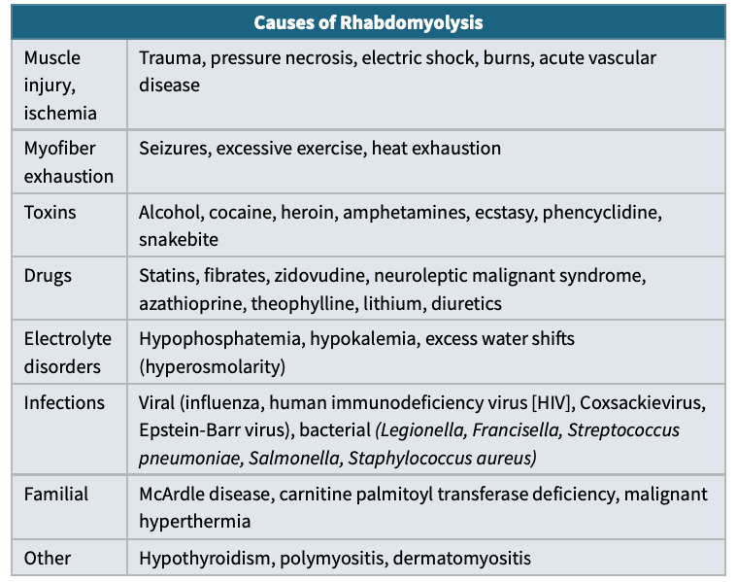
Special settings
1. rhabdomyolysis
2. contrast-induced nephropathy
3. warfarin nephropathy
4. HRS
5. Sars-Cov-2-associated AKI
…….

Slide 34
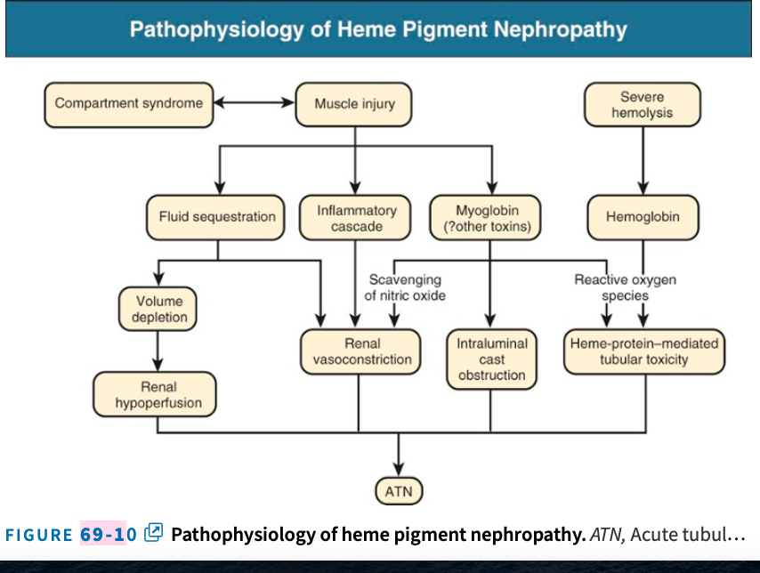

Slide 35
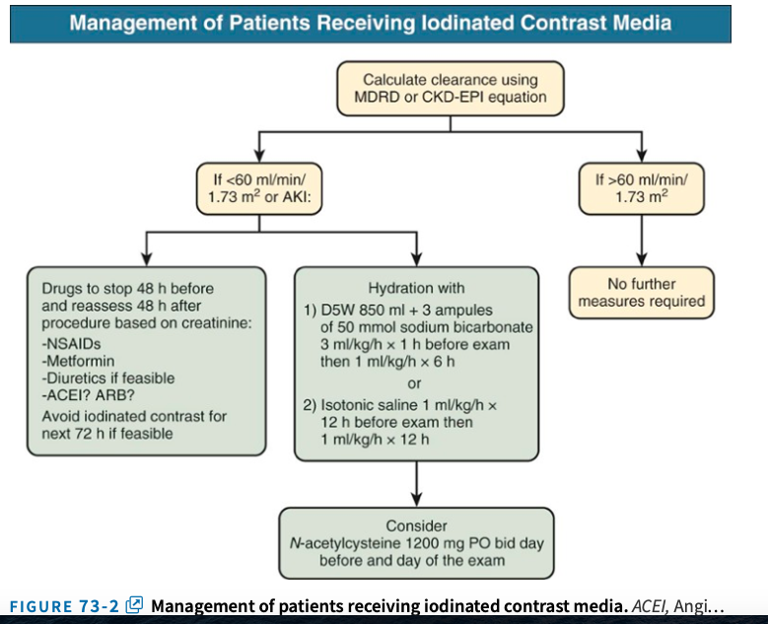
CIN
SCr >0.5 mg/dl or a 25% increase from baseline value assessed at 48h
The Society of Urogenital Radiology – same df but Scr changes within 72h

Slide 36
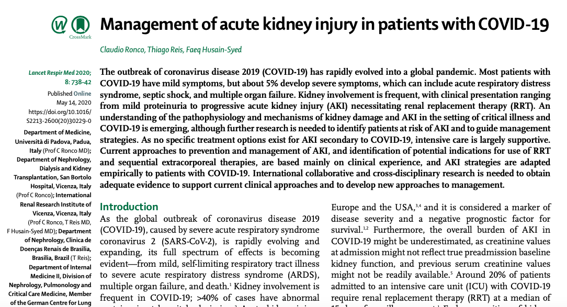

Slide 37
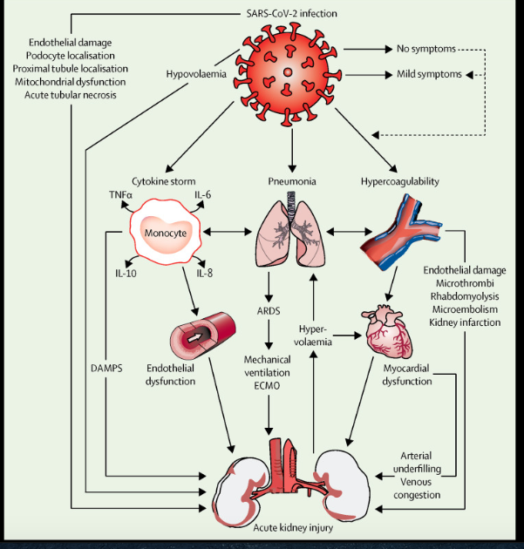

Slide 38
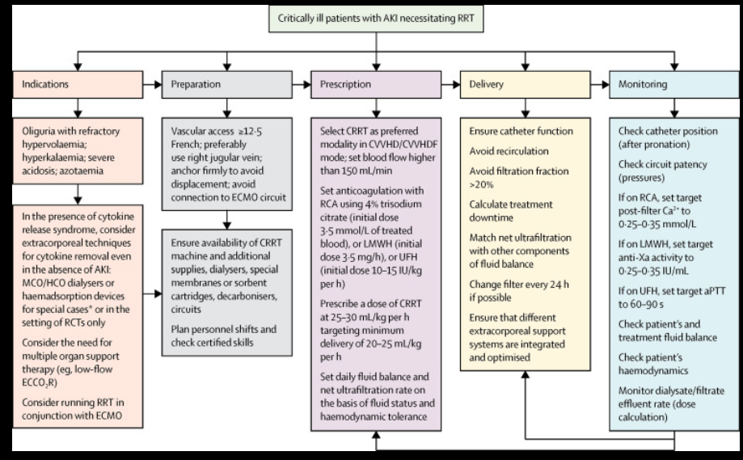

Slide 39
AI FOR ACUTE KIDNEY INJURY
From delayed recognition → to dynamic, early-warning kidney protection
01
MULTIMODAL DATA
02
AI / ML
03
CLINICAL ACTION
• Creatinine & urine output
• Learns temporal patterns
• Earlier AKI recognition
• Vital signs & fluid balance
• Integrates many variables
• Medication review
• Medications / nephrotoxins
• Updates risk dynamically
• Hemodynamic optimization
• EHR + biomarkers
• Generates explainable alerts
• Closer monitoring
KEY MESSAGE
AI can flag patients at high risk before conventional AKI criteria become obvious — but prospective clinical benefit remains to be proven.
Evidence: Tran et al., BMC Nephrology 2024; Shi et al., JAMIA Open 2025; Senatore et al., Int Urol Nephrol 2026. Current evidence supports prediction/early warning; routine bedside impact remains under validation.

