Slide 1

Immunosuppressive therapy
Teresa Bączkowska
Dept of Transplantation Medicine, Nephrology and Internal Diseases
Warsaw Medical University

Slide 2
Immunosuppression
Purpose: to improve long-term outcome, to improve quality of life (prevention and treatment of kidney allograft acute and chronic rejection)
Expectations: effective and safe immunosuppressive therapy
Reality:
  Non-selective effects on immunological system
    Prevention of acute rejection episodes
    Infections and neoplasms
    Non-immunologic effects - drug toxicity

Slide 3
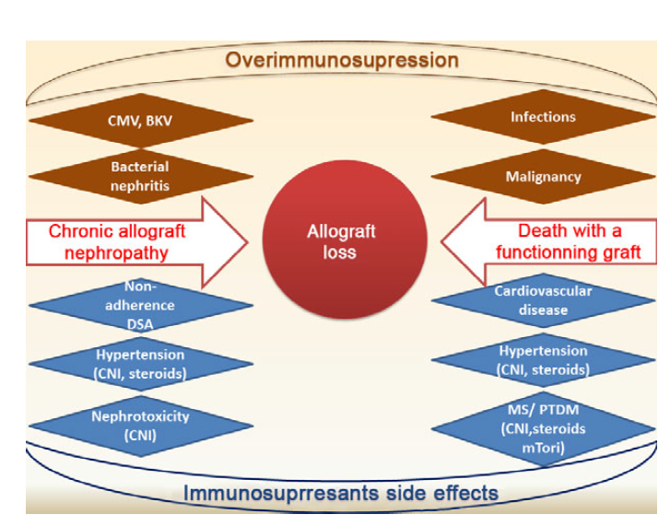

Slide 4
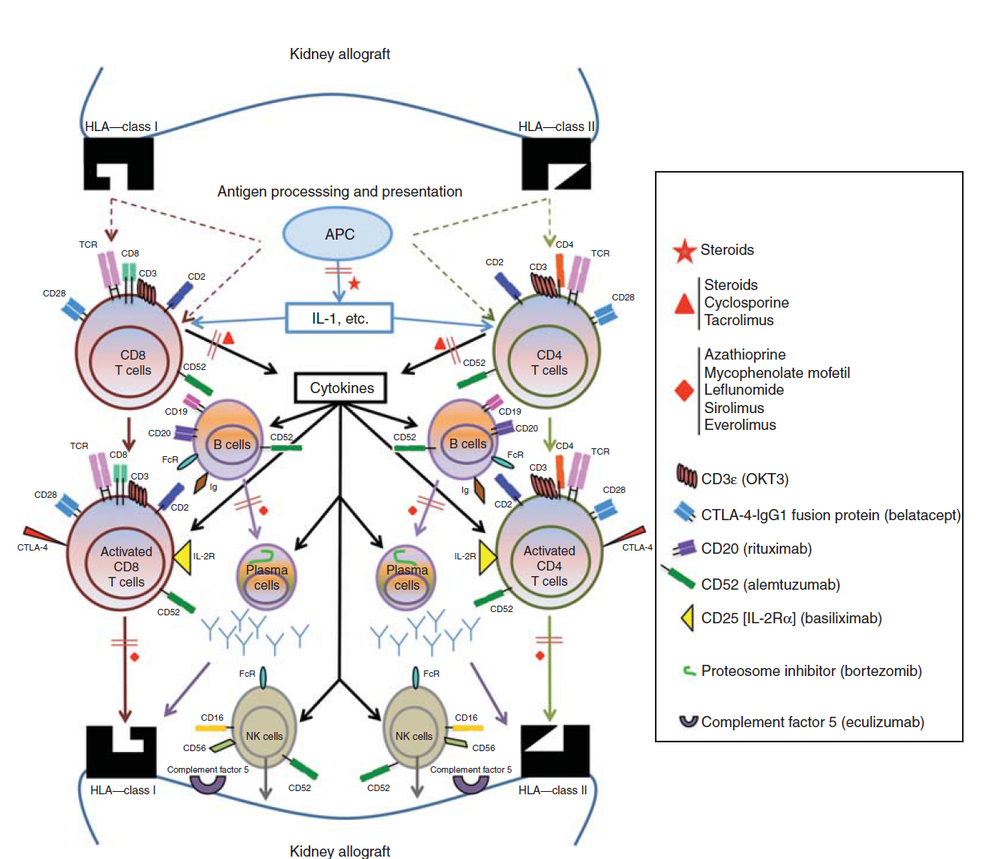


Slide 5
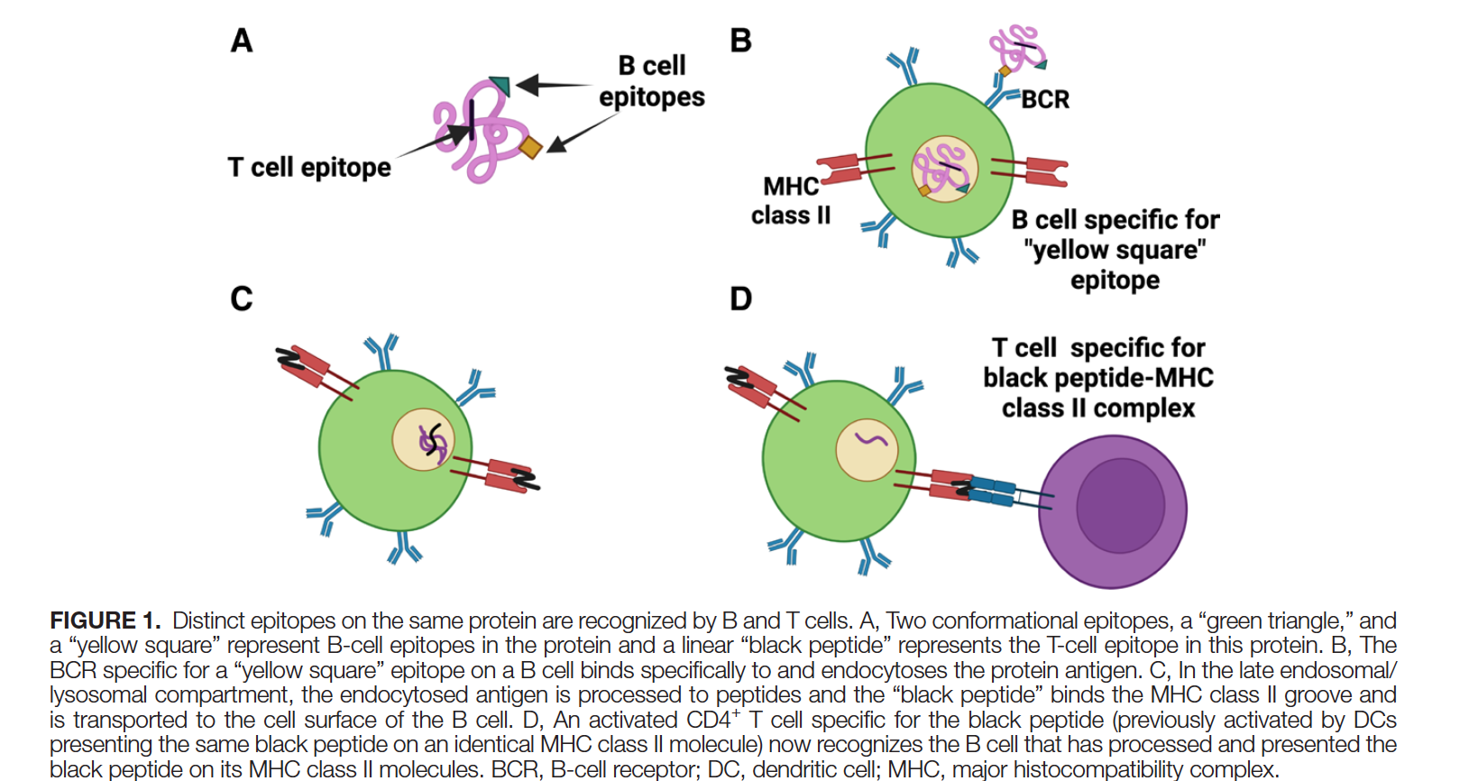

Slide 6
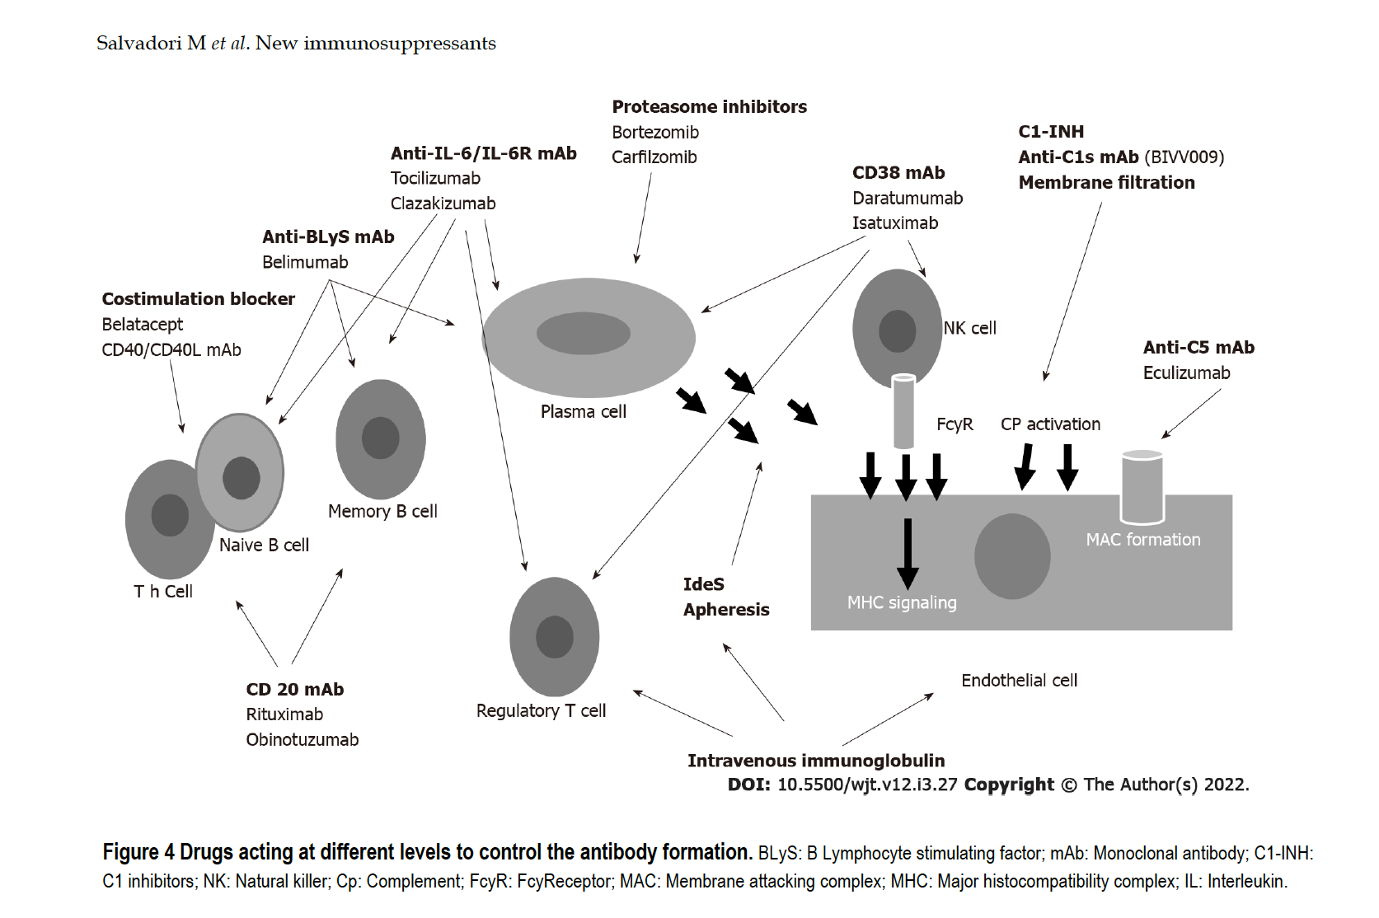

Slide 7
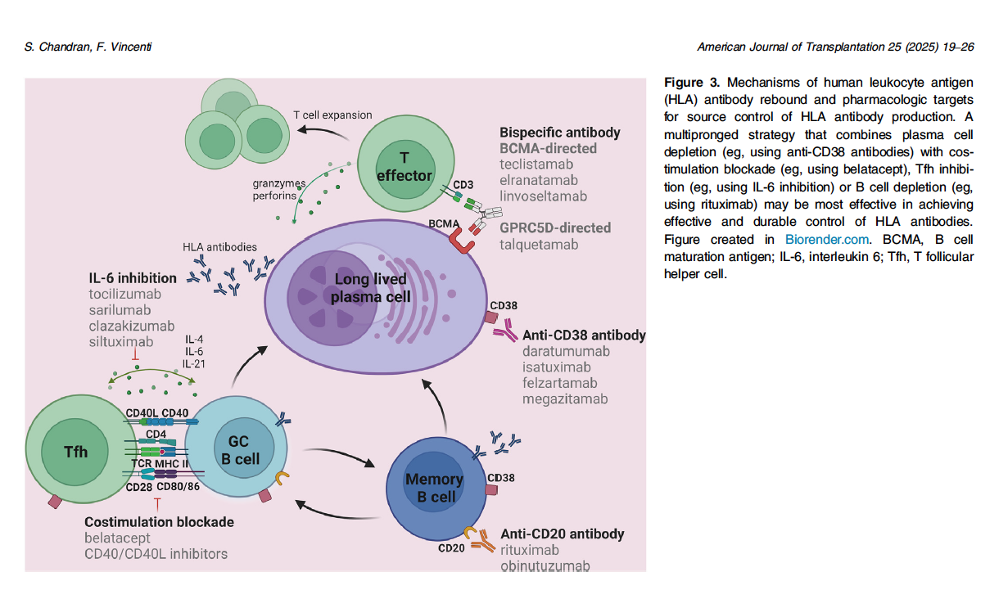


Slide 8
Classification of immunosuppressive drugs
used in organ transplantation
Inhibitors of T-cell dependent response
signal 1 inhibitors
Glucocorticosteroids (GS): methylprednisolone, prednisolone, prednisone
Calcineurin inhibitors: cyclosporine A, tacrolimus, tacrolimus MR,
tacrolimus LCP, voclosporine (registered in lupus nephropathy class III, IV)
  signal 2 inhibitors
  Co-stimulation inhibitors: anty- CD80/86 (belatacept)
  Signal 3 inhibitors
  early signal 3 inhibitors (mTOR i) – sirolimus, everolimus
  late signal 3 inhibitors – mycophenolate mofetil, mycophenolate sodium, azathioprine
  Biological agents
  anty-thymocyte globulin, anty –CD52 (alemtuzumab), anty-IL2-R (basiliximab)

Slide 9
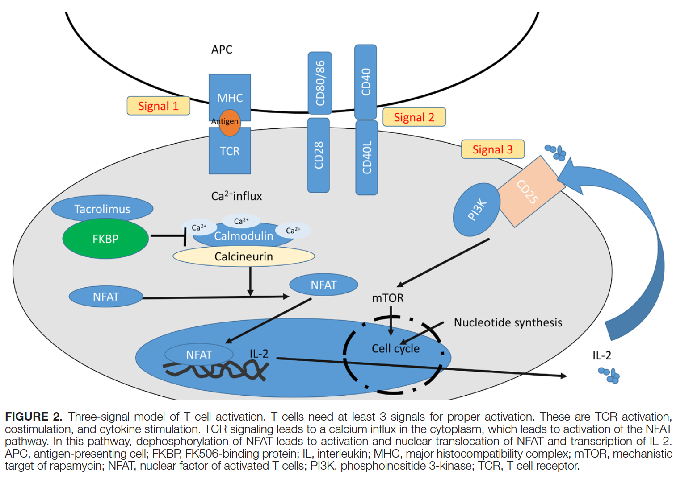

Slide 10
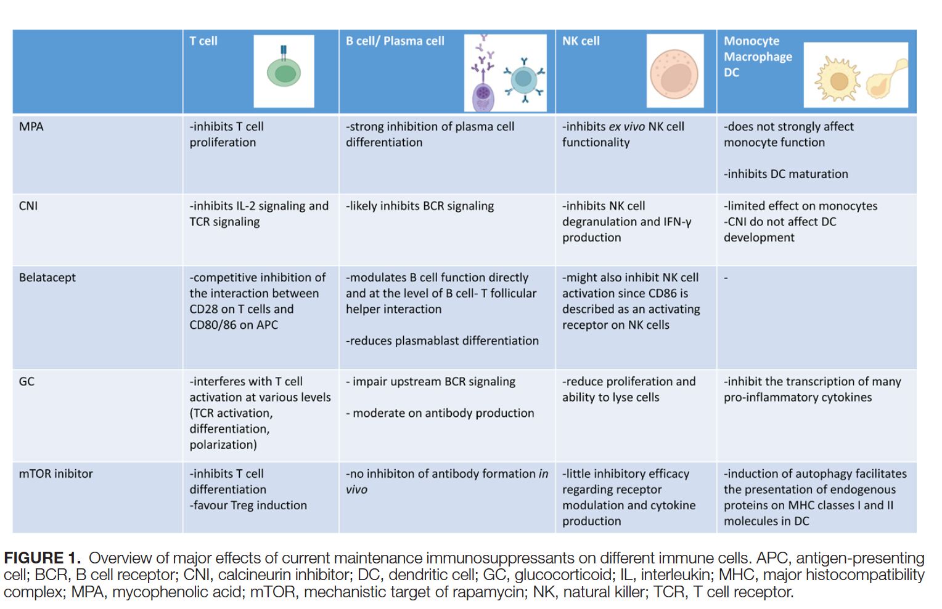

Slide 11
Classification of immunosuppressive drugs used in organ transplantation
Inhibitors of antibody mediated response (off label)
B-cell depleting drugs: anty-CD20 (rituximab, belimumab, obinutuzumab)
Plasmocyte depleting drugs : bortezomib, carfilzomib, anty-CD38 (daratumumab)
Complement inhibitors: anty-C1 esterase inhibitor, anty-C1 s (sutimlimab), anty-C5a (eculizumab, ravuizumab)
IL- 6 inhibitors: clazakizumab, tocilizumab
IVIG
Plasmapheresis
Imlifidase (IdeS)

Slide 12
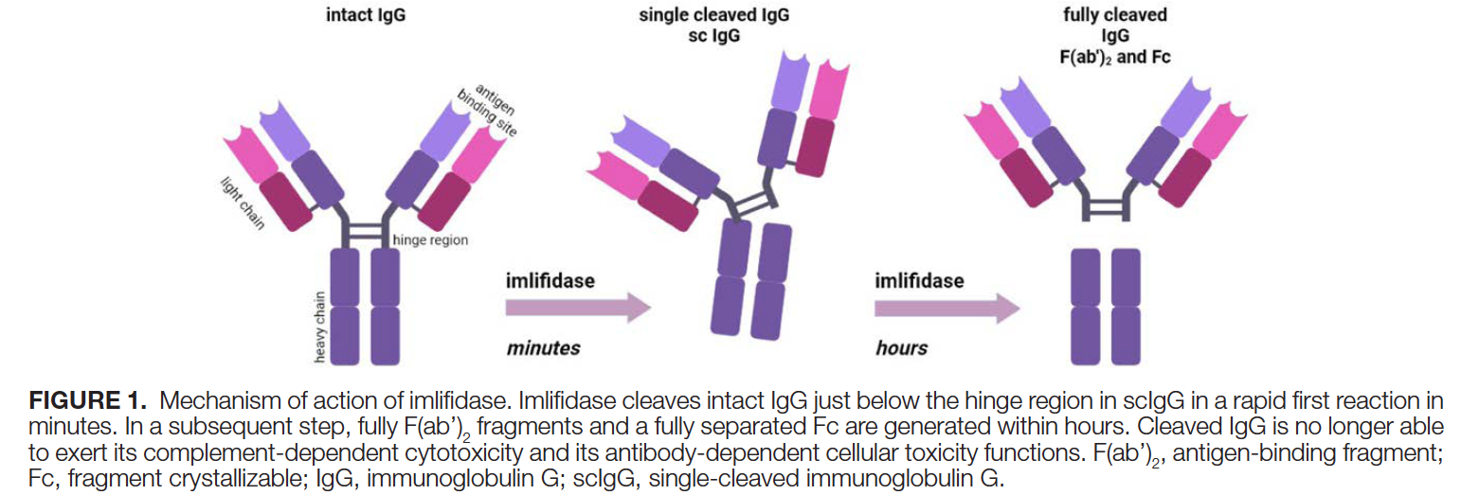

Slide 13
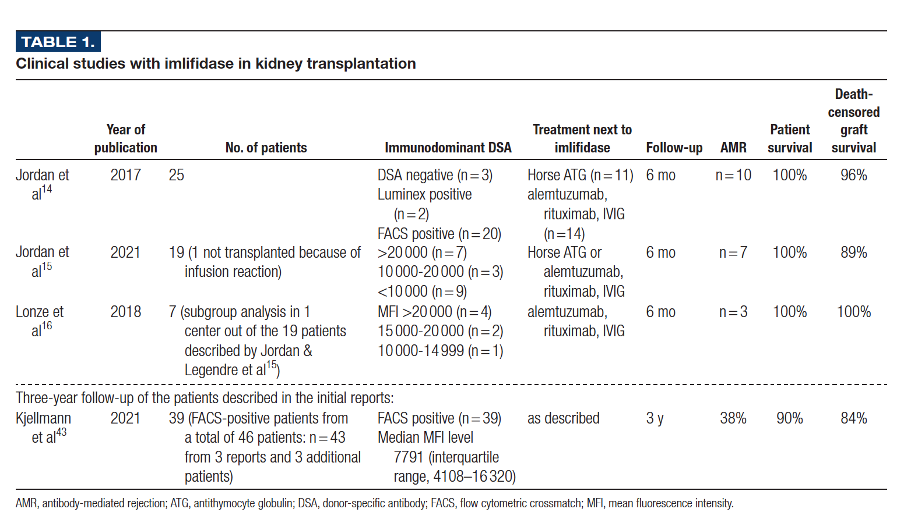

Slide 14
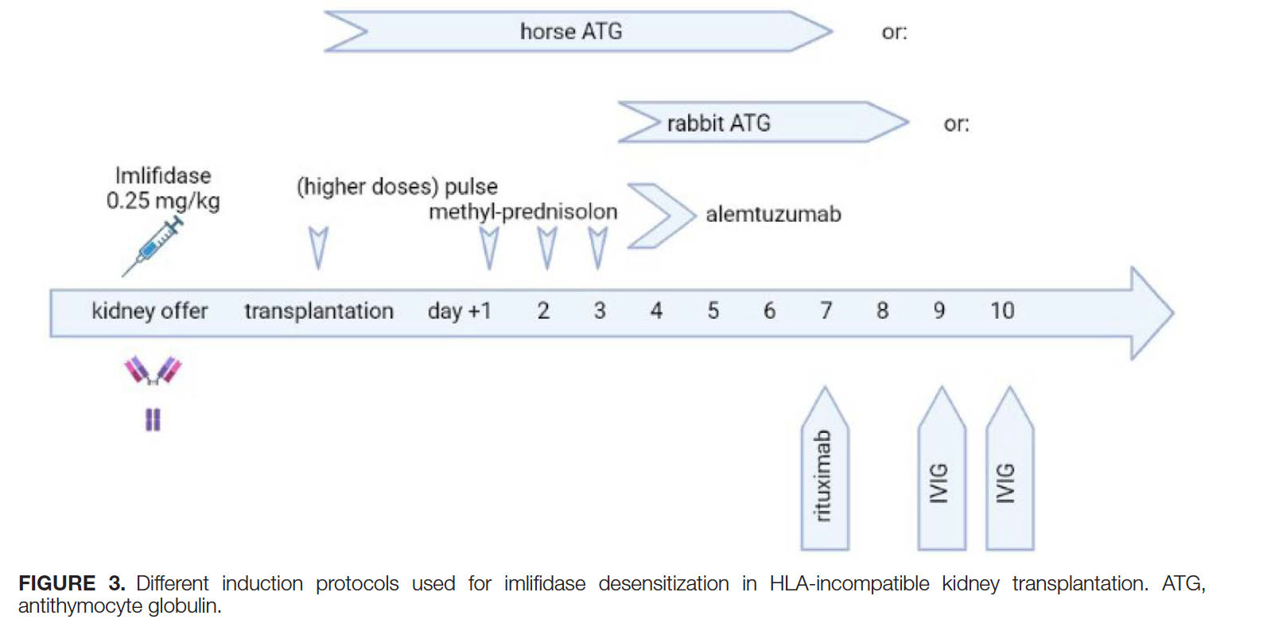

Slide 15
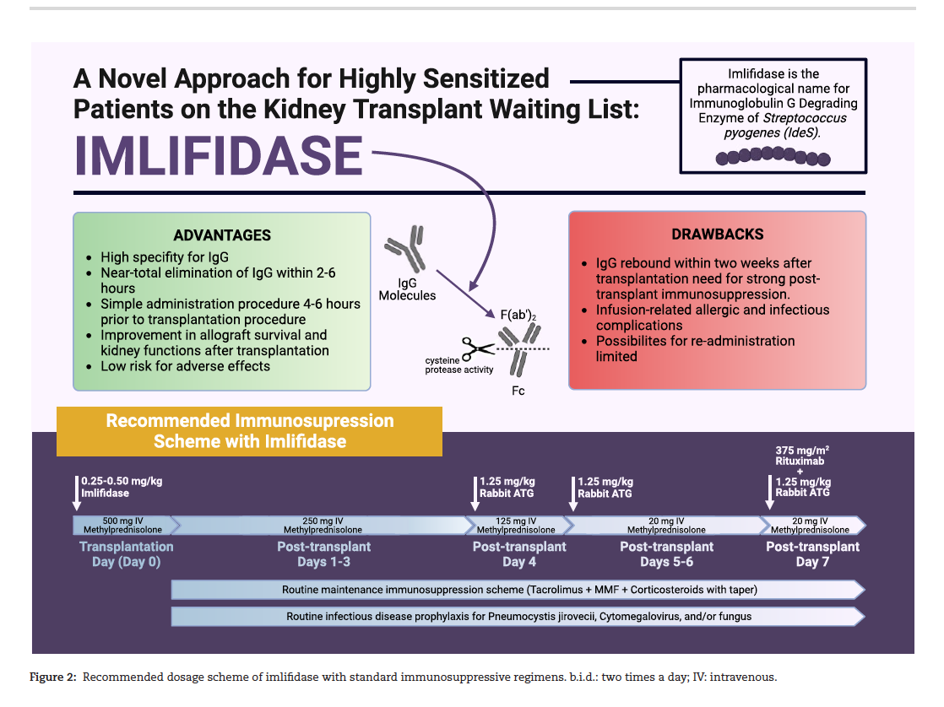

Slide 16
Historical Development of
Immunosuppressive Regimens
1954 First kidney transplantation across identical twins
1958/9 Irradiation
Appr. 1960 Oral Corticosteroids
1962 6-mercaptopurine, azathioprine (AZA), Imurane®
1963-78 Antithymocyte globulin (ATG, adjuvant to AZA+steroids (KTx)
1978 Cyclosporine (Sandimmun®)
1982 Cyclosporine + prednisone
1985 Cyclosporine + steroids + AZA (triple therapy)
1985-9 Triple therapy+ Antithymocyte globulin ALG for rejection)
1990 on Optimal regimen varies: typically triple +/-ATG
1994 Tacrolimus (Prograf®) + steroids + other regimens (tacrolimus MR 2008)
1995/6 Mycophenolate mofetil (Cellcept®) replaces AZA
        Cyclosporine (Neoral®) replacesCyA Sandimmune®
1998 Basiliximab (Simulect®)
1998/9 Daclizumab humanised antibody (Zenapax®) - withdrawn
1999/2000 Sirolimus, rapamycin (Rapamune®)
2002/3 Mycophenolate natrium (Myfortic)
Everolimus (Certican®)
Belatacept
Tacrolimus LCP (Envarsus)
2021 Imlifidase (IdeaS)
Off label anty-CD20 (rituximab), anty-CD52 (alemtuzumab), anty-C5 (eculizumab), bortezomib, anty-CD38 (daratumuma
Notes:
Irradiation- Bestrahlung
Aza- non specific inhibition of cell proliferation by alcylating DNA precursors. IS efficacy is moderat but enormous myelotoxic with possible inhibition of non specific immun response (bone marrow depression with leukopenia and thrombocytopenie). Aza is mutagenic and can lead to severe pancreatitis. Dosage is by body weight. Side effects are monitored by monitoring myelotxicity with aspired Leukocytes 4000- 6000 / nl. Indication is as well induction as maintenance therapy.
CS- especially used are Prednisolon and Methylprednisolon are common since appr. 1960. They act by their antiinflammatory activity by inhibition of Phospholipase 2. The also inhibit the formation of different Zytokines and so inhibit the interaction between T- Lymphocytes and antigen- presenting cells. They are used for induction as well as for maintenance therapy.
ATG- polyclonale Antibodies against lyphocytic antigenes. They are obtained from rabbits or horses. They are used for induction and rejection therapy. ATG is dosed by body weight. The IS effect is quite non- specific, but side effects are limited to the Immune system (e.g. Infections). But on the other hand because of antibody formation also the IS effect ist limited by time.
A real break through was the development of Cyclosporin CsA is an cyclic peptid and inhibits the generation of IL-2 by inhibiting the Calcineurin- Calmodulin- Complex. CsA is used for induction as well as for maintenance therapy. CsA is dosed by patients body weight. The blood levels have to be monitored very carefully. This is not that easy as it looks like. Because of the pharmacokinetic profile of CsA the blood level monitoring is 2 hours after intake of the medication. It is metabolized via CYP system in the liver and therefore is good for a lot of pharmacological interactions with many other drugs, which are important for Tx pts. (like antifungals, antibiotics etc.) CsA is nephro- and neurotoxic. Other common side effects are hyptertonia, hyperlipidaemia, hirsutism, gingivahyperplasia, osteoporosis. CsA is given twice daily.
Tacrolimus- is chemically a macrolid. The mode of action is similiar to CsA. Both are CNI´s but differ in some features, which we will discuss later on. Tac is 10- 100 times more efficious compared to CsA. Tac is used for induction as well as for maintenance therapy AND also sucessfully for the therapy of rejections. Tac is given twice daily. For therapeutic monitoring with Tac so called „Trough levels“ are used.

Slide 17
Principles of immunosuppressive treatment
Combined
More intensive in the early posttransplant period („induction”)
Duration: till the end of the graft function
Reduction in case of life threatenting:
  opportunistic infections
  lymphoproliferative disorders, malignancy
Reduction in BK nephropathy
Pregnancy – MPA (CellCept, Myfortic), PSI (Rapamune, Certican) contraindicated (teratogenicity)
Trends:
  individualisation
  GS withdrawal
  efforts to minimize CNI nephrotoxicity

Slide 18
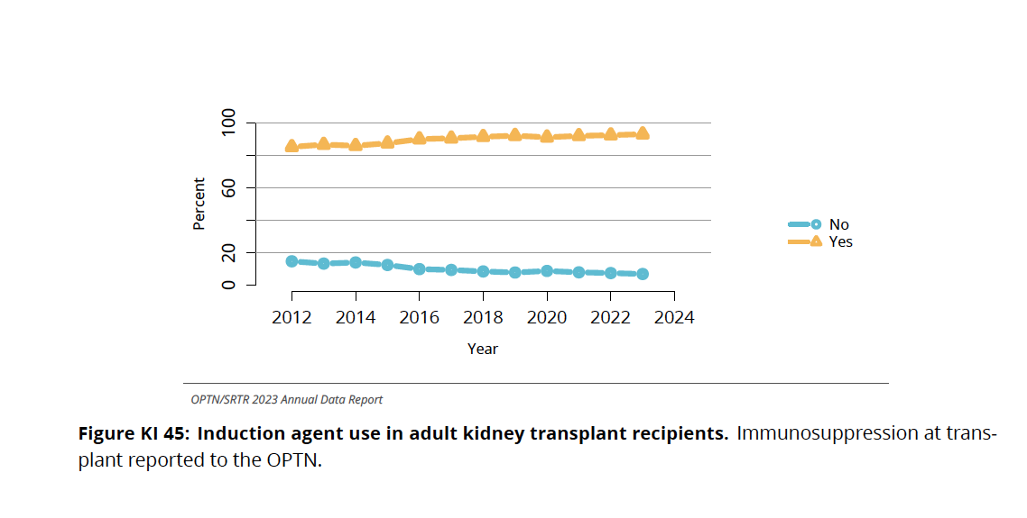
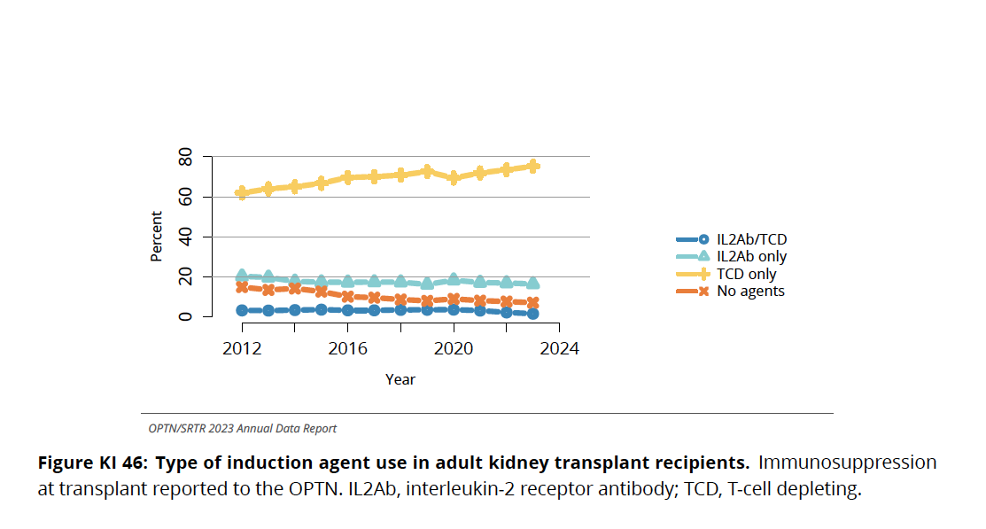
OPTN Registry 2024

Slide 19
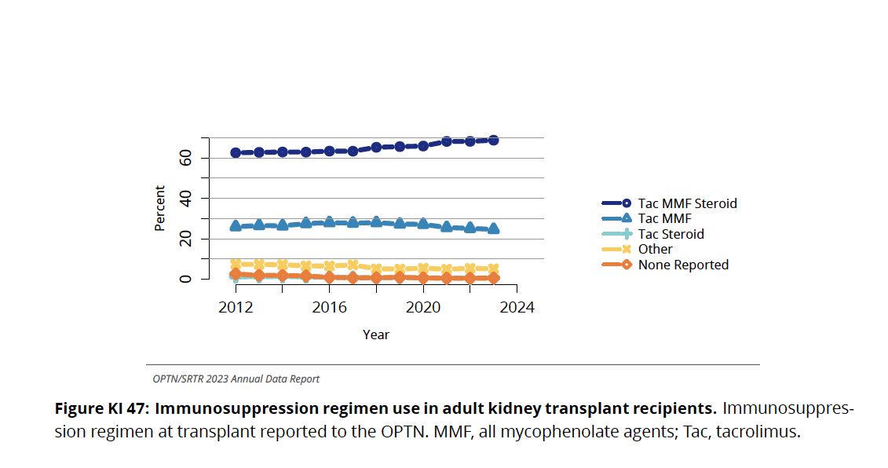
OPTN Registry 2024

Slide 20
OPTN Registry 2024

Slide 21
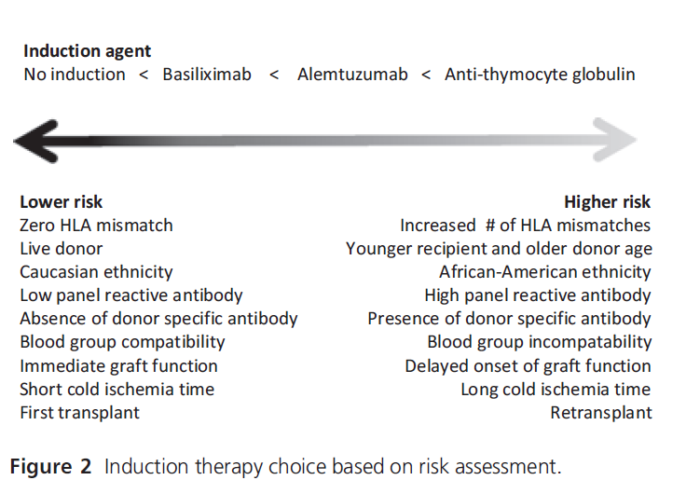
Induction therapy

Slide 22
Indication for induction therapy with antibodies - cont
Risk level | MFI | Description | Polyclonal Antibodies (ATG) | Monoclonal anty-CD25 IL-2R
I | Anty-HLA not detectable | Standard risk of rejection | not recommended | decision to give induction depends on other factors
II | DSA <2000 | Low risk of hiperacute rejection (HR), but higher than in standard risk | to consider for retransplants and loss of previous graft in the course of AMR | indicated if there are no risk factors in the previous column
III | DSA 2000-5000 | Low risk of HR, but high risk of early AMR or in previous tissue typing XM CDC positive | indicated
IV | DSA >5000 | Contraindication for transplantation, patient waits for another donor (with different HLA)
MFI – mean fluorescence intensity, DSA – donor specific antibodie,
AMR – antibodies dependent rejection , XM CDC – complement dependent cytotoxicity

Slide 23
Immunosuppressive schema
Maintenance immunosuppression:
Tac/CsA + MMF/MPS and/or mTOR inhibitor or Aza or mTOR + GS
Potency of immunosuppressive action:
TAC/TAC MR/LCPT > CsA > SIR = EVERL= MMF/MPS > AZA

Slide 24
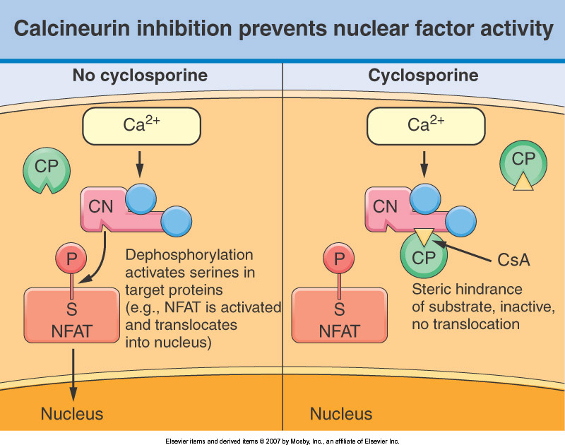
Carrier protein – cyclophlin alone
Cyclophilin/CsA
complex
Calcineurin
No dephosphorylation
Activation of IL-2, IFN-y… genes
Inhibition of IL-2, IFN-y..genes

Slide 25
Cyclosporine A (CsA)
Structure - cyclic polypeptide
Absorption: variable, depends on diet and bile production
Metabolism: cytochrom P450- CYP3A4; 15 metabolites
Excretion: in bile, T1/2 6,3 - 20,4h
Narrow therapeutic window, high intra-, interpatient variability - repeated laboratory monitoring of through (C0) or C2 CsA blood level is required
Dosage: oral - 8-10mg/kg/d in 2 doses (first doses greater),
i.v.- 1/3 oral dose

Slide 26
Cyclosporine A - adverse reactions
1. NEPHROTOXICITY:
dose - related, reversible renal vasoconstriction → GFR decrease
interstitial fibrosis, artheriolopathy
hemolytic-uremic syndrome (HUS)
electrolyte abnormalities (hyperkalemia, hypomagnesemia), hyperuricemia (gout)
2. HEPATOTOXICITY
3. NEUROTOXICITY - tremor, seizures
4. gingival hyperplasia
5. hirsutism
6. hypertension, hyperlipidemia, diabetes
7. thrombembolic events

Slide 27
Tacrolimus
Macrolide antibiotic isolated from Streptomyces tsukubaensis
Used in maintenance immunosuppressive therapy, acute rejection, 10-100x more potent than CsA (greater affinity of the FK-FKBP12 complex for calcineurin)
Absorption independent of bile, variable: 4-63% (mean 20%), meal reduces bioavailability by 25%, drug should be administered 1 hour before or 2 hours after a meal
Erythrocytes/plasma 20: 1; in plasma 98% with albumin, alfa 1 AGP
tmax 0.5-8 h, average 2 h, Cmin - good drug exposure index, saturation 4-8 weeks after transplantation
Narrow therapeutic window, high inter-, intra-individual variability - drug concentration monitoring
Dose orally form 0,17- 0.20 mg /kg/day; if i.v. - 20-30% of the oral dose
metabolism - cytochrome P450 CYP3A4, CYP 3A5 mainly hydroxylation, demethylation in liver (much less dependent on CYP3A4 in the intestine, gp 150)
Elimination: Bile> 90% (mainly as metabolites, <2% in urine)

Slide 28
Molecular mechanism of action of tacrolimus
Mode of Action
Antigen presenting cell
Activated
TCR/CD3
Peptide +
MHC-II class
B7
CD28
Helper T cell
ZAP70
IP3
PKC
Ca²⁺
Ras/GAP?
PLCg1
DAG
Raf/MEK?
Calcineurin
FKBP12
(FKBP12- carrier protein)
Activation
Tacrolimus
Inhibition
MAPK
NF-AT c/p
NF-AT c/p
P
P
P
Jun
Fos
Jun
Fos
NF-AT c/p
CD28RC
(Nucleus)
CD28RE
IL-2
NF-AT

Slide 29
Calcineurin inhibitors and mTOR inhibitors interactions (2)
Drugs increasing CI and mTORi concentrations (inhibition of cytochrome P 450):
large doses of corticosteroids
ketoconazole, fluconazole, itrakonazol, posiconazol, voriconazol
verapamil (Isoptin), diltiazem (Dilzem)
erythromycin, clarithromycin
Metoclopramide
Grapefruit juice

Slide 30
Calcineurin inhibitors and mTOR inhibitors interactions (3)
Drugs decreasing CI and mTORi concentration (induction of cytochrom P 450):
rifampin
phenytoin
phenobarbitol
carbamazepine
octreotide
ticlopidine
St. John's wort

Slide 31
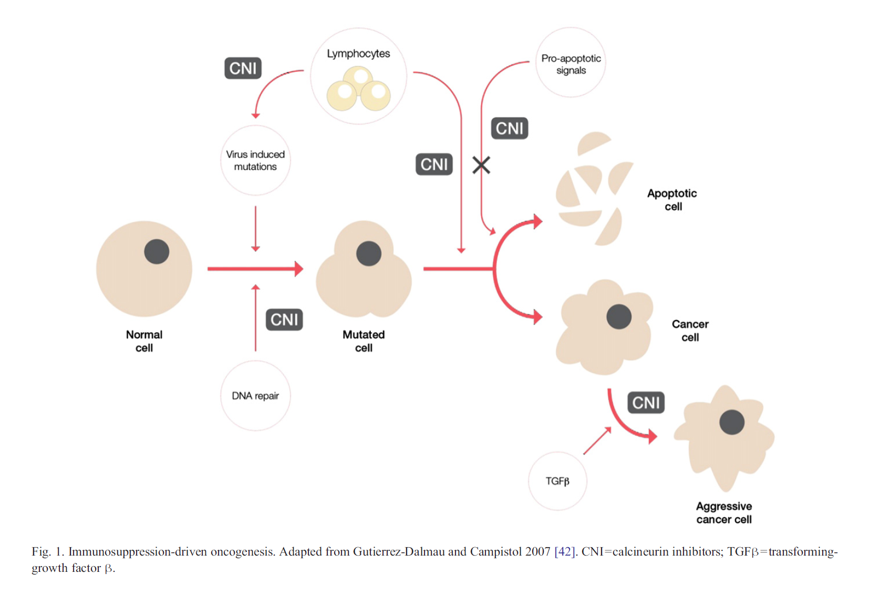
CNI - carcinogenesis

Slide 32
Side effects CsA tacrolimus
Nephrotoxicity ++ ++
Neurotoxicity + ++
Hypertension ++ +
Postrtransplant diabetes + ++
Hyperlipidemia ++ +
Hiperurycemia ++ +
Alopecia + / - ++
Hirsutism ++ + / -
Gingival hyperplasia ++ + / -
HUS ++ +
Hyperkaliemia ++ ++
Hypomagnezemia ++ ++
Hepatotoxicity ++ +
Gastric complications + / - ++

Slide 33
New calcineurin inhibitors
MR-4 (Advagraf) - once a day, 1:1 conversion AUC 20% lower than “standard” tacrolimus
Tacrolimus-LCP (Envarsus) - once a day, 1:1 conversion AUC 15 - 20% higher than “standard” tacrolimus
Voclosporine - CsA derivative - off label)
Generics formulae of CsA, tacrolimus (Equoral)

Slide 34
Cyclosporin | Tacrolimus | Voclosporin
Neoral 2x 5 mg/kg Co 200-300 ng/mL C2 1000-1500 ng/ml | IR 2x0,1 mg/kg Co 12-15 ng/ml – 1.szy miesiąc Co 8-12 ng/mL 1-2 msc 5-10 ng/mL 3-12 msc >12 msc 5-8 ng/mL | 2x 23,7 mg
IV 2 mg/kg – infusion 2-6 h max C 250 ng/ml | MR-4 Before Tx 0,1 mg/kg 1x0,2 mg/kg C0 12-15 ng/ml
 | LCP Before tx 0,09 mg/kg 1x0,17 mg/kg.m.c (1x0,14 mg/kg) C0 12-15 ng/mL
 | IV 0,03 mg/kg.m.c – infusion

Slide 35
Mycophenolate mofetil (MMF)- CellCept
Mycophenolate sodium (MPS) - Myfortic
derivative of mycophenolic acid (MPA)
mechanism of action:
1. MPA selectively inhibits inosine monophosphate dehydrogenase (IMPDH) in de novo pathway of purine synthesis, producing potent cytostatic effects on T and B lymphocytes
2. inhibits antibodies and smooth muscle cells synthesis
CellCept: 50% reduction of first acute rejection episodes
dosage: 2 x 1,0 g
contraindication: pregnancy
adverse reactions: diarrhea, leukopenia, vomiting
Increased risk of infections (oportunistic)
monitoring: WBC, (therapeutic drug monitoring non obligatory)

Slide 36
MMF/MPS (MPA) - mechanism of action
Rybozo-5P
RNA
PRPP
synthetase
glicoprotein
synthesis
MPA – mycophenolic acid
GTP
PRPP
IMPDH
GMP
Xanthosine-monoP
Inosine-monoP
de novo
dGDP
xanthosine
inosine
PNP
dGTP
xanthine
hipoxantine
DNA

Slide 37
Azathioprine (Imuran)
mechanism of action:6-MP is antimetabolite, which interferes with DNA and
RNA synthesis → inhibition of lymphocytes T and B proliferation
  contraidication: hypersensitivity
  adverse reactions: leukopenia, thrombocytopenia, anemia
  hepatotoxicity
  nausea and vomitig
  alopecia
  interactions: ALLOPURINOL - (xantine oxidase!), ACE-I - agents affecting myelopoesis (myelotoxicity!!!)
  dosage: 1-3mg/kg/d, WBC monitoring

Slide 38
GS- mechanism of action
GS with transcortin)
Free GS
cytoplasm
Hsp90, Hsp70, Hsp56
Hsp90, Hsp70, Hsp56
GRE
(-)
IL-1, Il-6, TNF-a
transcortin
nucleus
GS
Modulative domene
Hormon ligand
(-) Il-3, IL-4, IL-13, GM-CSF, IL-2
GRE

Slide 39
Glucorticosteroids - adverse reactions
emotional liability, insomnia
peptic ulcer disease
cataracts
}atherosclerosis
cushingoid facies
growth suppression in children
osteoporosis
aseptic necrosis of bone
hypertension ------------------------
diabetes------------------------------
hyperlipidemia----------------------
obesity
impaired wound healing
acne

Slide 40
Glucocorticosteroids (GS)
prednisolon (Fenicort i.v. Solupred p.o.)
prednison = 11-keto metabolite of prednisolon (Encorton p.o.)
metylprednisolon (Solu-Medrol i.v., Medrol, Metypred p.o)
Day 0: 250 mg methylprednizolon
Day 1: 250 mg methylprednizolon
Day 2 125 mg methylprednizolon
> day 2 0,5 mg/kg prednisone
slow reduction of dose to 7,5 – 5 mg after 3 months
► ► ►PREVENTION OF ADRENOCORTICAL FAILURE: STRESS, ANAESTHESIA, VOMITING….etc,
▶︎▶︎▶︎ PLEASE administer GS intravenously!!!

Slide 41
PSI (mTOR inhibitors): sirolimus, everolimus
Chemical structure: macrocyclic antibiotics
Mechanism of action: form a complex with immunophilin FKBP (but does not inhibit calcineurin) and block growth factor-driven cell proliferation → inhibition of lymphocyte proliferation (G1 → S inhibition)
Synergism with CsA and Tacro, ½ dose of CNI!
Side effects: thrombocytopenia, leucopenia, anemia, hyperlipidemia, lymphocele, impaired wound healing, HUS, diabetes, proteinuria, edema, pulmuno-toxicity, mouth ulcer, infertility, teratogenicity

Slide 42
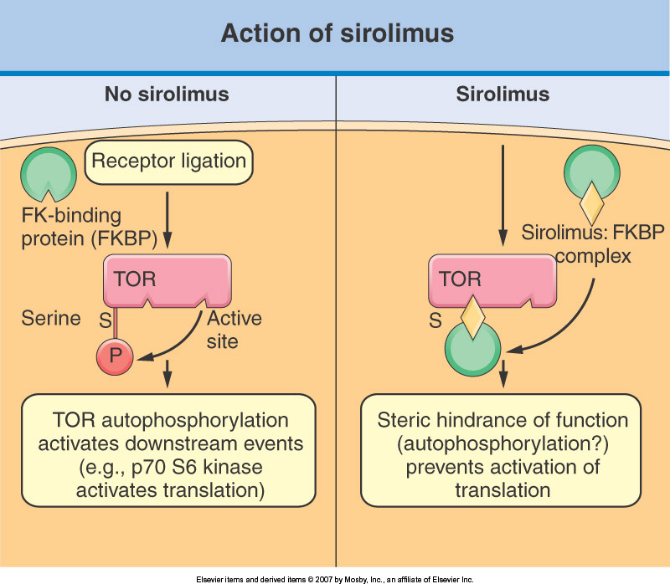

Slide 43
PSI (mTOR inhibitors): sirolimus (Rapamune), everolimus (Certican)
Monitoring:
  whole blood level
  WBC
  serum lipids
Sirolimus - T1/2 = 62h → 1x/24h, check blood level min. 7 days after dose changing
Everolimus T1/2 = 26h → BID, check blood level min. 5 days after dose changing
Metabolism: liver, jejunum (cytochrom P450 CYP3A4, gp130) → interactions
Decreased incidence of malignancy, antitumor activity

Slide 44
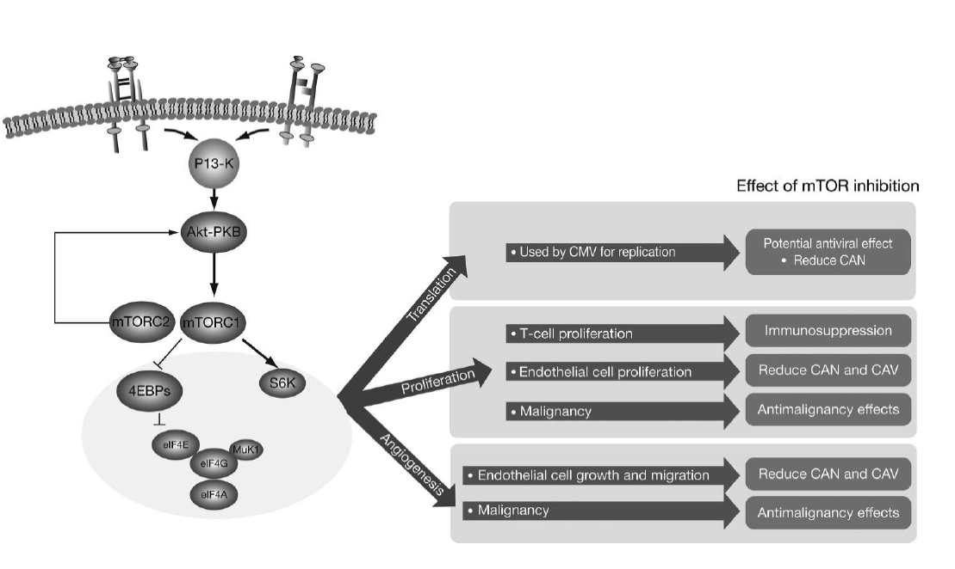
mTOR - pleiotropic mechanism of action
CAN
(chronic allograft
nephropathy)
CAV
(chronic allograft
vasculopathy)

Slide 45
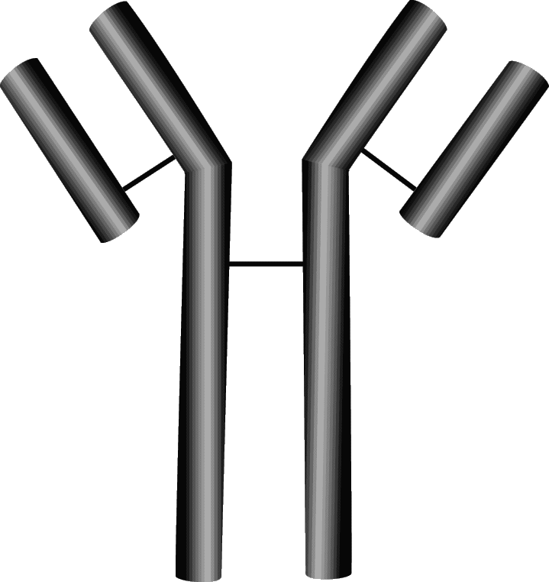
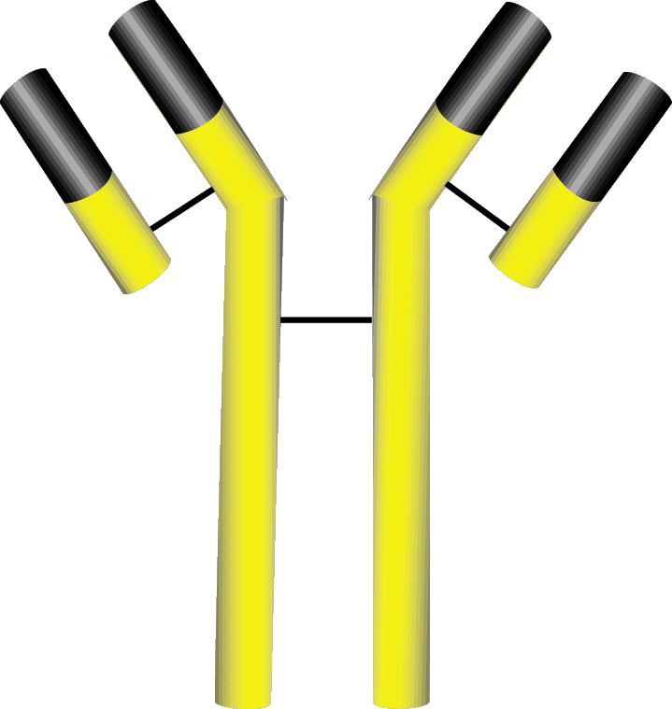

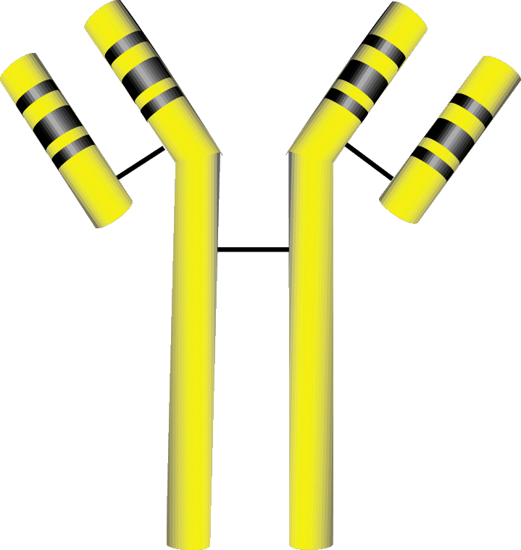
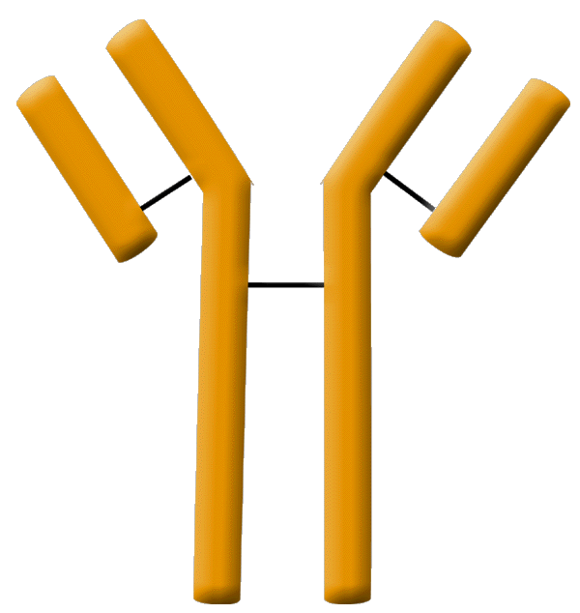
Types of antibodies
Murine
Human
Rabbit
anti-CD3
(monoclonal)
anti-CD25 (anti-IL2R) - basiliximab
(chimeric monoclonal)
antiCD25 (anti-IL2R) - daclizumab
(humanised monoclonal)
ATG
(polyclonal)

Slide 46
Polyclonal antibodies antithymocyte globulin (Thymoglobuline/Grafalon)
Production: immunisation of rabbits with
human lymphocytes
Mode of action:
        1. lymphocytes are lysed or cleared into the reticuloendothelial system
        2. their surface antigens may be masked by the antibody
Administration: 1. premedication with GS, metamizole, antihistaminic
2. slow infusion i.v. - central line (min. 4 hours infusion)
Duration of treatment: 3-14 days
Indication: 1. prophylaxis of rejection (high immunogical risk, GS/CNI avoidance/reduction)
2. treatment of acute severe or steroid-resistant rejection
3. Tolerogenic properties?
Monitoring: WBC, CD3 (20/mm3)

Slide 47
Polyclonal antibodies - adverse reactions
fever, chills
leukopenia, thrombocytopenia
Hemolysis
phlebitis, clotted A/V fistula
Anaphylaxis
other risk:
1. opportunistic infection (CMV, EBV)
2. neoplasm, lymphoproliferative disease

Slide 48
ATG - depletion of limphocytes T
Human Complement
(C1q…)
iC3b
Apoptosis
T Cell
T Cell
T Cell
Complement
cascade
FcR
CR3
Macrophage
CD14
CD36
a_{v}b3
PS-R
ABC-1
...
Membrane attack
complex
Macrophage
Opsonisation
Apoptosis
Lysis
Phagocytosis
Phagocytosis
Horse >rabbit
Rabbit > horse
Rabbit > horse

Slide 49
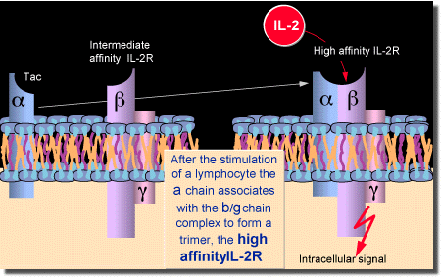
Anti - CD25 (anti- IL-2Rα) antibody
Mechanism of action:
IL-2Rα = CD25 - is expressed on activated lymphocytes
(IL-2 + IL-2Rα) => lymphocyte proliferation
anti- CD25 (anti-IL2Rα) is interleukin 2 antagonist
Types of antibodies and preparations:
1.chimeric - basiliximab (Simulect)
2.humanised - daclizumab (Zenapax) - withdrawn

Slide 50
Anti-IL-2Ra = anti-CD25
Indication: PROPHYLAXIS OF REJECTION
Tolerance: very good
Efficacy: high, but less powerful than ATG
Administration:
Basiliximab (Simulect): day 0 and 4th after Tx - 20mg iv

Slide 51
Acute rejection frequency
Aza+Pred 60%-80%
CsA+Pred+Aza 40-50%
CsA+Pred+MMF, C_{0 CsA} 25-30%
CsA+Pred+Rapa 25-30%
CsA+Pred+MMF, C_{2 CsA} 11%
Tac+Pred 30%
Tac+Pred+Aza 25%
Tac+Pred+MMF 20-8%
Tac+Pred+Rapa 20%
Rapa+Pred+MMF 35-40%

Slide 52
Treatment of acute T cell mediated rejection
(cellular) - ACR
pulse steroids 250-500mg i.v. for 3-5 days
Thymoglobuline, ATG-Grafalon
Indications:
1. acute vascular rejection moderate or severe
2. steroid resistant rejection
if UNSTABLE GRAFT FUNCTION:
Conversion from CsA -----> to Tacro
from Aza -----> to MMF (if not performed yet)
increase the dose of oral steroids

Slide 53
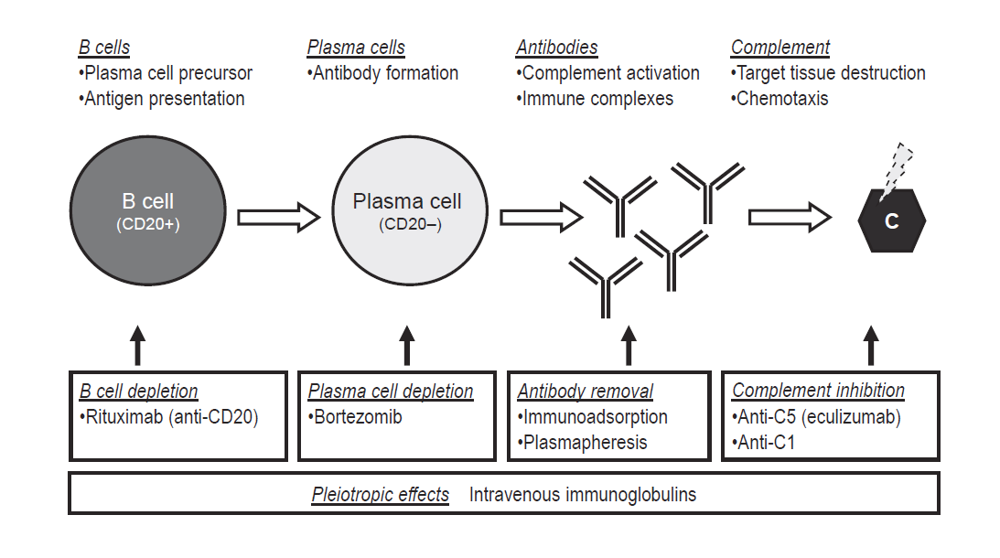
Antibody medated rejection (ABMR) - treatment
IL-6/IL-6R antagonists
Imlifidase
rivalizumab
Carflizomib, inflixomid
Belimumab,
obinutuzumab

Slide 54
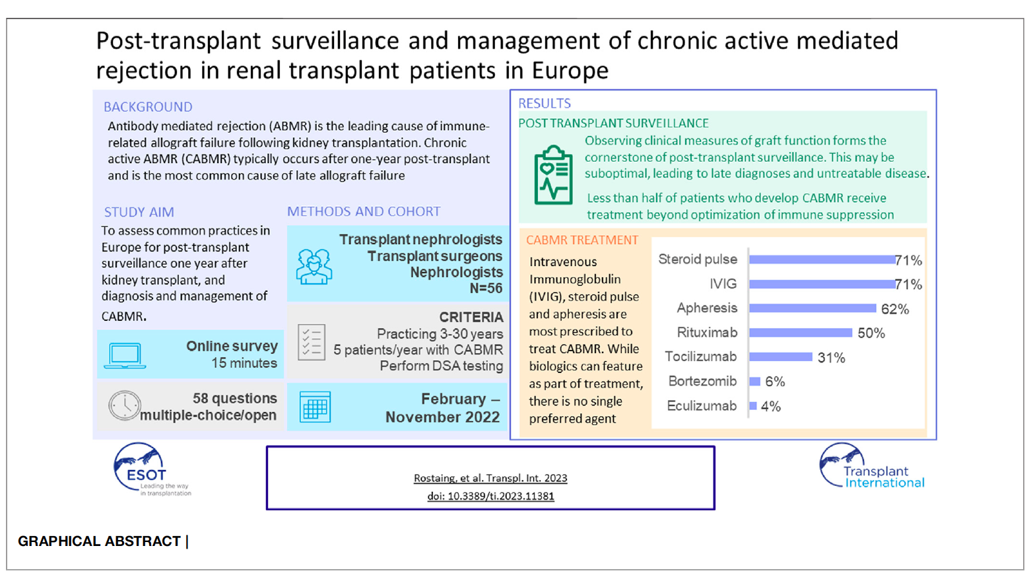


Slide 55
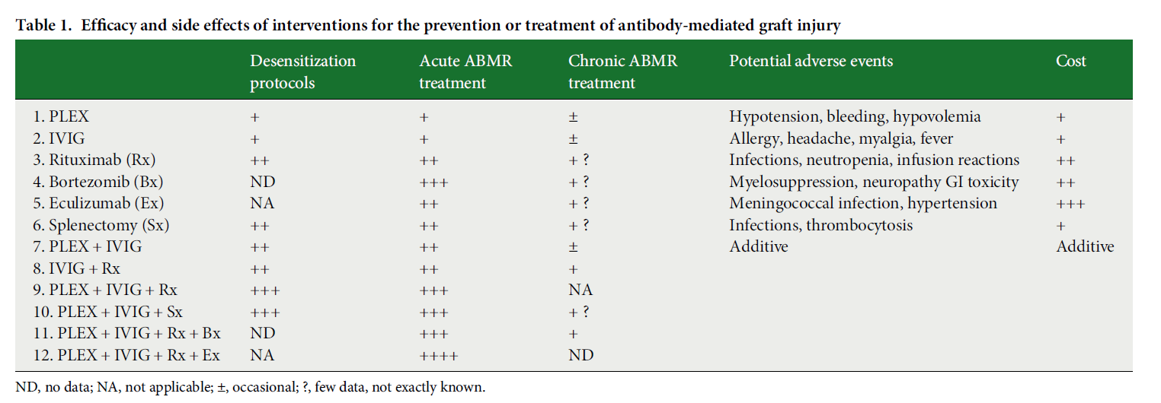
Treatment of acute and chronic antibody mediated rejection

Slide 56
New immunosuppressive drugs
Antibodies:
- B-cell-depending monoclonal anti-CD20 antibody (rituximab)
- humanized monoclonal anti- C5 antibody (eculizumab, Solaris)
- anty-CD80/86 (belatacept)
- anty IL-6 (tocilizumab)
Small molecule drugs
  Bortezomib (Velcade)
  Imlifidase (IdeS), clazakizumab

Slide 57
Anti-CD20 (RITUXIMAB)
Anty-CD20 – chimeric monoclonal anti-CD 20 antibody, selectively depletes B-cells
Prophylaxis, treatment of antibody-mediated rejection in patients at high immunological risk
ABOi transplantation or positive cross-match in living donor recipients
Side effects: high risk of infections (11.8%) and death related to infection disease (9.1%) in patients treated with rituximab (n=77) vs 1.55% in the control group (n=902); p= 0.0007
LEUKOENCEPHALOPATHIA, RALI (rituximab associated lung injury), cytokine release syndrome, leucopenia

Slide 58
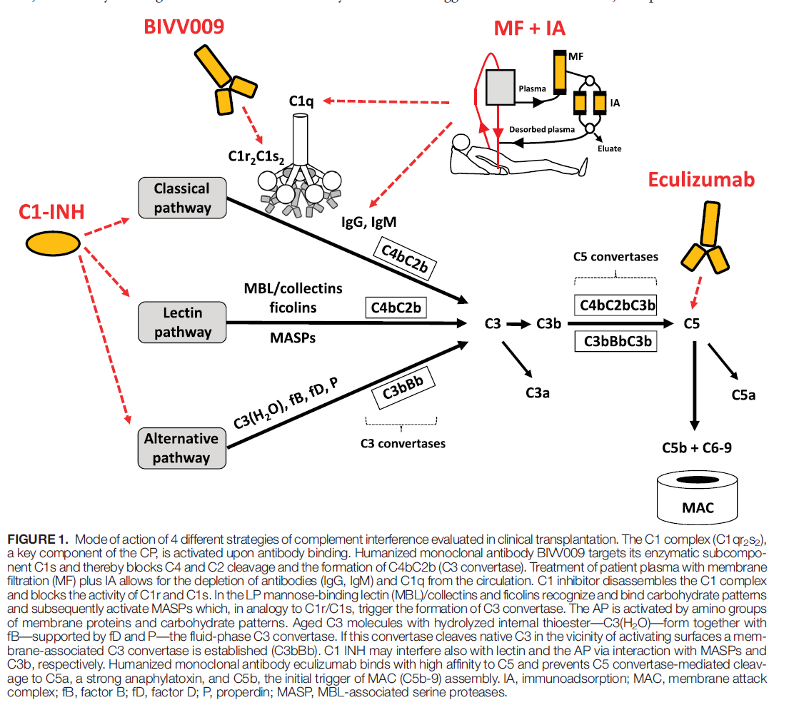
New complement suppressive strategies

Slide 59
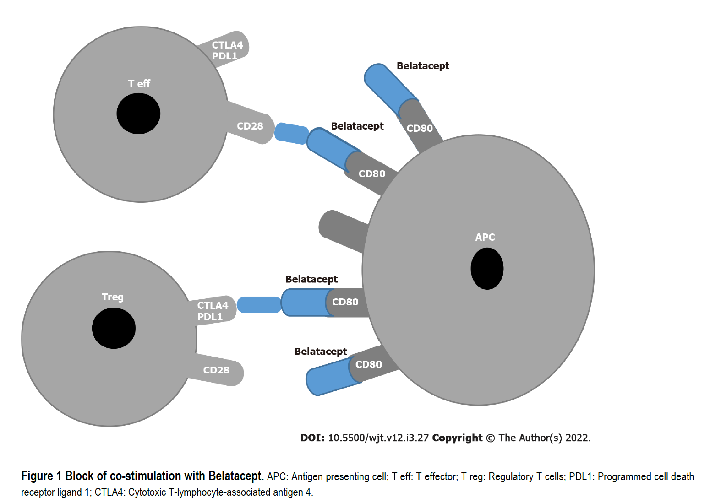

Inhibition of the costimulatory signal (signal 2)

Slide 60
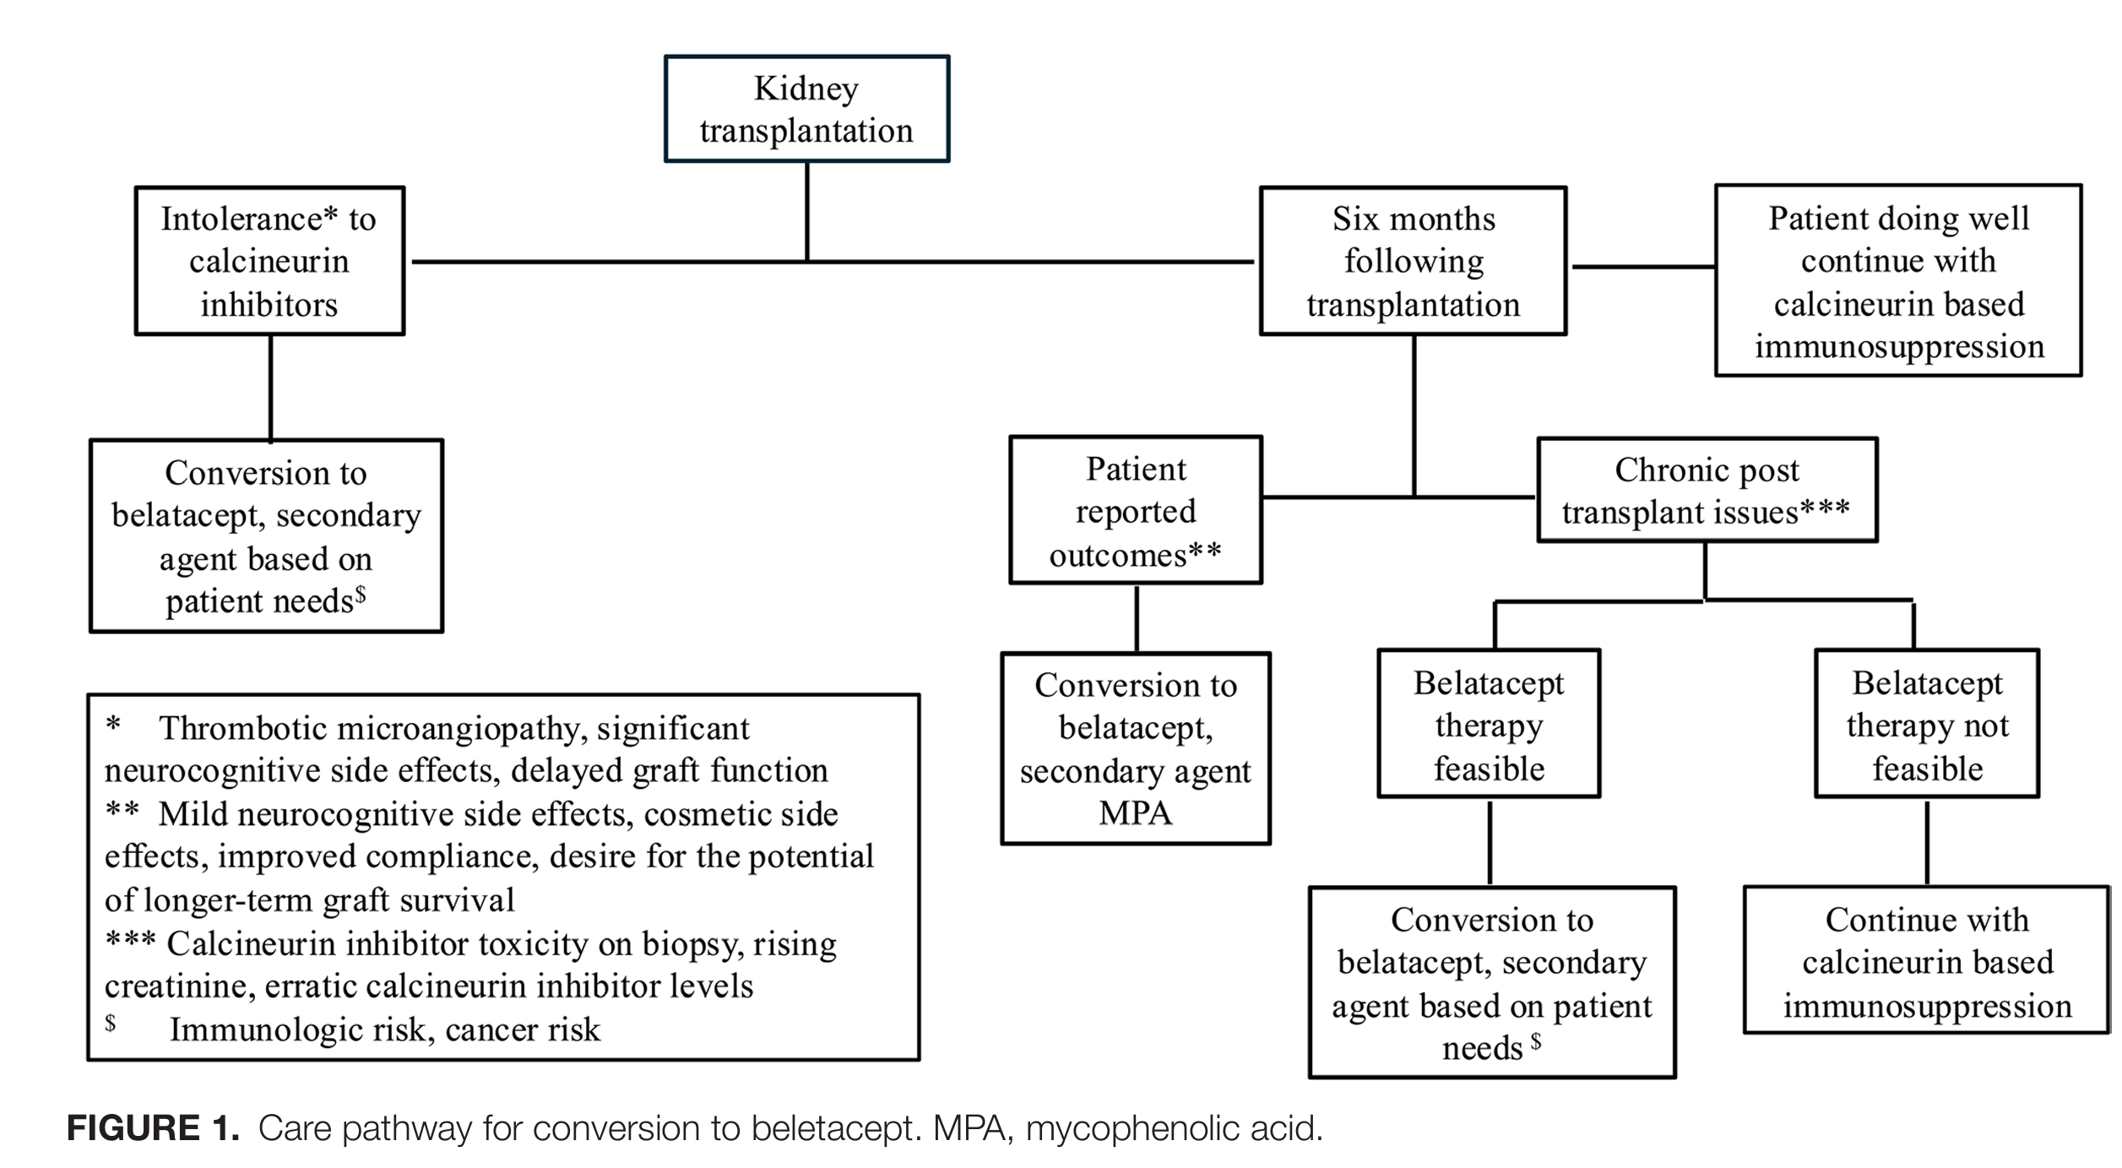


Slide 61
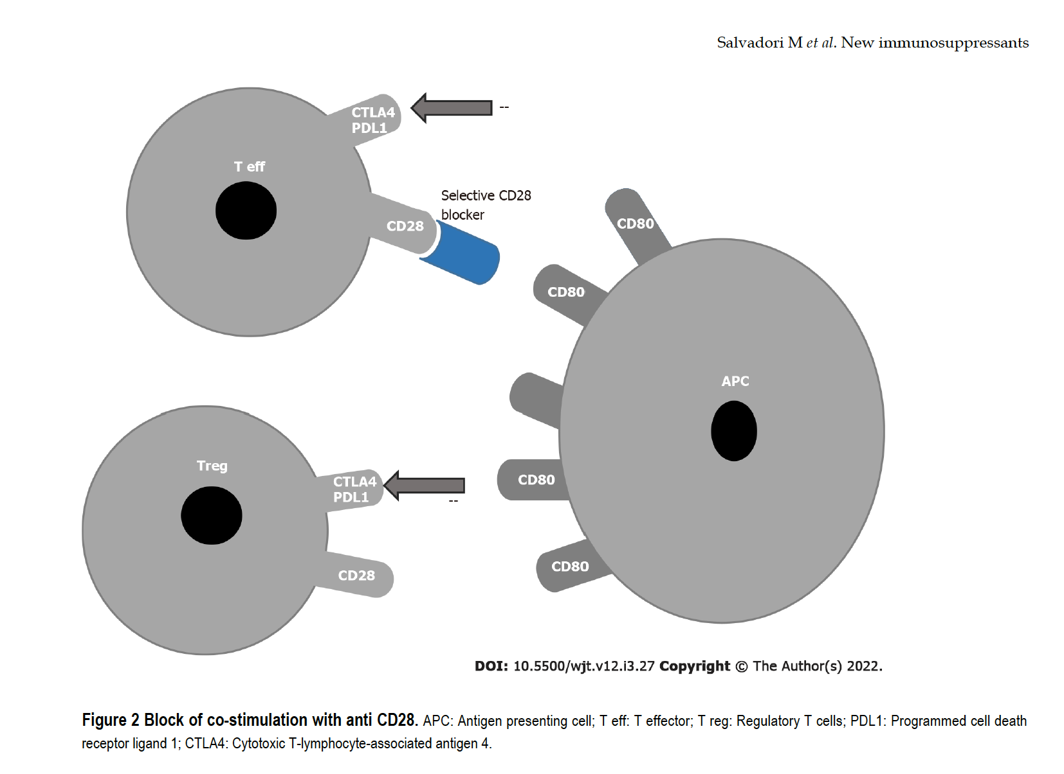


Slide 62
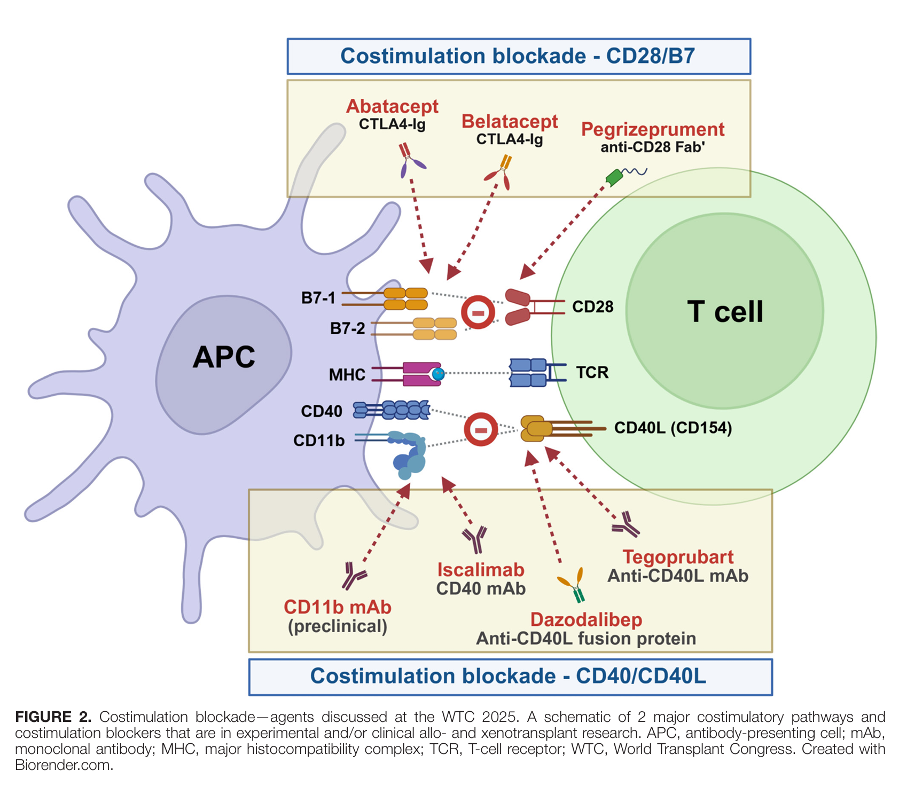

Slide 63
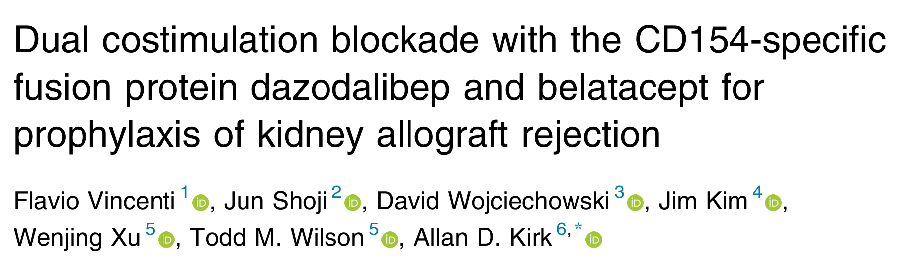

Slide 64
Bortezomib (Velcade)
Bortezomib selective, reversible inhibitor of the 26S proteasome (Velcade)
Depletes malignant and nonmalignant plasma cells
May decrease anti-HLA antibodies in patients with high DSA levels during desensitization or during treatment of antibody mediated rejection (AMR in renal transplant recipients

Slide 65
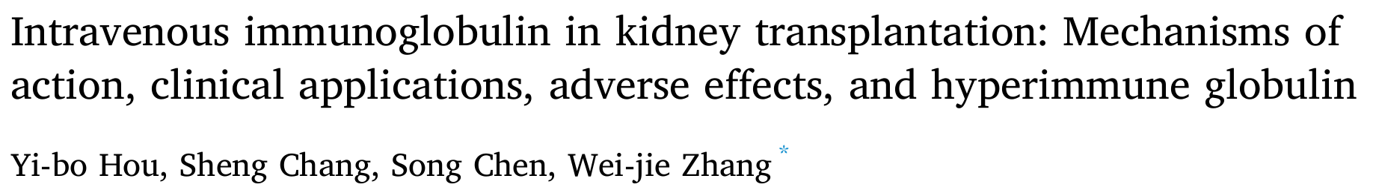


Slide 66
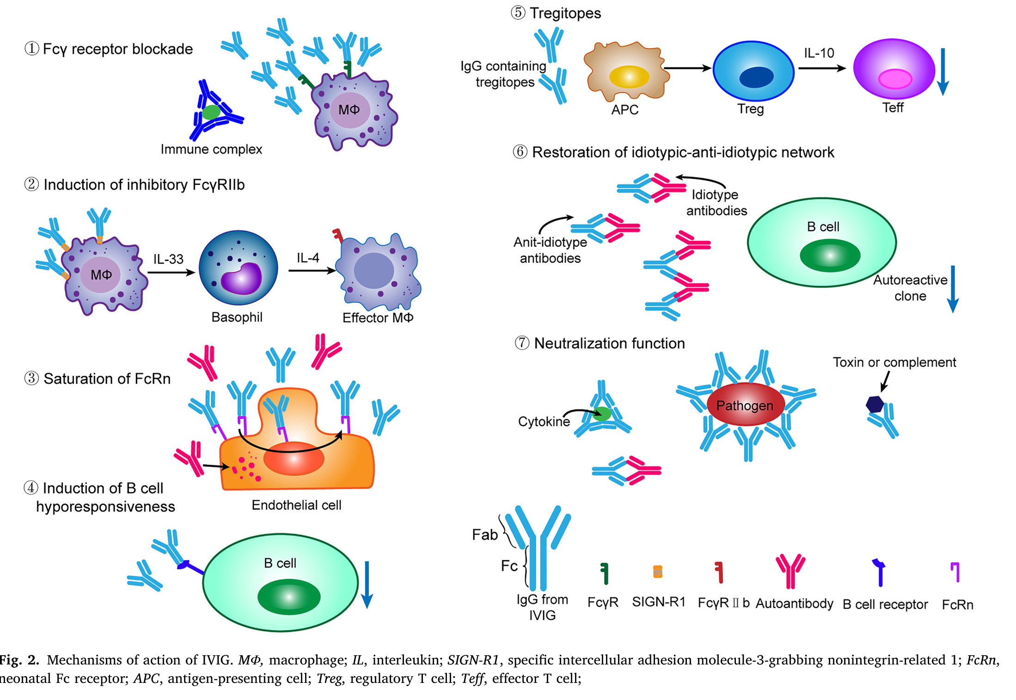

Slide 67
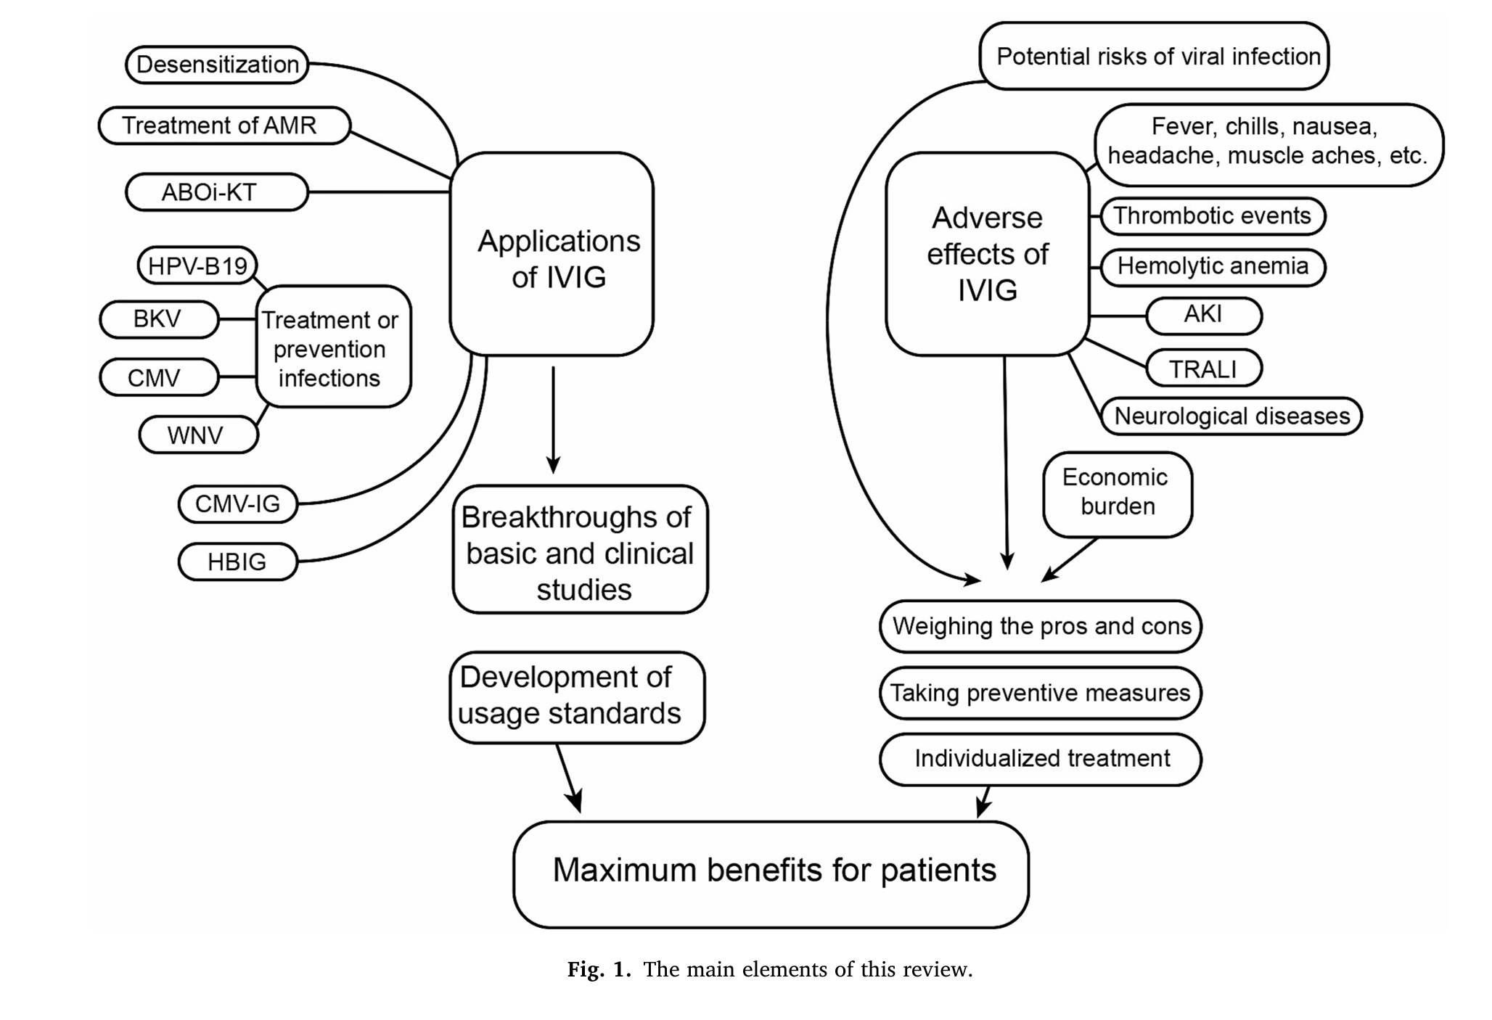

Slide 68
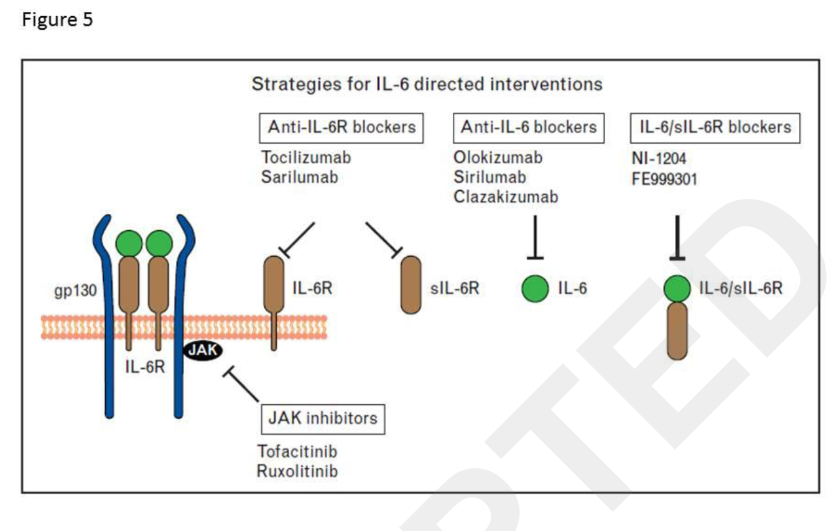
Anty - IL-6 strategies for treatment of antibodies mediated rejection

Slide 69
Metabolic toxicities of immunosuppressive drugs
Complication | CsA | Tac | Ster | AZA | SRL/ EVL | MMF
Nephrotoxicity | + | + | - | - | - | -
Hypertension | ++ | + | + | - | - | -
Hyperlipidaemia | ++ | + | + | - | +++ | -
Diabetes | + | ++ | ++ | - | + | -
Haematologic toxicity | - | - | - | + | + | +

Slide 70
Emerging Clinical Objectives
Early Phase
Maintenance Phase
Minimize Acute Rejection
Optimize Therapy
side effects
CV mortality
infections
neoplasia
non compliance
3 Months
6 Months
9 Months
12 Months

Slide 71
There are no specific, effective and safe new immunosuppressive drugs
CNI remain fundamental IS drugs
GS and CNI sparing strategies at de novo renal allograft recipients require induction therapy with mono or policlonal anty-T antibodies
GS or CNI withdrawal at early period after kTx is combined with increased risk of AR, the impact of these strategies on long-term results is unknown?
AMR does not respond to conventional therapy with GS, and needs an alternative therapy
Individualization of immunosuppressive therapy provides improvement of patient and graft survival
Future:
  More detailed TDM monitoring
  Tolerogenic immunosuppression
Conclusions

