Slide 1
RPGN Rapidly Progressive Glomerulonephritis
Rapid loss of renal function over a very short period
Nephritic urine analysis: proteinuria, micro or macroscopic hematuria, dysmorphic red blood cells (RBC), RBC casts
Histopathological characteristic on renal biopsy finding; cellular crescent formation in the glomeruli; which is proliferative cellular response seen outside the glomerular tuft within Bowman's capsule and because of its crescentic shape called crescentic glomerulonephritis.

Slide 2
RPGN is broadly classified based on histopathology and immune complex deposition
Type I: Anti-glomerular basement membrane (GBM) linear antibody deposition disease.
Type II: Granular immune complex deposition disorders.
Type III: Pauci-immune disease (absence of deposition, generally anti-neutrophil cytoplasmic antibody (ANCA)-positive vasculitis).
Type IV: Double antibody positive for both ANCA and anti-GBM.

Slide 3
Anti-Glomerular Basement Membrane Disease
Circulating immunoglobulin G (IgG) antibodies are directed against an antigen normally present in the GBM and alveolar basement membrane, specifically the non-collagenous domain of the α-3 chain of type IV collagen. This anti-GBM antibody deposition accounts for approximately 10% to 15% of diffuse crescentic glomerulonephritis cases. About 40% to 60% of these cases are associated with alveolar hemorrhage, a condition known as Goodpasture syndrome

Slide 4
Immune complex glomerulonephritis is believed to comprise 25% to 30% of RPGN cases.
The general consensus favors that immune complex–mediated crescentic glomerulonephritis has a more favorable outcome compared to either anti-GBM–mediated or pauci-immune RPGN. An exception to this is lupus, typically class IV, as a cause of RPGN, which is also often associated with positive ANCA.
In adults, immune complex glomerulonephritis can be idiopathic or secondary to the following:
Postinfectious glomerulonephritis, especially after a Streptococcus infection
Collagen vascular disease
Lupus nephritis
IgA vasculitis, also known as Henoch-Schönlein purpura, with IgA deposits and associated systemic vasculitis
IgA nephropathy, also known as Berger disease, without vasculitis
Mixed cryoglobulinemia
Membranoproliferative glomerulonephritis
Membranous nephropathy
Fibrillary glomerulonephritis
Secondary glomerulonephritis associated with hepatitis B and C

Slide 5
Pauci-Immune Glomerulonephritis or Anti-Neutrophil Cytoplasmic Antibody–Associated Vasculitis
About 40% to 50% of adult cases are considered to have pauci-immune RPGN, also called ANCA-associated vasculitis or type III crescentic glomerulonephritis, representing the most common presentation in adults with RPGN. These cases typically fall into 3 main types as follows:
Granulomatosis with polyangiitis, formerly known as Wegener granulomatosis, with renal involvement observed in about 80% of cases.
Microscopic polyangiitis, with renal involvement observed in about 90% of cases.
Eosinophilic granulomatosis with polyangiitis, also referred to as Churg-Strauss syndrome, with renal involvement observed in about 45% of total cases.

Slide 6
Drugs Linked to Anti-Neutrophil Cytoplasmic Antibody–Associated Crescentic Glomerulonephritis
Medications can induce an ANCA-associated RPGN.
The most common offending medications include:
Hydralazine
Propylthiouracil and methimazole
Allopurinol
Sulfasalazine
Minocycline
Penicillamine
Rifampicin
Aminoguanidine
Sofosbuvir
Anti-tumor necrosis factor-alpha (TNF-α) therapy for rheumatoid arthritis and ankylosing spondylitis

Slide 7
Double-Positive Antibody Disease
Also called dual antibody disease, this type of crescentic glomerulonephritis is associated with a positive ANCA and anti-GBM antibody. Some studies indicate that 10% to 50% of patients with anti-GBM disease have detectable ANCA, typically anti-MPO. In contrast, up to 10% of patients with ANCA-associated vasculitis also have circulating anti-GBM antibodies

Slide 8
GPKZN
etiology
50-60%
10-20%
30-40%
Cancers

Slide 9
Objective
Identify early signs and symptoms of rapidly progressive glomerulonephritis to enable timely intervention.
Differentiate between rapidly progressive glomerulonephritis and other renal conditions by conducting comprehensive diagnostic evaluations and analyzing histopathology results.
Select appropriate immunosuppressive therapies tailored to the specific etiology of rapidly progressive glomerulonephritis and the appropriate timing of treatment initiation.
Collaborate with nephrologists and other healthcare professionals to ensure comprehensive management and follow-up monitoring of rapidly progressive glomerulonephritis.

Slide 10
52-years old woman
symptoms
↑ T > 38,8º C last week
weakness
night sweats
dry cought
swelling and reddening of right lower limb

Slide 11
Chest radiography showing a large infiltrate with a central cavitation in the right upper pulmonary field.

Slide 12
BP 170/90 mmHg, HR 100/min, T 38,8 º C
Results of laboratory tests
creatinine | 1,6 mg/dl
urea | 112 mg/dl
hemoglobin | 10,8 g/dl
leukocyte | 14 G/l (N 92%)
acute phase protein | 255 mg/l
Ultrasonography dopp: right lower limb vein thrombosis

Slide 13
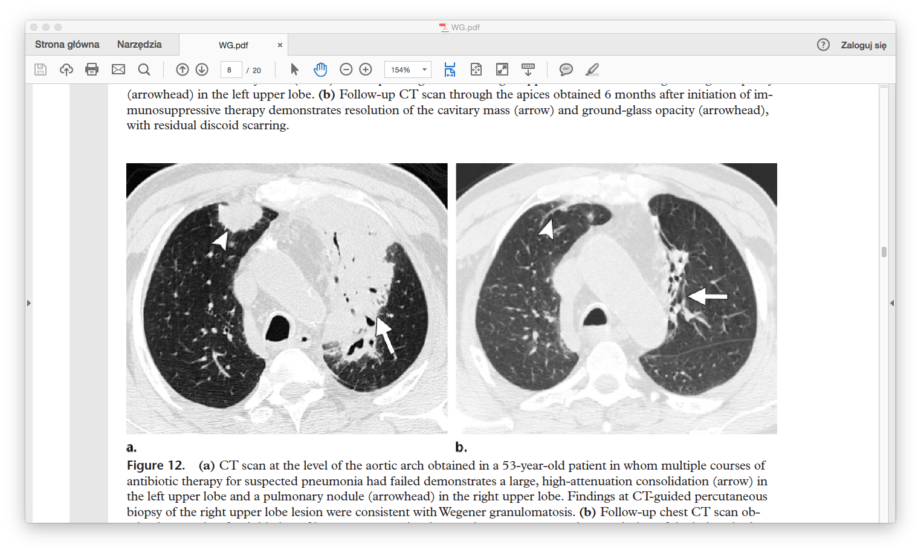
CT scan at the level of the aortic arch demonstrates a large, high-attenuation consolidation (arrow) in the left upper lobe and a pulmonary nodule (arrowhead) in the right upper lob

Slide 14
A 52-year-old man with relapsing infections of the lower respiratory tract and hearing impairment for two months was admitted to our hospital. The patient had been discharged from another hospital after showing no clinical improvement from two month of antibacterial and antituberculous treatment, and refusing to undergo lung operation for the postulated diagnosis of pulmonary abscess.

Slide 15
BP 170/90 mmHg, HR 100/min, T 38,8 º C
Results of laboratory tests
creatinine | 4,6 mg/dl
urea | 187 mg/dl
hemoglobin | 7,7 g/dl
acute phase protein | 232 mg/l
Cultures: blood (negative), urine (E. coli 10⁵)
Chest TK tumor in right lobus, lymph nodes packages, large, high-attenuation consolidation (arrow) in the left upper lobe and a pulmonary nodule (arrowhead) in the right upper lob, abscess
Ultrasonography: normal kidneys size and position, no urine stagnation, veins and arteries permeable

Slide 16
Differential diagnosis

Slide 17
atypical pneumonia pulmonary embolism
Ineffective antibiotic therapy: amikacin, ceftriaxon,meropenem klaritromycin and metronidazol
No improvement during anticoagulant treatment
Negative test for tuberculosis

Slide 18
BP 170/90 mmHg, HR 100/min, T 38,8 º C
Results of laboratory tests
creatinine | 10,6 mg/dl
urea | 230 mg/dl
hemoglobin | 6,7 g/dl
acute phase protein | 232 mg/l

Slide 19
Laryngologist consultation
Tinnitus, hearing impairment
Diagnosis: otitis with granulomatosis

Slide 20
Autoantibodies
ANA
c-ANCA
anti GBM
negative
titre 160
negative

Slide 21
Starting dialysis
Preparation for kidney biopsy

Slide 22
Histopathology
fibrosis in 25% of glomeruli
necrotizing glomerulonephritis with crescent formation
tubulitis
changes in vessels

Slide 23
Diagnosis
symptoms:
pneumonia
hearing impairment, otitis
AKI
Autoantibodies:
c-ANCA 1:160
histopathology:
Subacute crescentic glomerulonephritis
Wegener granulomatosis

Slide 24
Treatment
Methylprednisolone i.v. followed by oral prednisone
Cyclophosphamide p.o.
Plasmapheresis
Temperature normalization
Kidney function improvement creatinine 0,84 mg/dl
No pulmonary changes
Chronic hearing impairment

Slide 25
Follow-up chest CT scan obtained 9 months after initiation of immunosuppressive therapy demonstrates complete resolution of the lesions in the left (arrow) and right (arrowhead) upper lobes, with residual scarring.
CT scan at the level of the aortic arch demonstrates a large, high-attenuation consolidation (arrow) in the left upper lobe and a pulmonary nodule (arrowhead) in the right upper lob

Slide 26
RPGN Rapidly Progressive Glomerulonephritis
Epidemiology
RPGN is a rare condition worldwide.
The incidence is around 7 cases per 1 million person-years in the United States, whereas 2 cases per 1 million are reported in the United Kingdom.
The disease is more common among the White population and possibly in the Asian population. The prevalence is less common in the Black population.
The male-to-female ratio in most studies is approximately 1:1.
The disease represents a bimodal distribution related to the mean age for clinical manifestation. In most series, the mean age for the first peak is around 30, and the second peak is in the late 60s. However, cases have been reported across a wide age range, from 2 to 92, although RPGN is uncommon in the pediatric population

Slide 27
Although the cause of Wegener granulomatosis is unknown, an autoimmune element has been proposed because of the presence of circulating antineutrophil cytoplasmic antibodies (ANCAs) directed against proteinase 3 and, less commonly, myeloperoxidase

Slide 28
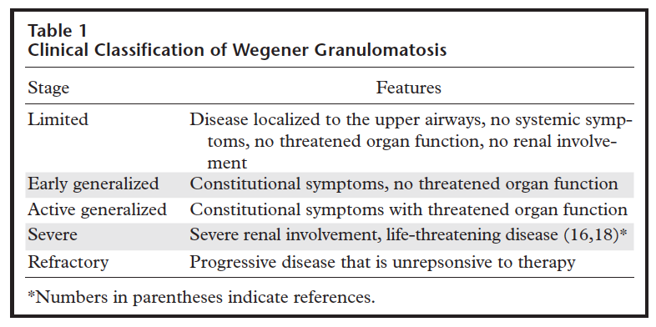

Slide 29
Histopathology
Quantitative definitions aid in the classification of ANCA-associated lesions.
Focal: 50% or more normal glomeruli.
Crescentic: 50% or more glomeruli with cellular crescents.
Mixed: less than 50% normal, less than 50% crescentic, and less than 50% globally sclerotic glomeruli.
Sclerotic: 50% or more globally sclerotic glomeruli.

Slide 30
RPGN
Clinical symptoms
A rapid decline in renal function occurs over weeks to months, with early nonspecific clinical features. Occasionally, hemoptysis and shortness of breath may be the first clinical feature.
Anti-GBM disease may result in diffuse alveolar hemorrhage along with renal complications. Patients present with symptoms such as shortness of breath, cough, hemoptysis, nephritis, hematuria, and edema. Patients younger than 30 show more pulmonary involvement compared to older patients.
Extrarenal manifestations suggestive of immune complex disorders or ANCA vasculitis include the following:
Systemic—fevers, night sweats, weight loss, and arthralgia
Oral—mucosa ulceration
Eyes—scleritis
Ear, nose, and throat—hearing impairment, otitis, epistaxis, nasal drainage, sinusitis, and nasal cartilage necrosis
Respiratory—shortness of breath, cough, hoarseness of voice, and hemoptysis
Gastrointestinal—abdominal pain secondary to ischemia, infarction, or pancreatitis
Central nervous system—vision changes including blurry vision or vision loss, numbness, weakness, and stroke-like symptoms
Skin—palpable purpura, ulcers, and livedo reticularis

Slide 31
Laboratory Testing
Urinalysis: Dysmorphic RBCs on microscopy are characteristic of glomerular hematuria and RBC casts are highly suggestive of this diagnosis.
The urine protein-to-creatinine ratio should be evaluated but may not be significantly elevated until later disease stages.
Elevated serum creatinine and abnormal electrolyte levels, such as potassium, magnesium, and calcium, further support renal dysfunction.
A complete blood count with differential may show eosinophilia in eosinophilic granulomatosis with polyangiitis.

Slide 32
Serology for anti-GBM antibodies should always be performed using enzyme-linked immunosorbent assay (ELISA) or western blot. However, as noted above, approximately 10% of patients with biopsy-confirmed anti-GBM disease do not have identifiable circulating antibodies with conventional assays. Therefore, a negative anti-GBM antibody test does not rule out the disease.Chemiluminescence immunoassay is also being studied as a possibly more sensitive test.
Previously, ANCA testing was performed using indirect immunofluorescence, and its qualitative assay resulted in perinuclear ANCA (P-ANCA) or cytoplasmic ANCA (C-ANCA). However, a newer method utilizes ELISA, which identifies specific antigens and provides a quantitative titer for anti-PR-3 and anti-MPO. C-ANCA (a cytoplasmic antineutrophilic nuclear antibody with extranuclear cytoplasmic staining) is 90% PR-3 reactive and 10% MPO reactive; P-ANCA (a perinuclear antineutrophilic nuclear antibody with staining around the nucleus) is 90% MPO reactive and 10% PR-3 reactive.
Serologies for postinfectious causes include antistreptolysin titer for streptococcal infection, HIV, and hepatitis B and C.
Complement C3 and C4 levels may be low in some forms of granular immune complex disorders causing RPGN, such as lupus, cryoglobulinemia, and primary membranoproliferative glomerulonephritis.
Serologies for lupus include antinuclear antibodies, anti-double–stranded DNA, and anti-Smith.
Rheumatoid factor and cryoglobulin levels should be checked in suspected cases of cryoglobulinemia.

Slide 33
Imaging and Invasive Diagnostic Testing
Chest x-ray and computed tomography scan can assess for signs of diffuse alveolar hemorrhage or cavitary lesions of vasculitis.
Bronchoscopy can be performed if diffuse alveolar hemorrhage is suspected.
Otolaryngologic evaluation and skin biopsy can be performed for vasculitis.
Histological diagnosis through renal biopsy is the mainstay for a definitive diagnosis.

Slide 34
Wegener granulomatosis affects multiple organ systems and may involve any part of the body.
The upper respiratory tract is involved in nearly all patients; in addition, a vast majority of patients with Wegener granulomatosis will also have pulmonary (90%) and renal (80%) involvement

Slide 35
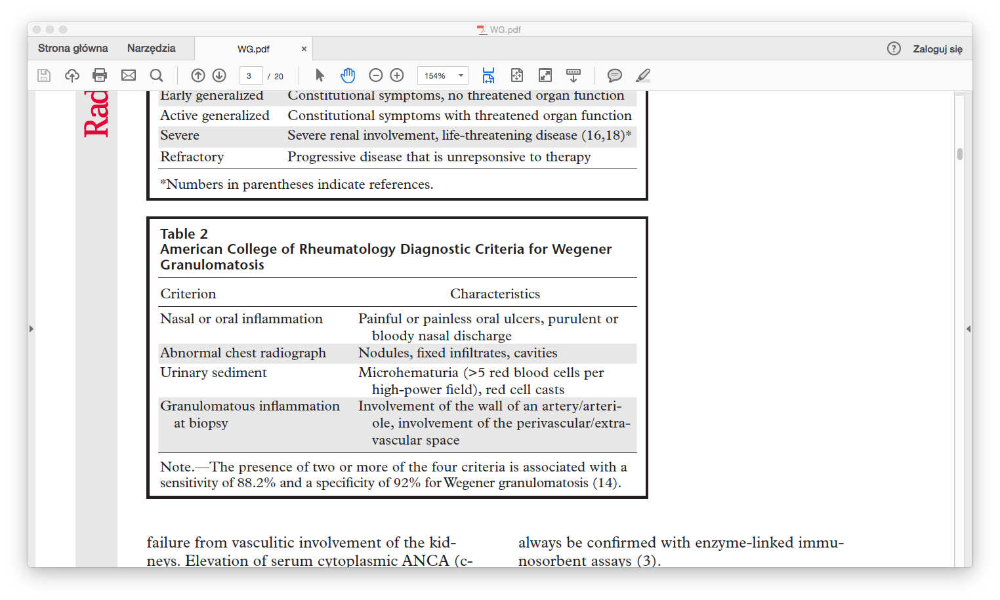

Slide 36
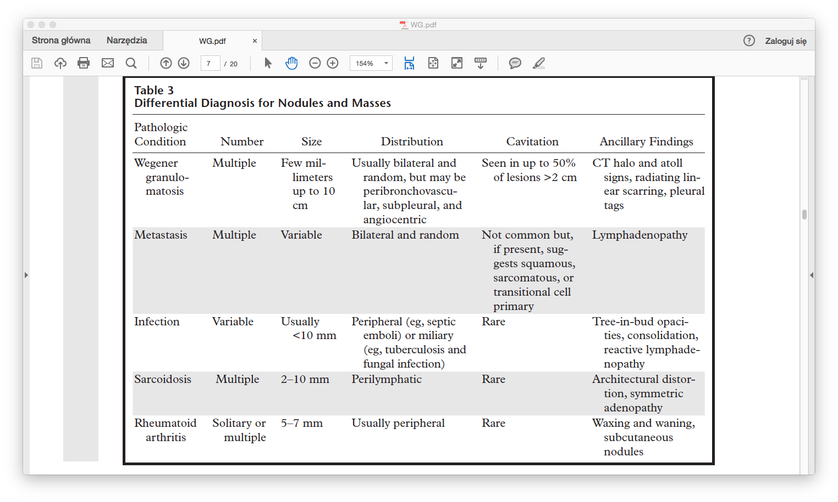

Slide 37
Light micrograph showing crescentic glomerulonephritis
Normal glomerulus
Light micrograph of a normal glomerulus. There are only 1 or 2 cells per capillary tuft, the capillary lumens are open, the thickness of the glomerular capillary wall (long arrow) is similar to that of the tubular basement membranes (short arrow), and the mesangial cells and mesangial matrix are located in the central or stalk regions of the tuft (arrows).
High-power light micrograph in crescentic glomerulonephritis. The hypercellular circumferential crescent (arrows) is compressing the glomerular tuft in the center of the glomerulus and closing the capillary lumens.
Courtesy of Helmut Rennke, MD.

Slide 38
Immunofluorescence microscopy showing linear IgG
Immunofluorescence microscopy showing fibrin deposition
Immunofluorescence microscopy showing intense deposition (bright areas in the upper right portion of the glomerulus) of fibrin within a circumferential crescent surrounding the glomerular tuft in any form of crescentic or rapidly progressive glomerulonephritis, including that due to anti-GBM antibody disease
Immunofluorescence microscopy showing characteristic linear deposition of IgG in anti-GBM antibody disease.

Slide 41


