Slide 1
Chronic kidney disease (CKD) Teresa Bączkowska

Slide 2
CKD 7,2% - 14,8% of population (600 mln in the word, ( 6-16% , 4,3 mln in Poland)
Annual incidence of new ESRD patients continues to increase at rate of
9% per year, with a predominance in patients older than 60 years of age
Dialysis treatment, kidney transplantation in patients with ESRD is considered as
an extension of the natural history of chronic renal failure
Aggressive treatment of risk factors for cardiovascular disease –
especially diabetes, hypertension – is essential (cardiovascular morbidity accounts
for 50% of deaths in patients with ESRD)
Dialysis treatment is an equivalent to GFR of only about 10 ml/min
Some problems of patients with chronic renal failure are not completely
resolved by chronic dialysis
A substantial proportion of patients with chronic renal failure might be
converted to chronic renal insufficiency, or at least progression toward ESRD
might be slowed

Slide 3
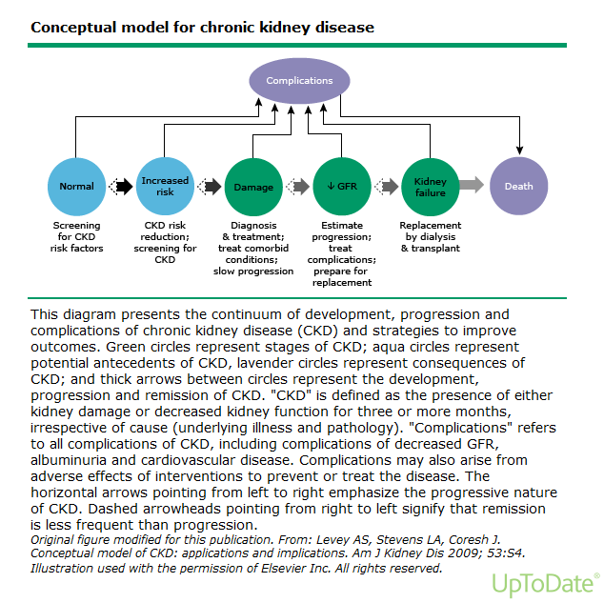

Slide 4
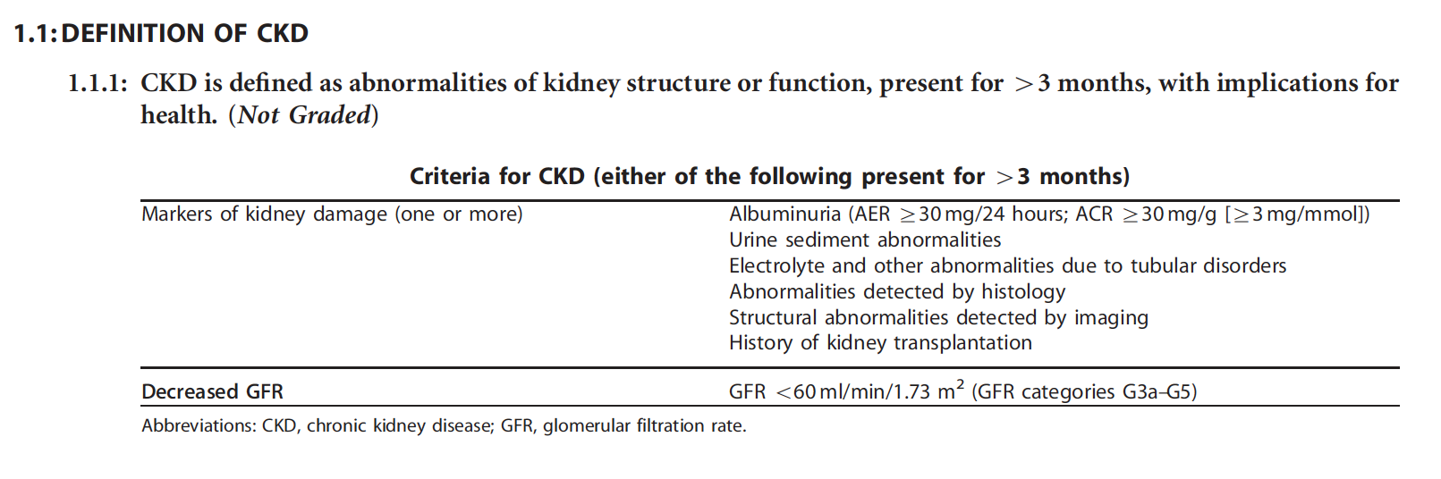

Slide 5
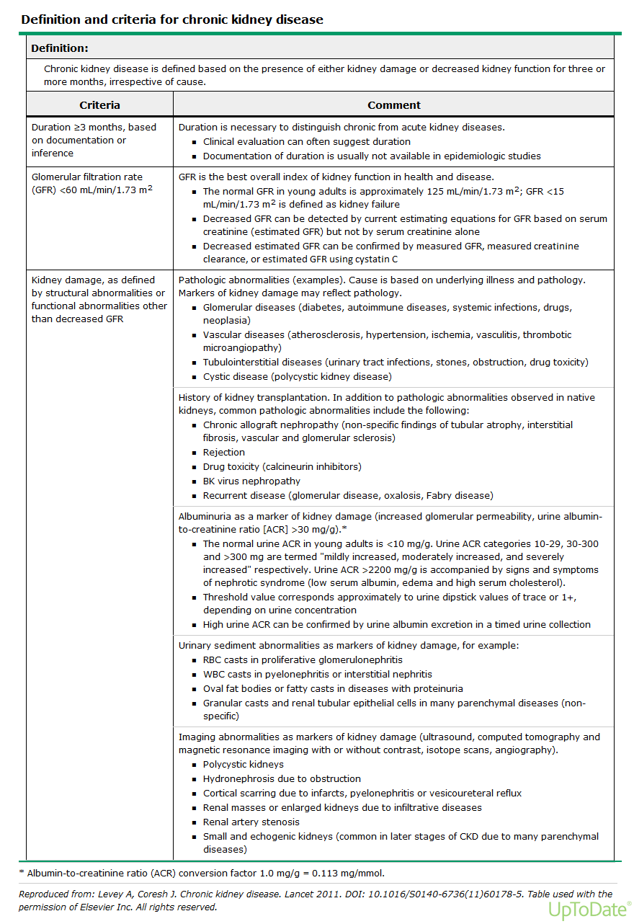

Slide 6
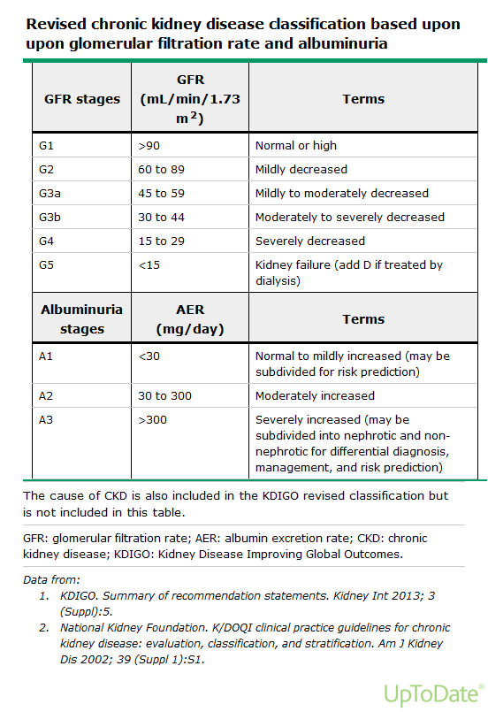

Slide 7
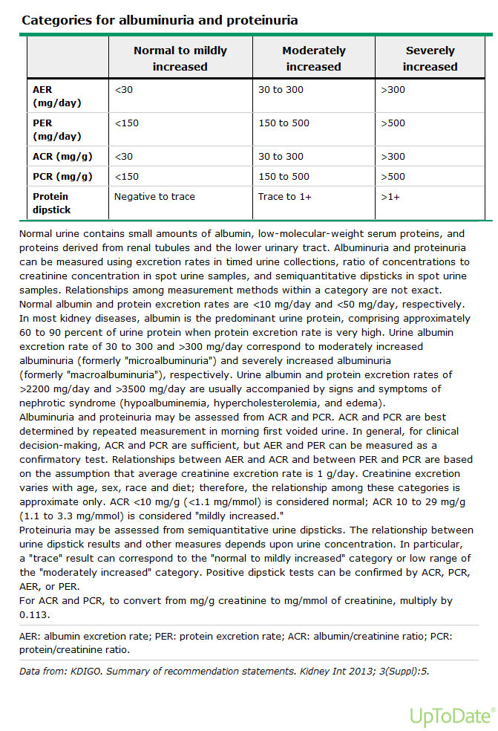

Slide 8
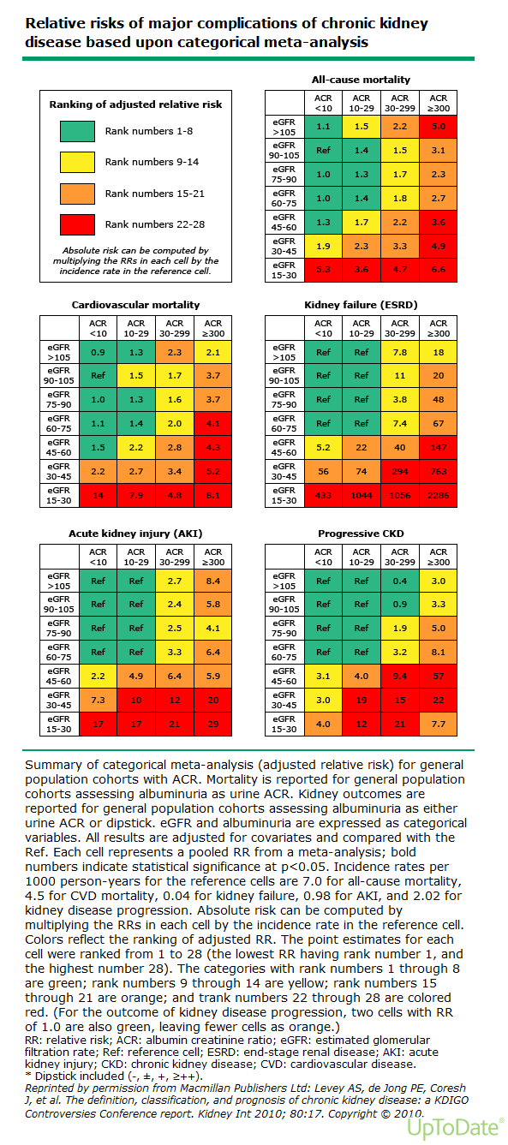

Slide 9
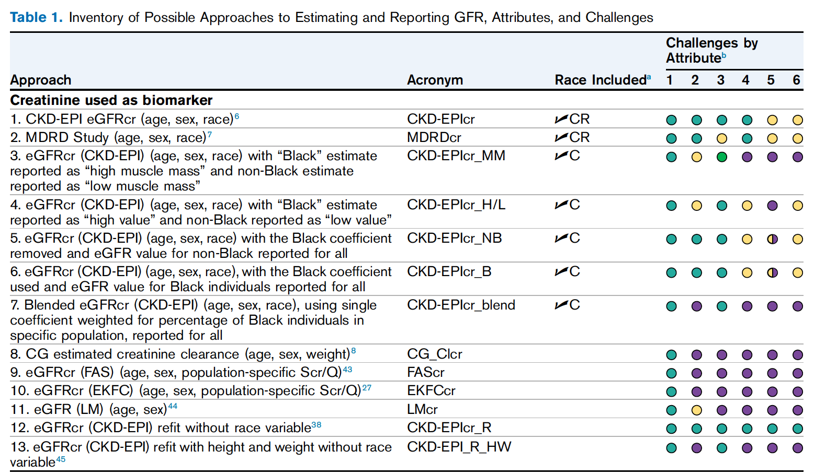


Slide 10
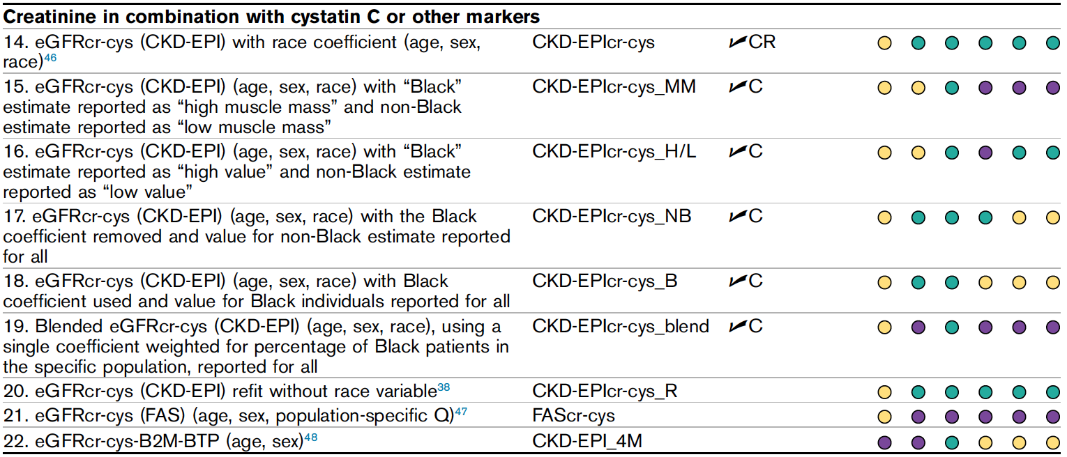

Slide 11
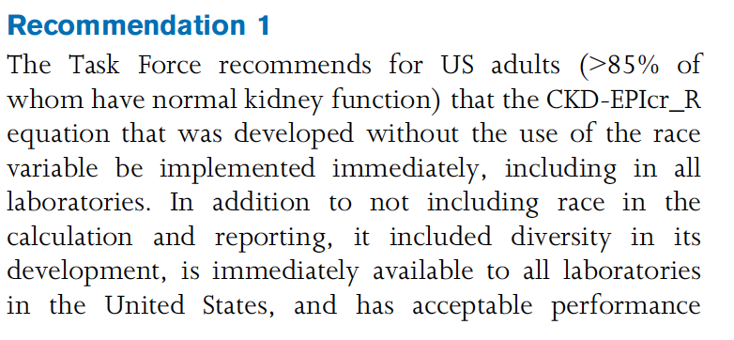

Slide 12
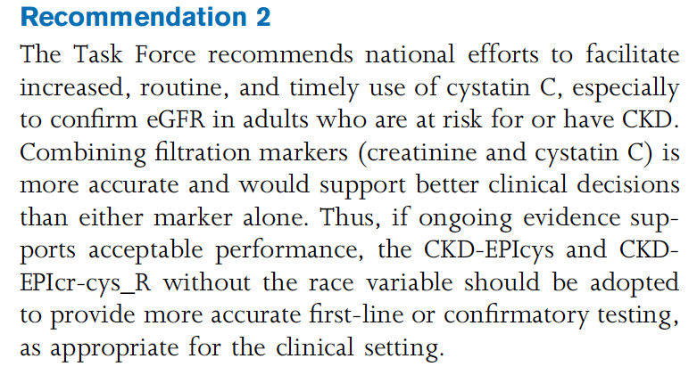

Slide 13
CKD
the site of primary damage may be clinically evident and may indicate
the type of disease process: nephrotic syndrome indicates a primary
or secondary glomerular disease, whereas severe impairment of renal
concentrating mechanism may suggest a primary tubuloinstertitial
disease

Slide 14
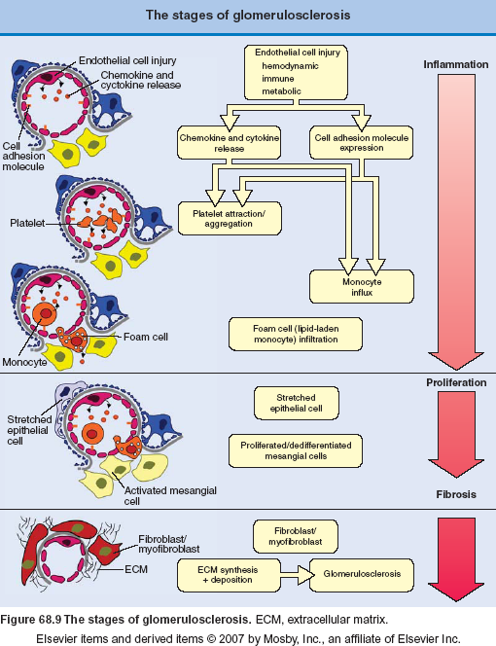

Slide 15
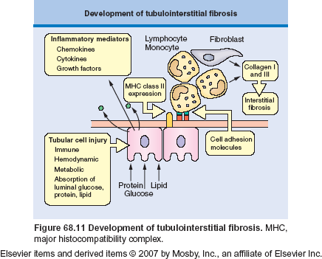

Slide 16
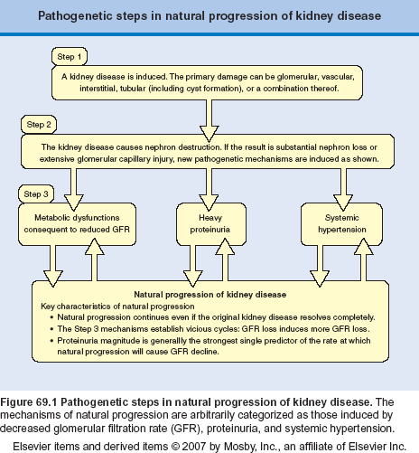

Slide 17
Water excretion
Blood osmolality: 285-295 mOsm/kgH20
CKD - impairment in the urinary concentrating ability (normal range: 50-1200 mOsm/kg H20)
In progressive renal failure the maximum urine osmolality approaches that of plasma
The increased obligatory water excretion in chronic renal disease may lead to polyuria and nocturia

Slide 18
Sodium excretion
Fractional sodium excretion increases and extra renal balance is maintained until late in the course of renal disease
ECF volume is relatively well preserved
In a normal person sodium chloride intake may vary from 3.5 – 7.0 g/day,
(fractional sodium intake changes from 0.25 to 0.5%/day to maintain balance)
In a person with GFR 4 ml/min fractional sodium excretion has to change from 4% to 16% (to maintain sodium balance – restriction in sodium intake!!!)
1-2% of patients with early renal failure have a urine sodium leak, which causes sodium depletion even when sodium salt intake is normal (medullary cystic disease, analgesic nephropathy, chronic interstitial disease, polycystic kidney disease). They are typically normotensive and require a high sodium intake to maintain sodium balance

Slide 19
Potassium excretion
Normally 90% - 95% of ingested potassium is excreted in the urine
In chronic renal failure 20% - 50% of patassium is excreted in the stool
CKD - a marked increase in potassium excretion per nephron
A normal concentration of potassium is maintained even on a normal potassium intake (60-80 mEq/day) until GFR falls below 10 ml/min
Potassium excretion depends on tubular secretion to maintain balance- aldosteron increases secretion in distal tubules (care with prescription of converting enzyme inhibitors – they may reduce aldosterone level)
Plasma level of potassium may rise in chronic renal failure as a result of redistribution of potassium between intra and extra cellular compartments, usually as a consequence of acidosis, use of beta blocking agents
Very little functional reserve remains to respond to sudden changes in potassium intake, metabolic acidosis or catabolic states may result in life-threating hyperkalemia

Slide 20
Acid-Base Balance
In normal human renal reabsorption of bicarbonate equals 4000 mEq
Urinary excretion of hydrogen ions is 50-100 mEq in the form of ammonium and titrable acid (H+ bound to phosphate and other buffer ions)
Because of compensatory adaptations in acid excretion by residual nephrons most patients do not have significant acidosis until GFR falls below about 25% of normal
Other buffers such as carbonate of bone are utilized in buffering the hydrogen ion retention
In some patients is also urinary bicarbonate leak when the plasma levels are restored by the infusion of bicarbonate (high PTH level)
Two types acidosis occurs in chronic renal failure:1) hyperchloremic acidosis (normal anion gap); 2) metabolic acidosis (increased anion gap: accumulation of phosphate, sulfate)

Slide 21
Magnesium
Most patients with chronic renal failure have normal or moderately elevated serum magnesium level
The serum magnesium level rises further in response to acidosis, administration of wit D
In patients with high level of magnesium may occur: muscle weakness, skin irritation, in patients with very high magnesium level may occur dramatic symptoms: muscle paralysis, respiratory failure

Slide 22
Phosphate and Calcium
Hyperfosfatemia is seen commonly in patients with GFR of 25 ml/min or less on an unrestricted diete
Hypocalcaemia is due to several factors: increase in serum phosphate level leads to reciprocal decrease serum levels of 1,25(0H)2 wit D3; nephron loss
Decrease calcium absorption from the gastrointestinal tract
Ability of PTH to mobilize calcium from bone is impaired
Metabolic acidosis tends to increase the fraction of ionized calcium and prevents some of the clinical consequences of hypocalcaemia
Rapid correction of acidosis may lead to a fall in ionized calcium level and to acute manifestations of hypocalcaemia (tetany, convulsions)

Slide 23
120 ml/min
GFR
PO4
Ca
PTH

Slide 24
Uremic syndrome
Urea itself is relatively non-toxic, but measurement of blood urea offers the best
single laboratory index of the likehood of certain symptoms that occur in renal
failure; it represents an overall measure of the accumulation of products of protein
metabolism
Accumulation of „toxins”
a/ low molecular weight substances (urea, urate, sulfate,
phosphate).
b/ substances such as phenols, guanidines, low-molecular weight
peptides
c/ extra cellular and intracellular electrolyte and acid-base
disturbances
d/ accumulation of various hormones: impaired renal degradation
(GH, insulin, glucagon); PTH, natriuretic factor
e/ impaired production of renal hormones (erythropoietin, 1,25(0H)2
wit D3

Slide 25
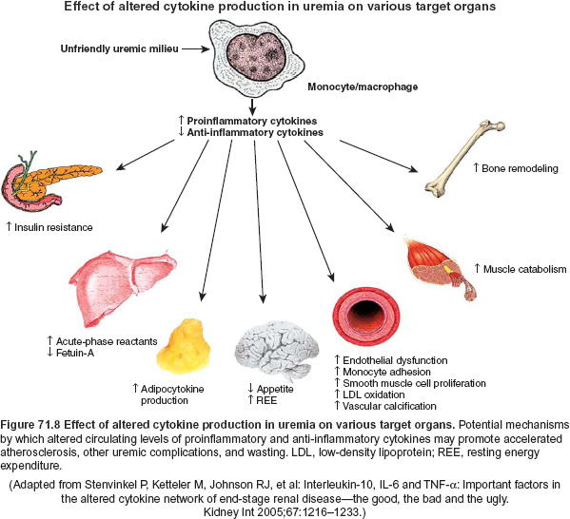

Slide 26
Causes of ESRD
Diabetic nephropathy
Hypertensive nephrosclerosis
Glomerulonephritis
Tubulointerstitial
Congenital *
Collagen vascular
Unknown
* mainly polycystic kidney disease

Slide 27
CKD
All patients with chronic renal disease and eGFR <30 ml/min/1.73m2 should be referred once to nephrologist and than managed in consultation with nephrologist until chronic dialysis becomes necessary
It must be remembered that there is normally a reduction in GFR with aging: at age 85-90 years GFR is reduced to about 50%. This reduction may not be associated with an elevation in serum creatinine because muscle mass and, consequently, creatinine production also fall with aging

Slide 28
Differentiation of acute and chronic disease (important distinction)
Most patients with CKD progress toward ESRD
Most patients with AKI recover (non-completely)
Evaluation is similar for acute and chronic kidney disease, but must be performed much more rapidly in patients with AKI

Slide 29
Differentiation of chronic from acute kidney disease
History | Long-standing history suggests chronic kidney disease
Renal osteodystophy | Radiographic evidence of osteitis fibrosa cystica, osteomalcia
Renal size (length) Small kidney (e.g. <9 cm) Normal or enlarged kidney (10-12 cm) | Chronic kidney disease of any cause Acute kidney disease of any cause Chronic kidney disease: HIV nephropathy Diabetic nephropathy Amyloidosis
Enlarged kidneys (>12 cm) | Autosomal dominant kidney disease Tuberous sclerosis Obstructive nephropathy
Renal biopsy | Histological diagnosis

Slide 30
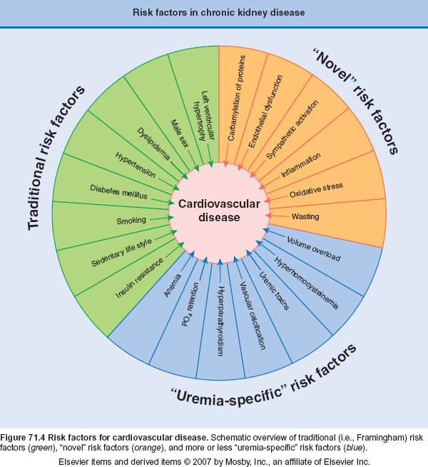

Slide 31
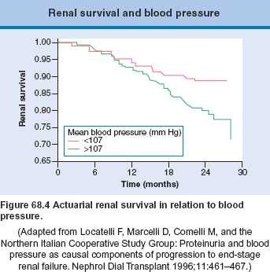

Slide 32
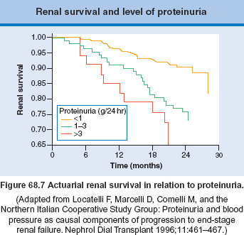

Slide 33
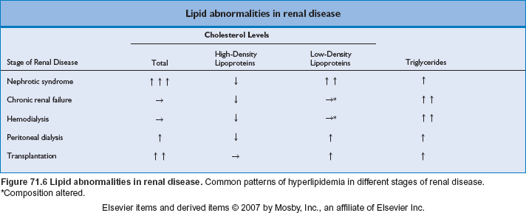

Slide 34
CKD
may be asymptomatic for many years
early recognition, establishment of cause, appropriate clinical management
medical history, physical examination, routine laboratory tests, genetic tests?
imaging examinations: usg – readily available, noninvasive, accurate, reliable, very reproducible, CT(computed tomography, contrast nephropathy), MRI (magnetic resonance imaging, not at GFR <30 ml/min - nephrogenic systemic sclerosis) these modalities are of limited value and in most cases do not provide more informations than Doppler flow scanning
biopsy „gold standard” for diagnostic accuracy in glomerulonephritis, tubuloinstertitial nephritis (overt contraindication)

Slide 35
Medical history
Risk factors for CKD: hypertension, diabetes mellitus, congestive heart failure, chronic liver disease, known or suspected hepatitis B or C infection, and rheumatologic diseases.
Chronic infection, chronic rash, or long standing arthritis may indicate a primary renal or systemic disease that is chronic in nature
A previous history of urologic disorders or procedures (obstructive and reflux nephropathies and congenital anomalies of the urinary tract)
A history of human immunodeficiency virus should be sought in patients with CKD of unknown cause
History of dysuria, nocturia, stranguria, recurrent bladder or kidney infection, trauma, urinary frequency may indicate vesicoureteral reflux
A history of abnormal finding on a urine analysis ( an entrance examination for education, military service or other purposes may provide clues to diagnosis of CKD)

Slide 36
A history of back pain or bone pain particularly in an older patients with CKD should raise the possibility of malignancy, especially multiple myeloma
A history of nephrotoxins exposure:
Prescribed medication: recent or long-standing history of ingestion of combination analgesic agents - is important in establishing analgesic nephropathy.
Environmental exposure to lead, arsenic, mercury or silicon or ingestion of certain herbal remedies (slimming regiments containing aristocholic acid), cancer chemotherapeutic agents can lead to diagnosis CKD.
Exposure to drugs for osteoporosis (pamidronate), lithium in patients with bipolar disorders and cyclosporine, takrolimus in patients after organ transplantation can cause CKD
A history of recurrent urinary tract infection with flank pain, fever, polyuria and nocturia suggests chronic pyelonephritis

Slide 37
Presentation of Renal Failure
Asymptomatic Presentation
Hypertension
Proteinuria
Microscopic hematuria
Abnormal renal imaging findings

Slide 38
Presentation of Renal Failure
Symptomatic Presentation
General
Fatigue
Weakness
Cardiovascular
Hypertension
Pulmonary congestion
Cough
Dyspnea
Hemoptysis
Neurologic
Encephalopathy
Seizure
Peropheral neuropathy
Genitourinary
Hematuria
Dysuria
Gastrointestinal
Anorexia
Nausea
Vomiting
Abdominal pain
Bleeding
Musculoskeletal
Muscle weakness
Periarticular and articular pain
Bone pain
Cutaneous
Pruritis
Necrosis
Bruising

Slide 39
Physical examination
Blood pressure should be measured in all patients undergoing evaluation for kidney disease.
Skin for excoriations due to uremic pruritis
Neurofibromas in patients with neurofibromatosis
Hiperpigmented macules in pretibial skin are often observed in patients with crioglobulinemic disease
Livedo reticularis may be seen in patients with atherosclerotic ischemic nephropathy
A general oedema are also common findings in patients with nephrotic syndrome or advanced CKD

Slide 40
Physical examination
Fundoscopic examination: micro aneurysms, proliferative retinopathy - diabetic nephropathy. Arteriolar narrowing, arteriovenous nicking, hemorrhage, and exudates consistent with hypertension are also common
Alport syndrome: anterior lenticonus and retinal flecks, high sensorineural hearing loss is overt in about 50%
Fabry disease: angioid streaks
Vasculitides: ocular palsy, nasal or oropharyngeal ulcers, perforated nasal septum
Carotid bruite is a manifestation of underlying atherosclerosis – clue to ischemic nephropathy
ESRD: diffuse conjunctivitis as a result of calcium-phosphorus deposition

Slide 41
Physical examination
Assessment of the cardiovascular and volume status is essential: volume depletion in a patient with CKD may be „a reversible” cause of ESRD
Cardiopulmonary examination for signs of volume overload (many patients have underlying heart diseases such as left ventricular hypertrophy and heart failure) - close inspection of jugular venous pulse level, detection of peripheral edema; in some cases it may be necessary to place a central venous catheter to measure right atrial pressure)
Cardiac murmurs may be present in patients with endocarditis or atrial myxoma associated with glomerulonephritis
Abdominal examination should include a search for palpable kidneys, as observed in polycystic kidney disease and tuberous sclerosis
A flank mass can be found in patients with retroperitoneal fibrosis, lymphoma, other tumors
A palpable bladder or enlarged prostate gland suggests chronic urinary prostatitis
Musculoskeletal examination, synovial thickening in small joints of the hands may be seen in SLE and rheumatoid arthritis

Slide 42
Urine examination
color and volume of the patient's urine
pattern of urination
Anuria < 100 mL/day; oliguria 100-400 mL/day.
Measurement of subsequent daily urine output is important for management of patients.
Close and careful bedside monitoring of vital signs, urine output, physical findings
Fractional excretion of sodium FeNa= Urine Na x Plasma Cr / Urine Cr x Plasma NaX100.(prerenal less than 1%, ATN greater than 1%).

Slide 43
Urinalysis
Not particularly useful for differentiating acute from chronic kidney disease
Pyuria, hematuria, proteinuria can be seen in the both disorders
High-grade proteinuria, dysmorphic red cells implies a glomerular disease
Calcium oxalate crystals may be seen in the urine of patients with hereditary or secondary forms of oxalosis causing kidney disease
Presence of calcium phosphate and sodium urate crystals may signify previous stone disease as a cause of CKD

Slide 44
Renal osteodystrophy
Radiographic evidence for renal osteodystrophy is present in CKD but not in ARF
Elevated plasma parathyroid hormone concentration can be present in both acute and chronic failure, but is not sufficient evidence for diagnosis of osteodystrophy.
Radiographs of the shoulders, ribs, hands and pelvis illustrating signs of osteitis fibrosa cystica strongly suggests CKD
This finding is rarely if ever observed in ARF
A possible exception may be a patient with parathyroid cancer in whom severe primary hyperparathyroidism may induce hypercalcemic AKI

Slide 45
Renal biopsy
Renal biopsy is the most definitive method of differentiating acute from chronic kidney disease.
Biopsy is used to establish diagnosis, determine treatment regiment, and collect prognostic information, and track the clinical course of CKD, especially in SLE
Histological findings of chronicity include glomerulosclerosis, tubular atrophy, interstitial fibrosis. The last finding is the best indicator of chronicity and best predictor of long term outcome.
Renal biopsy is a low-risk procedure in stable patients with kidney disease including the elderly.

Slide 46
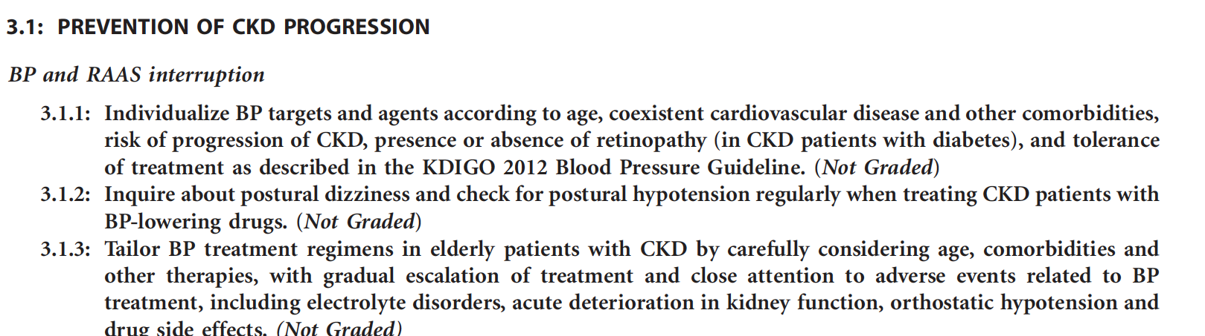

Slide 47
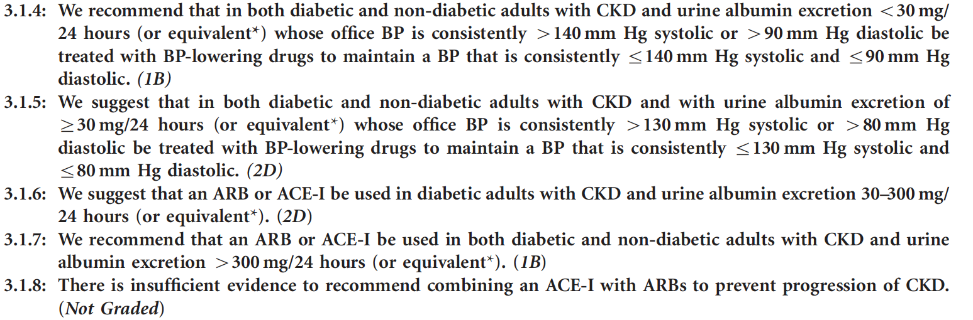

Slide 48
SGLT2 inhibitors – Patients who have proteinuric CKD (with or without diabetes) may benefit from treatment with SGLT2 inhibitors. While the majority of trials demonstrating kidney protective benefits have been performed in proteinuric patients with diabetic kidney disease, there are data to suggest that these benefits also extend to nondiabetic proteinuric patients

Slide 49
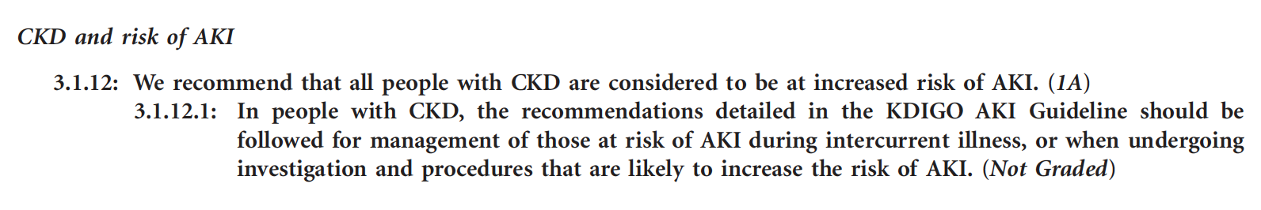

Slide 50
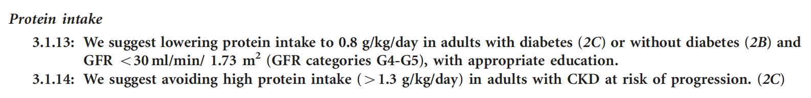

Slide 51
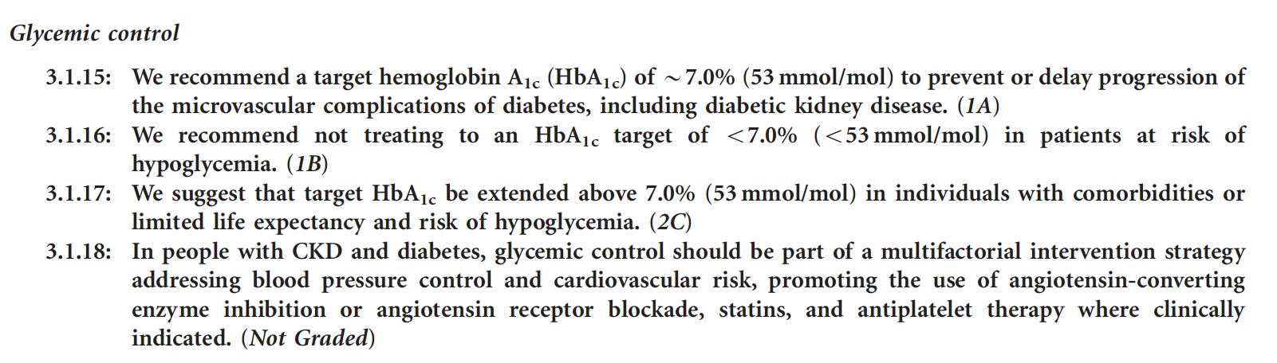

Slide 52
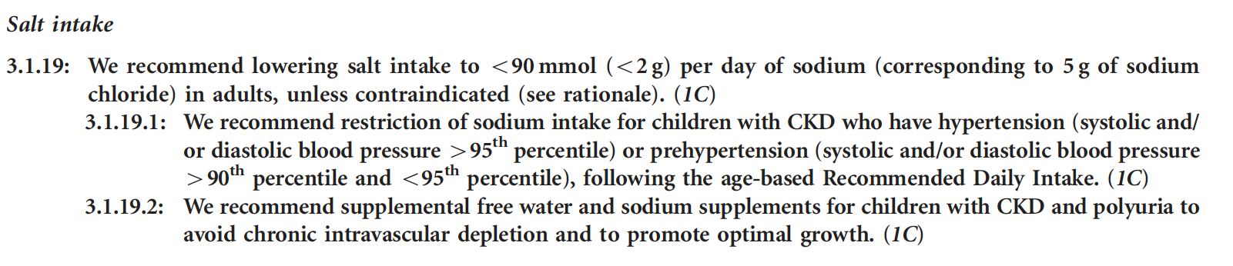

Slide 53
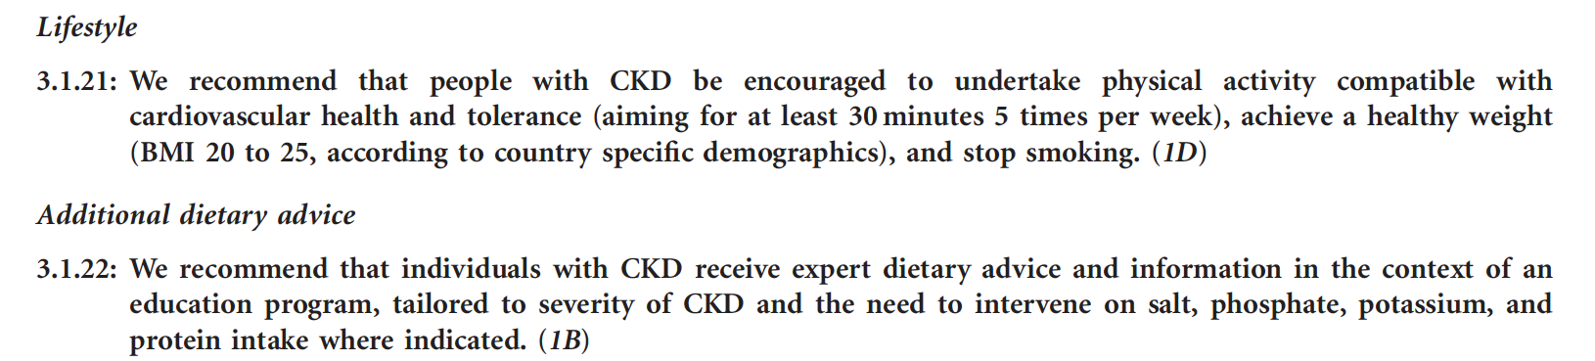

Slide 54
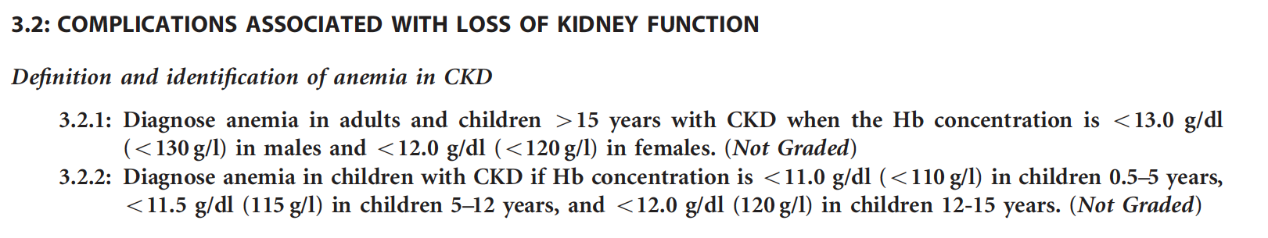

Slide 55
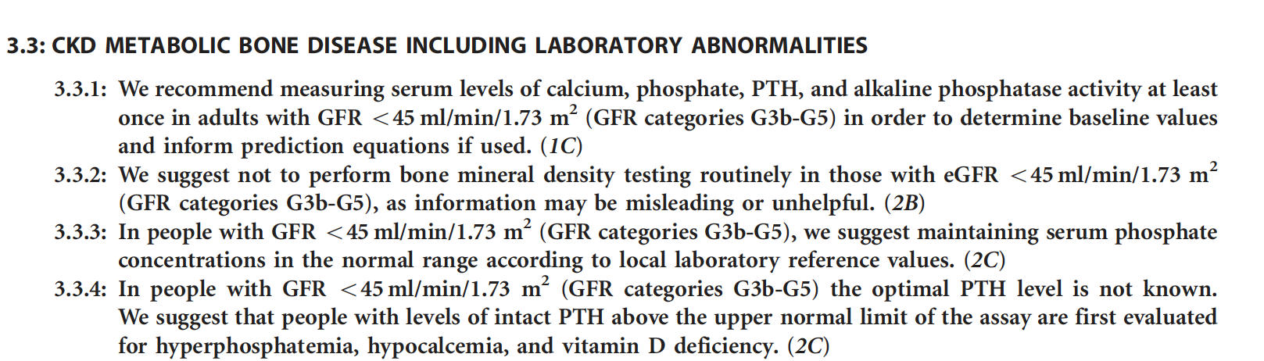

Slide 56
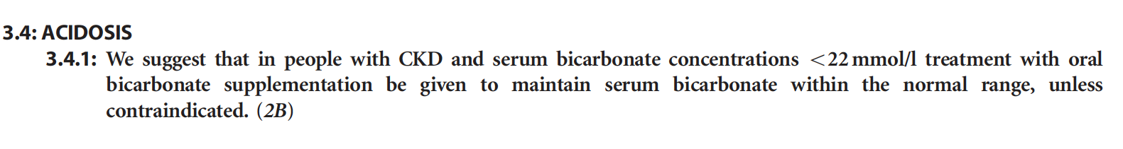

Slide 57
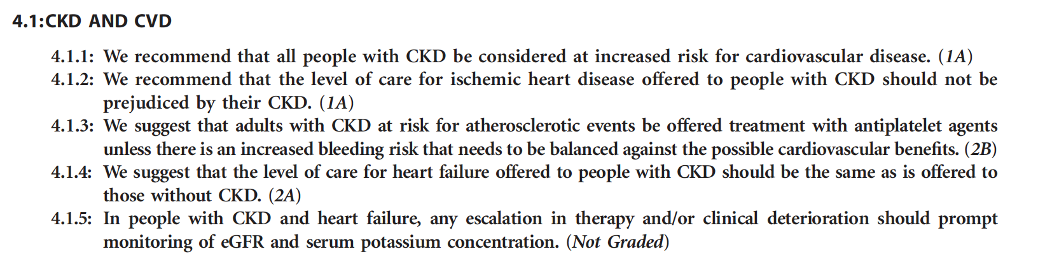

Slide 58
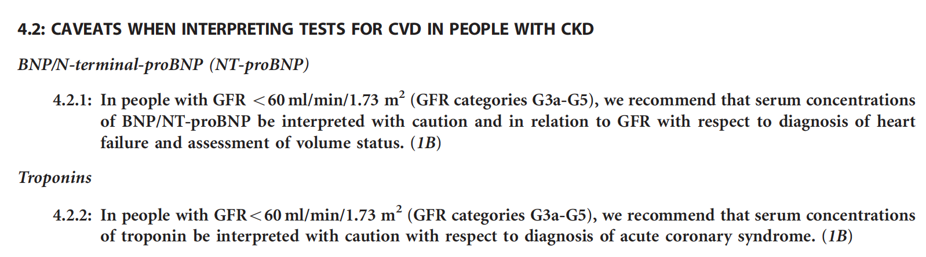

Slide 59
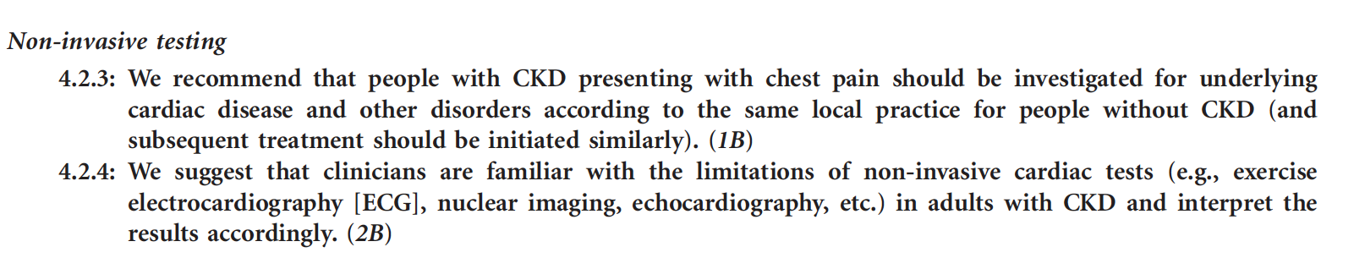

Slide 60
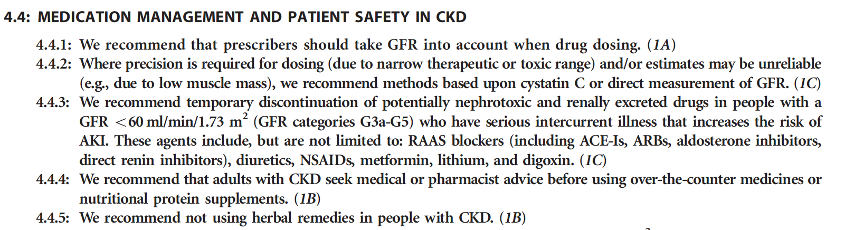

Slide 61
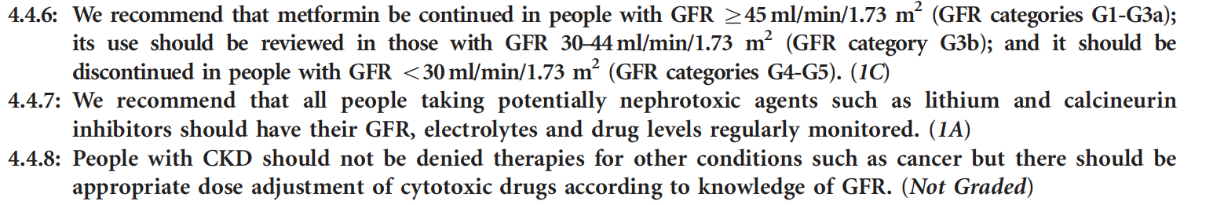

Slide 62
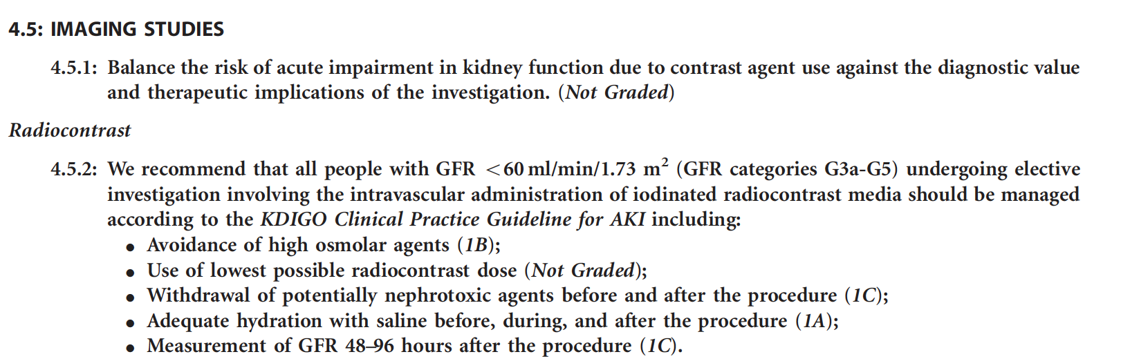

Slide 64
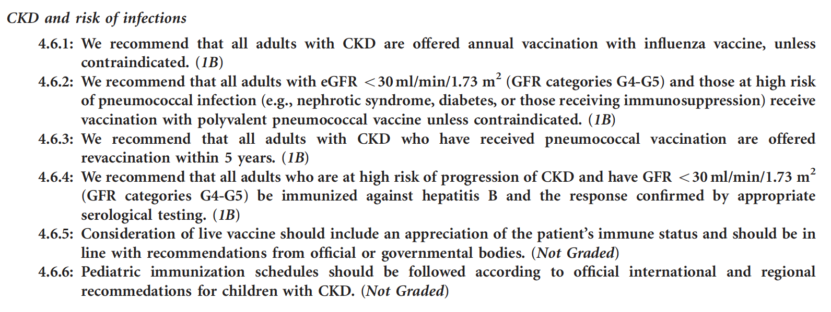
Vaccinaton against Sars-Cov2

Slide 65
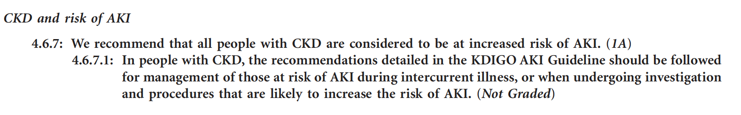

Slide 66
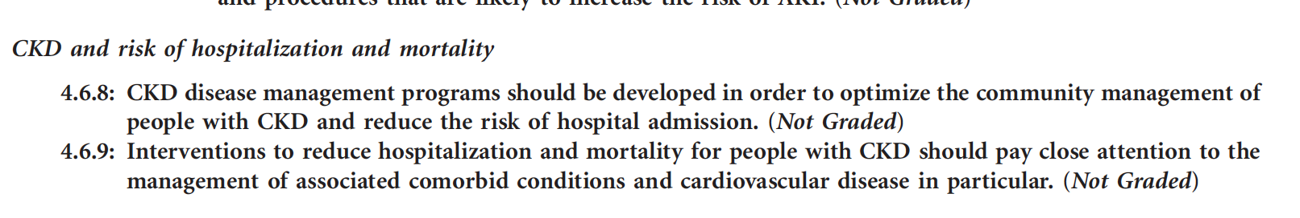

Slide 67
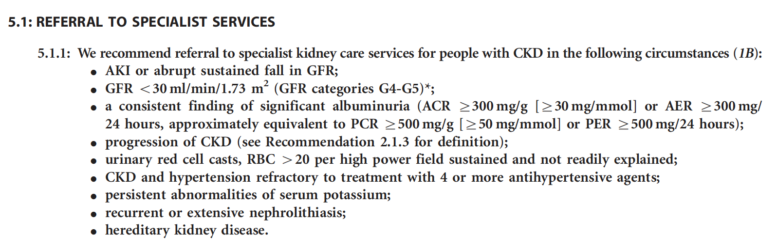

Slide 69
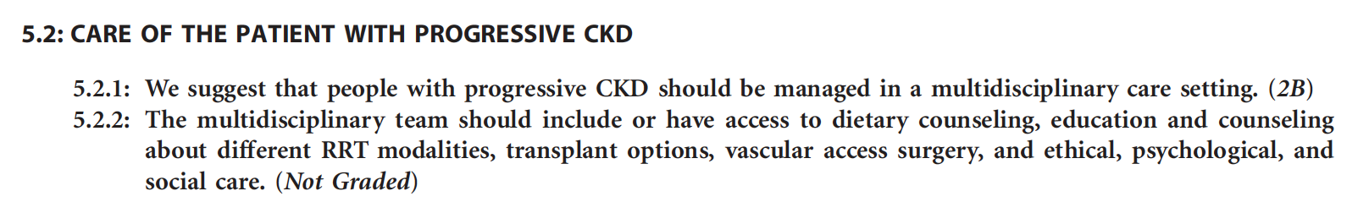

Slide 70
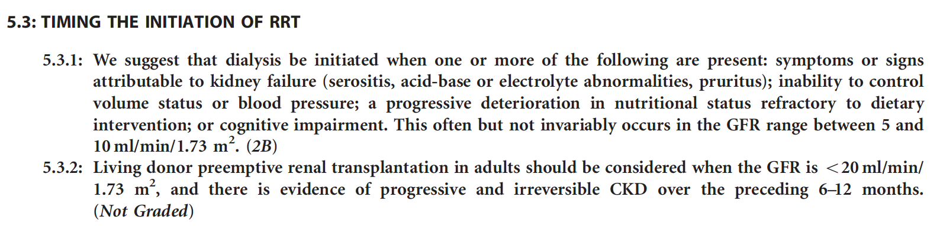

Slide 71
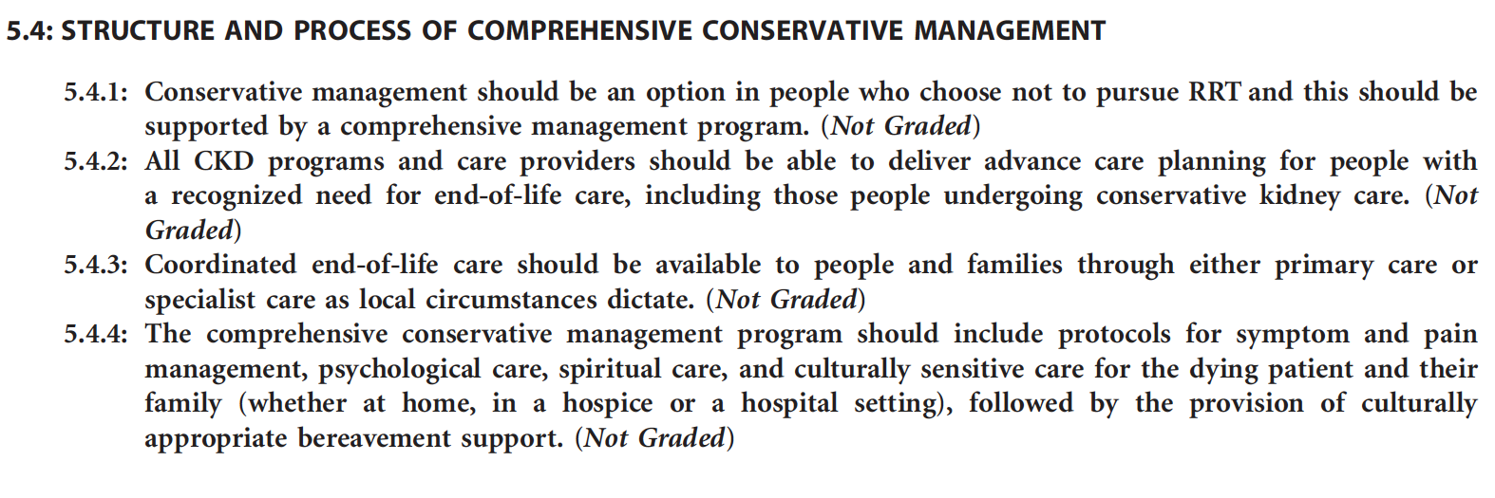

Slide 72
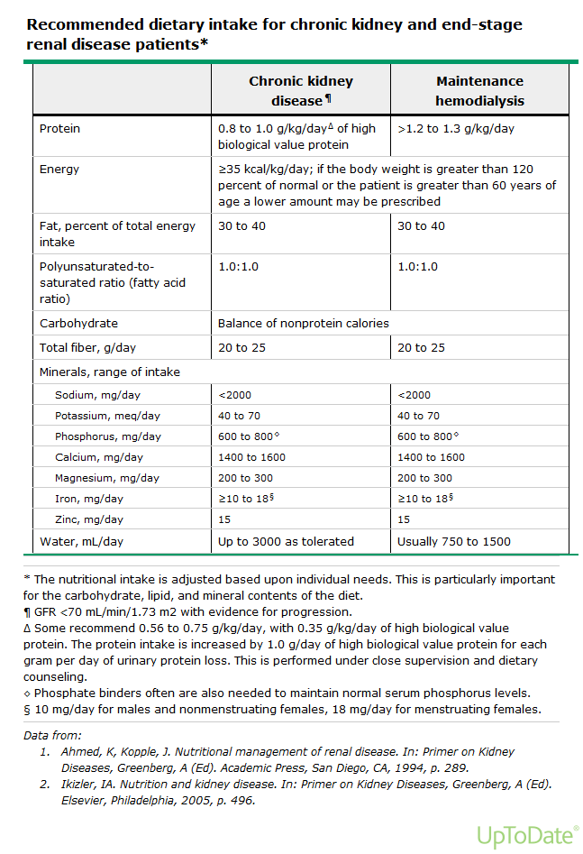

Slide 73
